Slide 1
Streamlining a complex development environment using Dyalog
DYNA ’24 – 04/11/2024
Mark I.Wolfson

Slide 2
Who is BIG?
Who is BIG and why is it a perfect use-case for APL
Service consultancy in the jewelry industry
Customers:
Retail Jewelers
Jewelry Manufacturers (vendors)
Jewelry industry service companies
Services:
Inventory analysis & merchandising consulting
Jewelry sales/inventory data aggregation
We provide these services by collecting accurate, timely data from 1600 retail jewelry stores using 40 different software systems.
Notes:
Prequel: What we’re doing with APL and how it has helped us disrupt our industry, increasing collaboration, creating efficiencies and improving overall performance.

Slide 3
Why is BIG interesting?
BIG is an interesting case study for:
Using APL in a non-usual industry
Migrating from APL2/PC → Dyalog APL
Developing a web-based subscription-based application
Developing in a multi-stack, multi-technology environment
Multi-generational dev team
Notes:
Prequel: What we’re doing with APL and how it has helped us disrupt our industry, increasing collaboration, creating efficiencies and improving overall performance.

Slide 4
Big Business – Disrupting the Jewelry Industry
Prior to BIG - 2005
Independent Jewelers – family-owned businesses
No POS/Inventory Management
Wrong inventory mix
Too much non-performing inventory
Balance to Buy - 2007
Improve performance by using data
Analyze prior consumer behavior
Strategies to reduce aged inventory
Budget/Plan/Buy/Manage
Notes:
Mall stores/free standing stores
Branded stores/ generic stores
Single stores / small chains
$1M stores / 5-10-20-50 M Stores

Slide 5
Upload Service
Retailers
Vendors
MS SQL Database
Balance to Buy
Integrations

Slide 6
How to get data from retailers?
Retailers with no technical capabilities
Direct user upload
Emailed reports
Monthly data
Direct POS Integration
Daily transmissions
With and without cooperation from software companies
The Applet – a big ask

Slide 7
Retailer Data – A HOT MESS
Integration with dozens of systems
Varying number of files even for the same system
Different formats
Flavors of CSV
Text files
Excel
XML
JSON
Different content
Variations in content between retailers using the same system
Variations within a retailer depending on who’s entering the data
Changes over time

Slide 8
Upload Service
Retailers
Vendors
MS SQL Database
Balance to Buy
Integrations

Slide 9
Upload Service
Retailers
Vendors
MS SQL Database
APL Process
Balance to Buy
Integrations

Slide 10
Retailer
APL Process
Upload Service
Retailer
APL Process
MS SQL Database
Retailer
APL Process
Balance to Buy
Integrations
Vendor
APL Process
Notes:
STOP after this slide to explain how the system is complicated and
LOT of Moving parts
EVERYTHING IS C# except Black Boxes

Slide 11
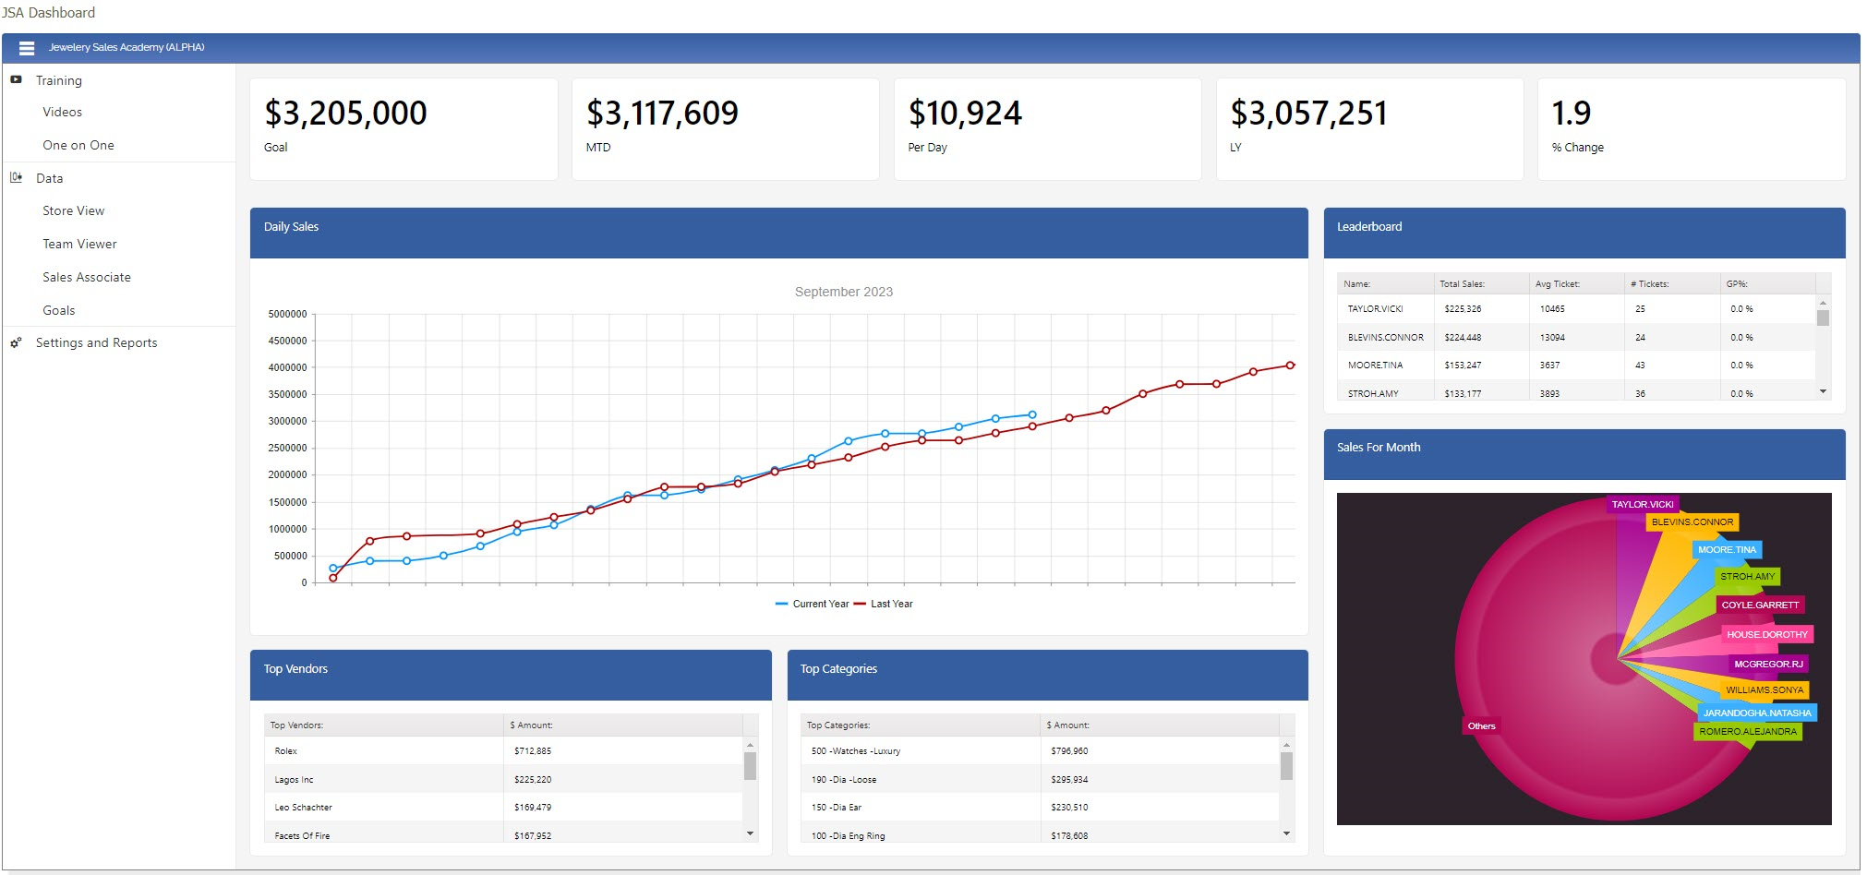
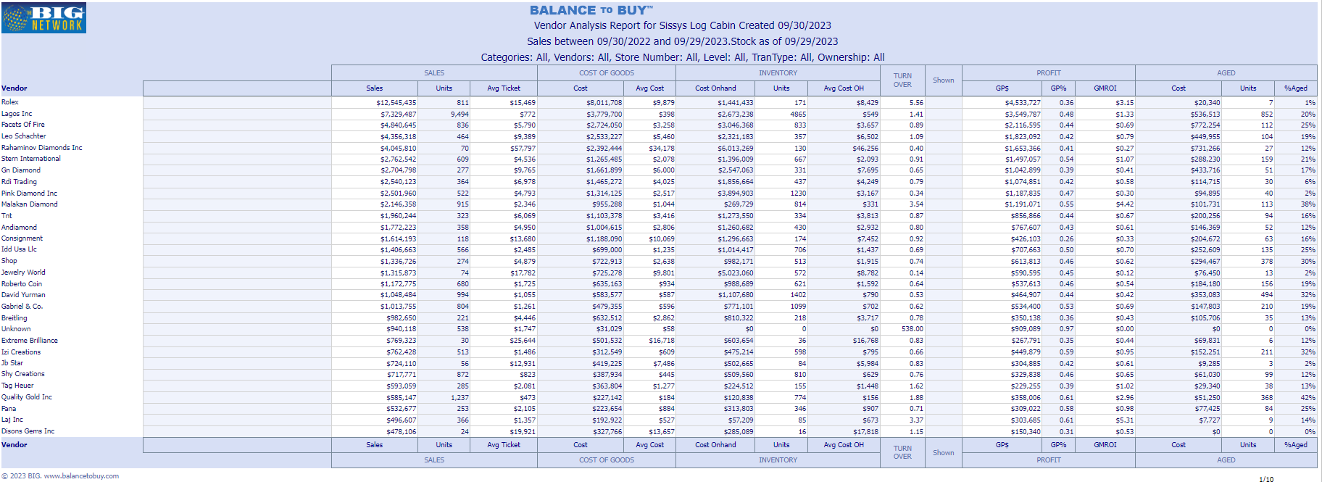
Retailer
.CSV
Black Box Process
MS SQL DB
Retailer
Retailer
Applet
15 POS Systems
Retailer
Black Box Process
Retailer
Retailer
Black Box Process
Retailer
.csv
API
Black Box Process
.txt
HttpCommand
Retailer
API
WinSCP Class
Black Box Process
Raw Data Store
⎕CSV
Jarvis
Retailer
.xls
⎕CSV
Jarvis,SQA
⎕CSV,⎕NGET
API
Black Box Process
LoadXL,ClosedXML
SQA,ClosedXML
LoadXL,ClosedXML
.xlsx
HttpCommand
Shopify Class
⎕JSON
Custom Reporting
⎕XML
HttpCommand
WinSCP Class
SQA,⎕JSON
Retailer
Black Box Process
API
⎕JSON
Vendor
.xml
API
Black Box Process
.json
Black Box Process
Vendor
API
Outbound Integrations
Black Box Process
Retailer
FTP
Black Box Process
Retailer
Vendor
Black Box Process
Outbound Datafeeds
Vendor
Retailer
Black Box Process
Retailer
Notes:
STOP before to explain APL is just tranche in the middle – application is all C#
STOP after to explain using Dyalog with standard tools – APL=GLUE
2 60-somethings doing black boxes, now 2 20-somethings

Slide 12
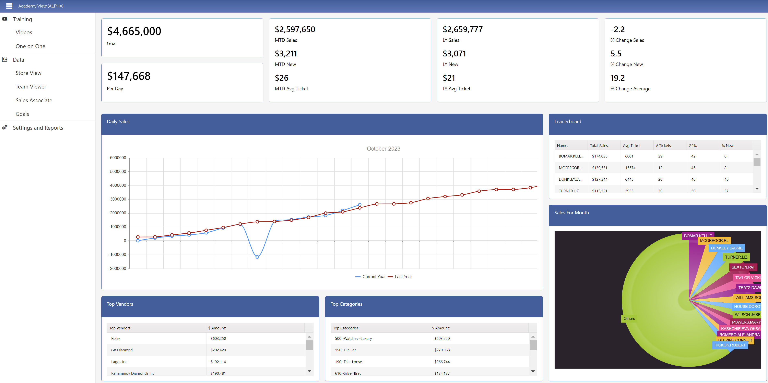
Notes:
Still IIS / HTML / JavaScript / KENDO
CUT dev time 80 % -- MAPS example

Slide 13
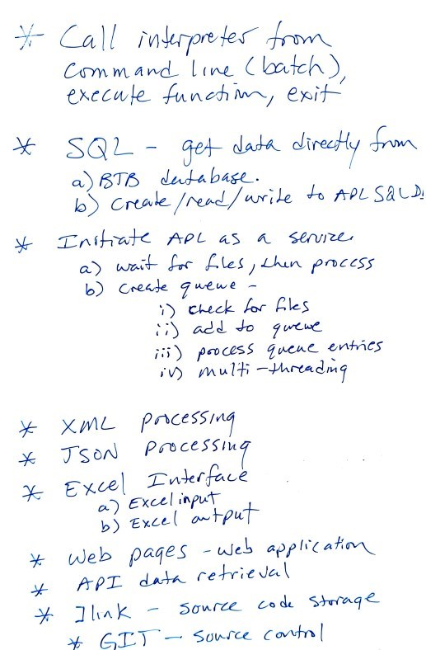
The Wish List!

Slide 14
New Production Environment
Windows Service
Code in text files
Full Source Control
Global file handling
Global error handling

Slide 15
Thank you!
DYNA ’24 – 04/11/2024
Mark I.Wolfson

