Slide 1
Dyalog Road Map Update
Morten Kromberg, CTO

Slide 2
Features of Version 19.0 (March 24)
Platform Support / Distribution
64-bit ARM support
New Macs, Pi 4&5, AWS Graviton
Enhanced .NET Bridge
Framework vs new .NET versions
Bound executables on all platforms
Building Production Systems
Token range reservation
WS FULL handling
NCOPY/NMOVE callbacks
Developer Productivity / IDE
Source "as typed" by default
Multi-line input on by default
HTMLRenderer updates
Link 4.0: Support for text data
HttpCommand client, Jarvis web service
Installing & Managing APL
Multiple session files
Health Monitor

Slide 3
Service Orientation
A rapidly increasing proportion of new APL code is delivered as services
Jarvis wraps APL code as HTTP/JSON or RESTful services on any platform
https://github.com/dyalog/jarvis
Off-the-shelf docker containers containing Dyalog APL (optionally with Jarvis)
HttpCommand is our HTTP client
HTTP(s) / JSON

Slide 4
Source Code Management
Productivity & IDE
Link 4.0 was included with v19.0. Highlights include:
Link a single namespace or class file
Default to current namespace if no namespace specified
Configuration files
Support for simple text vectors, vectors of text vectors, and character matrices in simple text files (rather than using array notation)
The Cider project manager and the Tatin package manager will be bundled with v19.0
Dyalog is starting to distribute tools as Tatin packages
Link (source)
Cider (projects)
Tatin (packages)

Slide 5
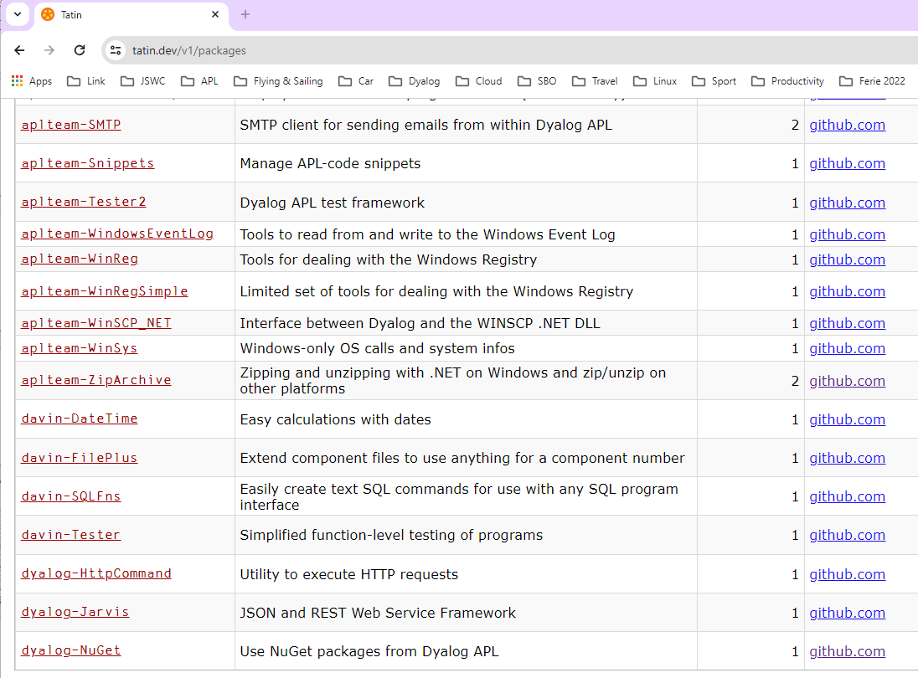

Slide 6
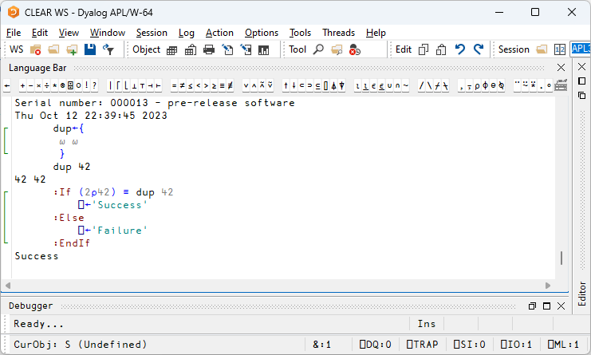
Multi-line Input

Slide 7
[Microsoft].NET History
.NET has been around for 20+ years. The old "Framework" is being replaced by an open source, cross-platform .NET, initially known as ".NET Core".
Dyalog v9.5 added a bridge to the Framework back in 2002
Dyalog v18.0 added a bridge to .NET Core 3.0, v18.2 targeted 3.1
v19.0 targets 8.0 (the current Long Term Support version)
Name | Platforms | Version Numbers
Microsoft.NET Framework | Windows | 1 2 3 4.0 4.8.1
".NET Core" | Windows Linux macOS | 1 2 3
".NET" | Windows Linux macOS | 5.0 6.0 7.0 8.0

Slide 8
v19.0 .NET Bridge
Adds support for .NET 6, 7, 8 …
Tested with 6.0 & 8.0
Configured for 8.0 by default
Also full support for 4.8 (aka ".NET Framework")
Can export APL code as .NET assemblies
Will allow embedding APL code in .NET frameworks like ASP.NET Core, etc
.NET 8.0 is the Long Term Support version (LTS)

Slide 9
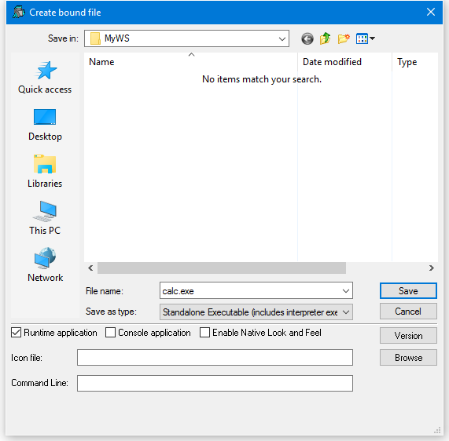
Bound Executables
A bound executable is a file which combines an interpreter and a workspace into a single .exe file
"Always" been available under Windows
In v19.0 also available for Linux
Maybe MacOS soon
In the longer term, I expect we will look at encrypting and signing application code

Slide 10
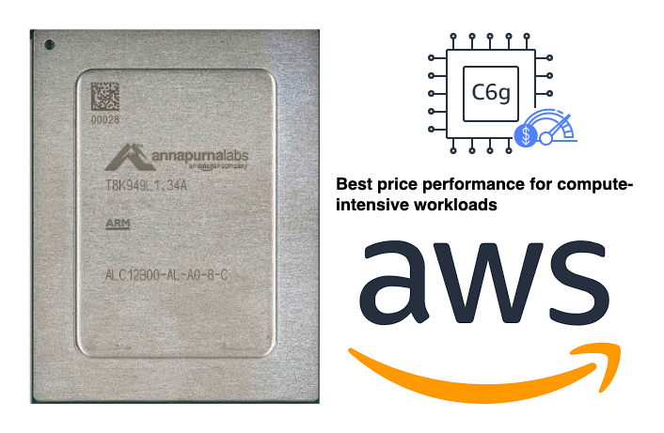
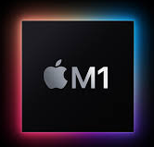
Arm64
Platforms & Distribution
64-bit ARM chips are appearing:
M1, M2, M3 Macs
Raspberry Pi – 64 Bit
Amazon Web Services "Graviton"
ARM64

Slide 11
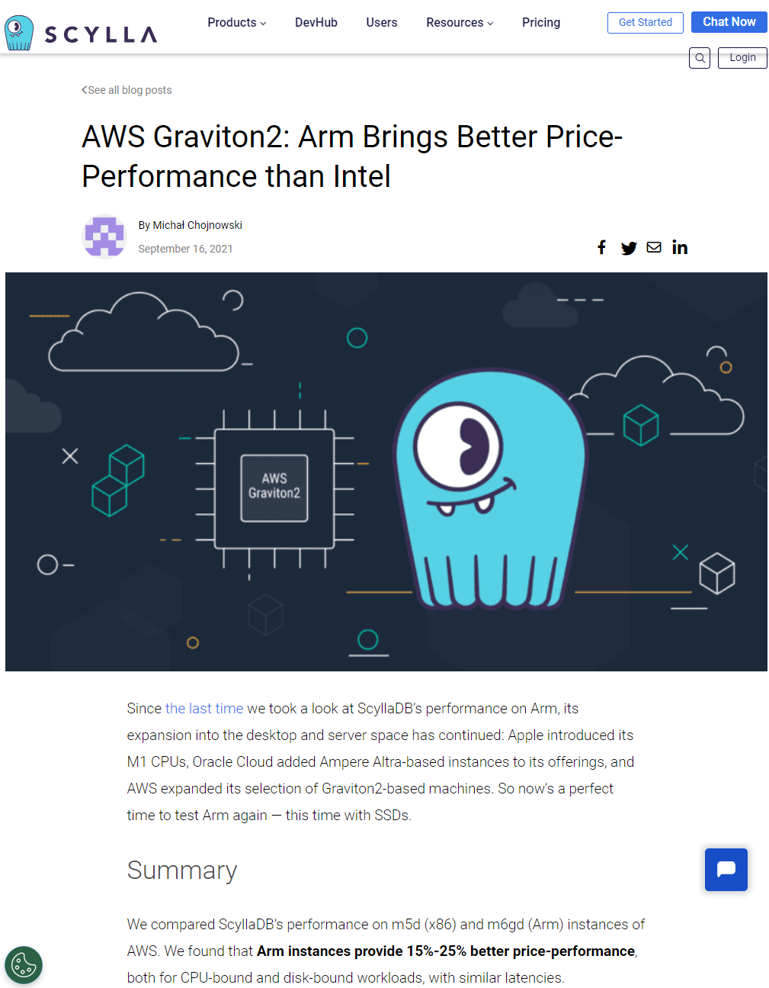

Slide 12
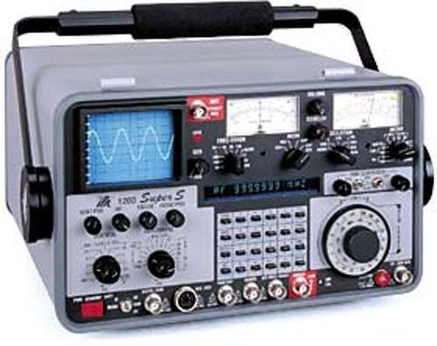
Health Monitor
Installing & Managing
Experimental TCP-based monitor:
Interpreter can broadcast regular updates on (e.g.):
CPU consumption, Memory statistics
)SI stack and Error information
Notifications on
untrapped errors
ws compaction
Exact execution location is available as an option (with runtime cost)
Also broadcasts details of how to connect Remote IDE if that is possible

Slide 13
Health Monitor Example
["PollFacts",{"Facts":["AccountInformation","Workspace","ThreadCount"],"Interval":5000,"UID":"1 1"}]
["Facts", {"Facts": [ { "ID": 2, "Name": "AccountInformation", "Value": { "ComputeTime": 438, "ConnectTime": 46973, "KeyingTime": 0, "UserIdentification": 0 }},{ "ID": 3, "Name": "Workspace", "Value": { "Allocation": 33882064, "AllocationHWM": 33882064, "Available": 2144207480, "Compactions": 2, "FreePockets": 186682, "GarbageCollections": 0, "GarbagePockets": 0, "Sediment": 2120, "Used": 3276168, "UsedPockets": 23209, "WSID": "CLEAR WS"
}},{ "ID": 6, "Name": "ThreadCount", "Value": { "Suspended": 1, "Total": 2 }} ], "Interval": 5000, "UID": "1 1" }]

Slide 14
HTMLRenderer updates
Productivity & IDE
New features include:
AllowContextMenu
Get/SetZoomLevel
IsLoading + LoadEnd event

Slide 15
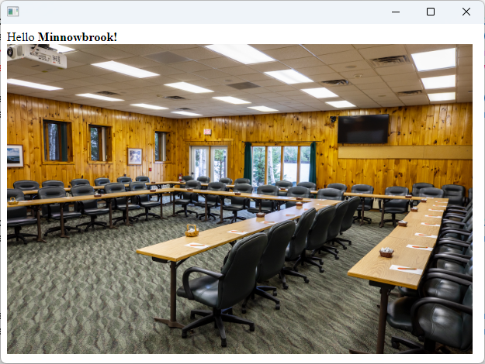
HTMLRenderer – what's that?
pic←'https://minnowbrook.org/wp-content/uploads/2022/04/ Screen-Shot-2022-04-18-at-2.24.30-PM.png' 'MyForm' ⎕WC 'HTMLRenderer' ('Hello <b>Minnowbrook!</b><br/> <img src="',pic,'" height=400 width=600>')
Chromium Embedded
Framework
(CEF)

Slide 16
HTMLRenderer updates
Productivity & IDE
New features include:
AllowContextMenu
Get/SetZoomLevel
IsLoading + LoadEnd event

Slide 17
Version 19.0 (March 2024)
Platform Support / Distribution
64-bit ARM support
New Macs, Pi 4&5, AWS Graviton
Enhanced .NET Bridge
Framework vs new .NET versions
Bound executables on all platforms
Building Production Systems
Token range reservation
WS FULL handling
NCOPY/NMOVE callbacks
Developer Productivity / IDE
Source "as typed" by default
Multi-line input on by default
HTMLRenderer updates
Link 4.0: Support for text data
HttpCommand client, Jarvis web service
Installing & Managing APL
Multiple session files
Health Monitor

Slide 18
Sketch of Version 20.0 (Q2/2025)
Transferred from v19.0
Resume Optimisation Work
.NET Bridge "enhancements"
Support "Generic" methods & classes
More HTMLRenderer improvements
Health Monitor
Script Engine Support
⎕NATTRIBUTES
Next Set of Projects
Relax Interpreter Limits
Array Notation
Token-by-token Debugging
Query Platform Features
New "Shell" System Command
Open-Source HTMLRenderer & Conga
JavaScript emulation of ⎕WC

Slide 19
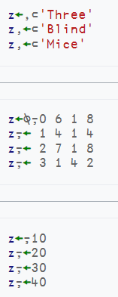
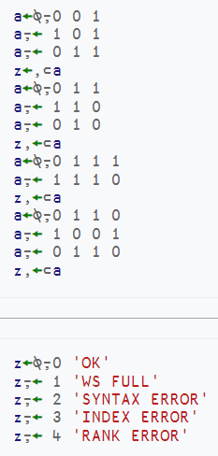
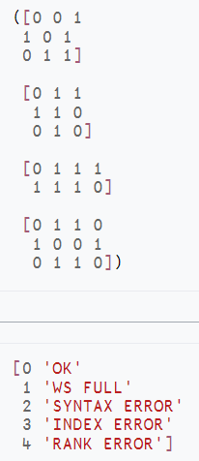
Array Notation
https://aplwiki.com/wiki/Array_notation

Slide 20
Array Notation
Public proposal published
https://aplwiki.com/wiki/Array_notation
APL model exists in Link since v3.0 and ⎕SE.Dyalog.Array.Serialise|Deserialise
Will be integrated with interpreter in v20.0

Slide 21
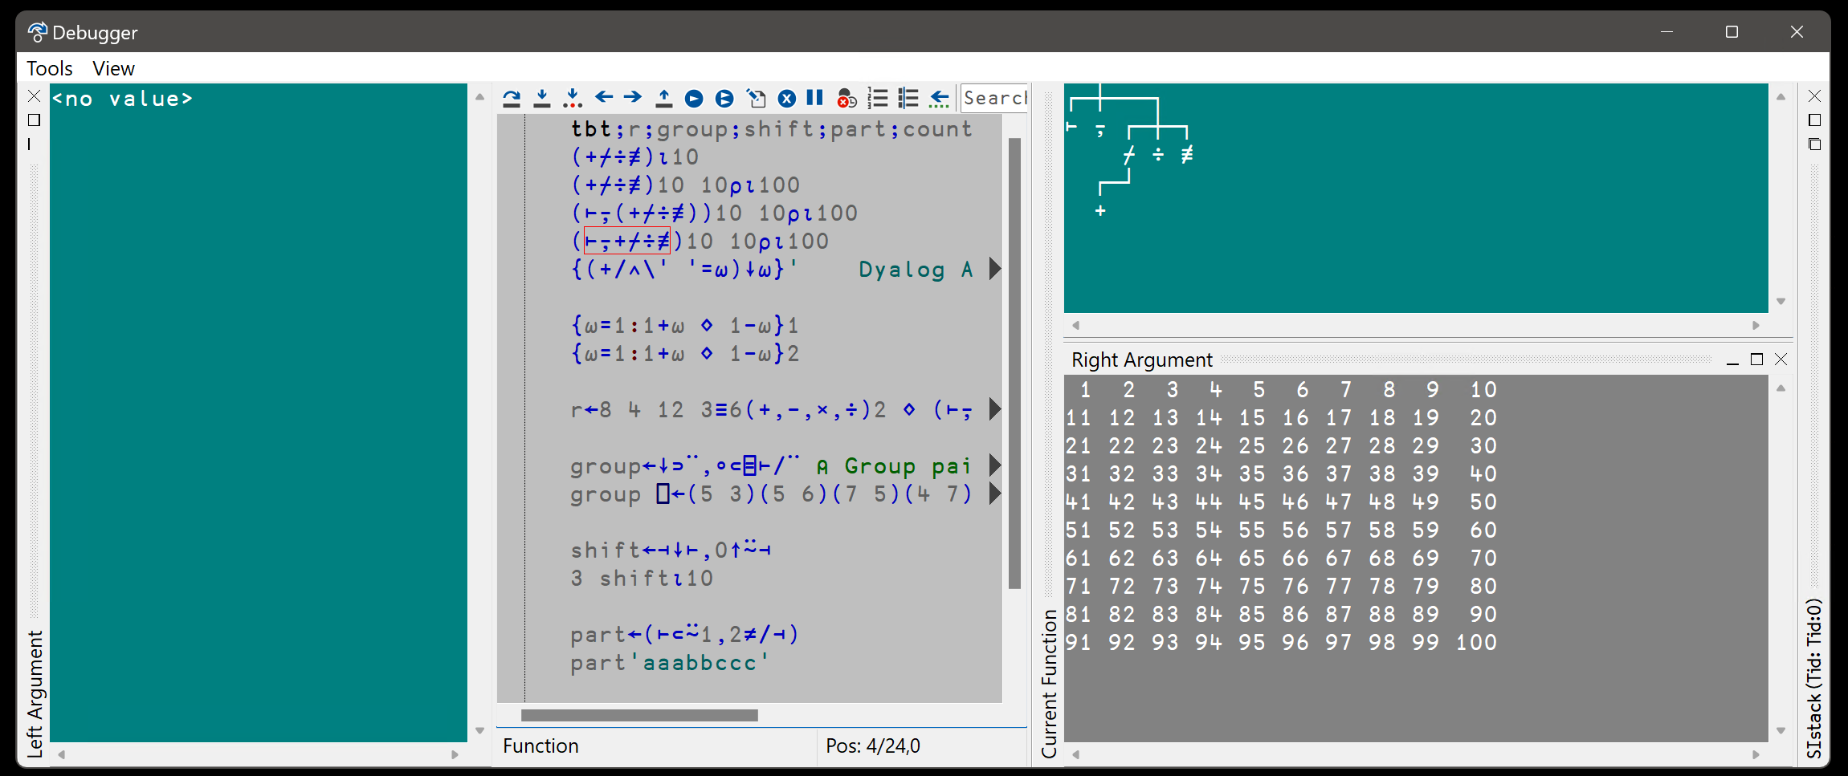
Token-by-token Debugging
See John's presentations at Dyalog'22 – and Dyalog'23

Slide 22
Token by Token Debugging

Slide 23
.NET Bridge Enhancements
The v19.0 bridge to .NET 6/7/8 is roughly on par with the Framework bridge
In v20.0, the new bridge may move ahead, adding:
Generics
Delegates
Async (design only, implementation probably not until v21)
Strategy: Support .NET well, but DO NOT depend on it!

Slide 24
HTMLRenderer Enhancements
Suggested:
File Upload
Modal HTMLRenderers
Other changes driven by EWC project

Slide 25
Easy Web Creator - EWC
A JavaScript emulation of our Win32 layer (⎕WC, ⎕WG, ⎕WS …)

Slide 26
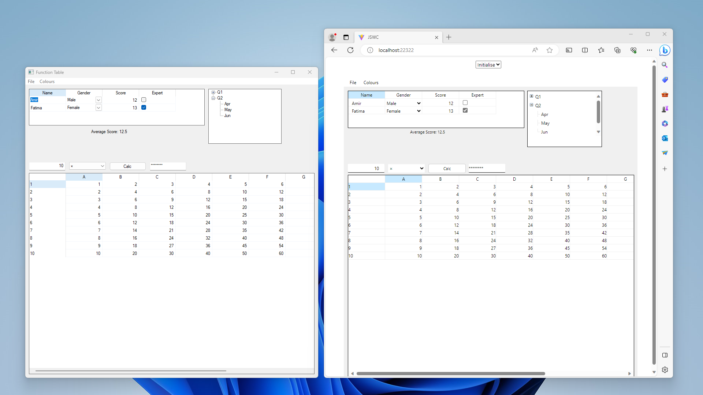
JavaScript ⎕WC

Slide 27
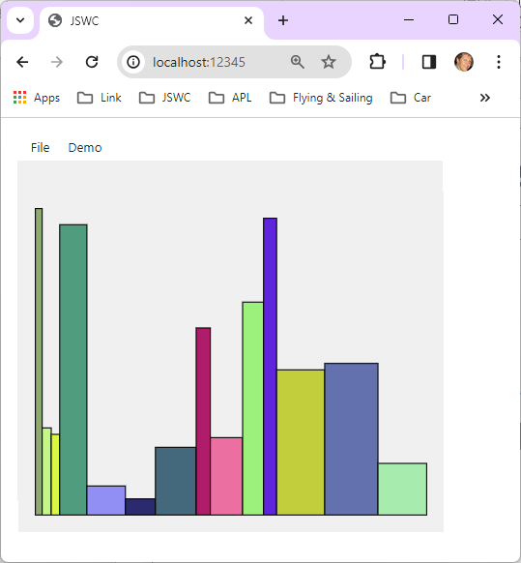
EWC + ∆WI
EWC will support all ⎕WC features used by ∆WI
The resulting GUI will run under Linux, macOS
… and in a Browser on any platform

Slide 28
Automated Testing w/ Selenium

Slide 30
Set and Get values without Execute
Working with data where the names of variables are held in an array
A common requirement when writing tools
Should have been done 20 years ago

Slide 31
⎕NS: Name Set
FirstName←'Jill' ⋄ Age←32
⎕NS ('FirstName' 'Jill') ('Age' 32) ⍝ (Name Value) pairs
⎕NS (↑'FirstName' 'Age') ('Jill' 32) ⍝ (Matrix of Names) (Vector of Values)
FirstName Age
Jill 32
⍝ Left argument can be a namespace reference

Slide 32
⎕NG: Name Get
⎕NG 'Age' 'FirstName' ⍝ Avoid ⍎
32 Jill
⎕NG ('Age' 0) ('LastName' 'Unknown') ⍝ (Name Default) pairs
32 Unknown
⍝ Left argument can be a namespace reference

Slide 34
Health Monitor
Version 19.0 contains a prototype. Ideas for v20.0 include:
Add feature to find last known location of a "hanging" interpreter
Sending signals to interrupt or terminate tasks
Discoverability: allow APL process to broadcast services that it provides
Switch ⎕PROFILE on and off; collect data

Slide 35
Static Analysis of APL Code
Static Analysis of application code is seen as a required "best practice" by some corporations
We are building a prototype of a tool which will
Detect vulnerabilities
"Lint" APL Code
Compute readability and other metrics
This tool will initially be licensed separately
A free "community edition" may follow

Slide 36
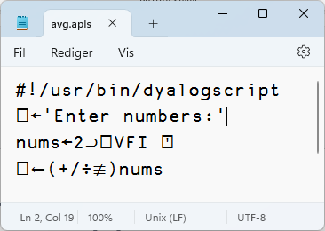
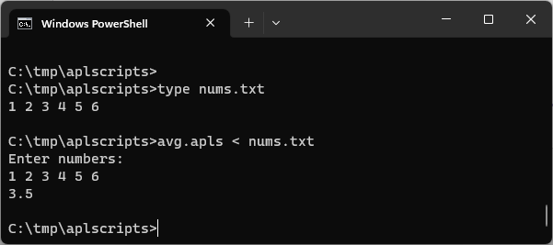
Script-Engine Support
#! (hash bang) scripting
We think the script engine is critical for attracting new users
Still a bit of a prototype
Will be hardened for v20.0
Need to be able to debug scripts via RIDE

Slide 37
⎕SHELL to replace existing ⎕SH
Invoke OS commands from APL
Interruptible
Optionally return data as an asynchronous "Stream"
Manage stdin, stdout & stderr
Handle variety of data encodings

Slide 38
No New Primitives in v20.0
There is a small set of APL primitives that are "missing"
See Adam Brudzewsky's presentation "Filling the Core Language Gaps" at Dyalog'22
These were expected in v20
However, we are going to spend the time relaxing limitations in the interpreter
Max Rank, # of lines in a function, tokens on a line, more primitives, …
New primitives will appear in v21

Slide 39
Possible New Primitives

Slide 40
Sketch of Version 20.0 (Q2/2025)
Transferred from v19.0
Resume Optimisation Work
.NET Bridge "enhancements"
Support "Generic" methods & classes
More HTMLRenderer improvements
Health Monitor
Script Engine Support
⎕NATTRIBUTES
Next Set of Projects
Relax Interpreter Limits
Array Notation
Token-by-token Debugging
Query Platform Features
New "Shell" System Command
Open-Source HTMLRenderer & Conga
JavaScript emulation of ⎕WC

