Slide 1
The Many Faces of Jarvis
Brian Becker APL Tools Architect Dyalog, LTD

Slide 2
Agenda
Jarvis overview
Case studies and evolution with intermingled demos

Slide 3
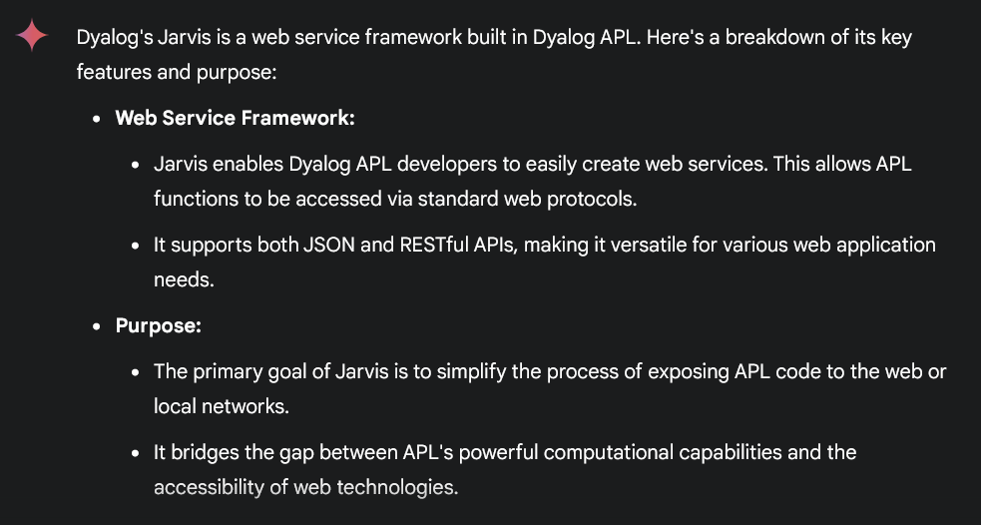
What is Jarvis?
Lets ask Anthropic's Claude
How about Google's Gemini?
JSON and REST service (vis)
APL-based web service framework supporting 2 paradigms
JSON – just like calling an APL function
REST – for the management of resources
Nearly every new Dyalog APL project uses Jarvis
HALLUCINATIONS!

Slide 4
Web Service
A web service is a standardized way for applications to communicate and exchange data over a network, typically the internet. It allows different systems, built on various programming languages and platforms, to interact seamlessly.

Slide 5
It started as a simple concept
APL!
APL?
JSONServer
http://someurl/sum
1 2 3 4 5
[1,2,3,4,5]
APL
JSON
sum←{+/⍵}
15
15
Notes:
Demo here

Slide 6
Clients
Anything that can send and receive HTTP messages
Phone app
Browser/JavaScript
C#
Python
Even APL

Slide 7
Let the UI experts do the UI
Jarvis doesn't do UI – it returns a data payload
There are a bazillion frameworks to develop UI
There are far more non-APL resources available to do UI
Jarvis and EWC give you options on how much and what sort of UI you need to develop

Slide 8
Quick Demo

Slide 9
Then people started using it…
Guess what? People are creative…
Can you make it do REST?
Can it serve HTML and other static content?
Can I use it to upload files?
Etc, etc, etc
So, we added features and functionality

Slide 10
Take a REST
REST (Representational State Transfer) is an architectural style for designing networked applications. It uses a stateless, client-server communication protocol, typically HTTP, to interact with resources. RESTful APIs rely on standard HTTP methods, like:
GET: Retrieve data.
POST: Create new data.
PUT: Update or create data.
DELETE: Remove data.
PATCH: Partially update data.

Slide 11
JSONServer becomes Jarvis
Adding REST support
In REST mode, Jarvis manages "resources"
Resource is specified in the request URL https://abc.com/customers/ID
Action is specified by the HTTP method
Method Action
GET Read
POST Create or Update
PUT Replace
PATCH Partial update
DELETE Remove

Slide 12
JSON vs REST
JSON
Endpoints are APL functions
∇ r←GetCustomer ID
REST
Endpoints are resources
https:/abc.com/customers/ID
Write a function for each HTTP method you want to support
The function parses the request to determine the resource and acts appropriate for the HTTP method

Slide 13
To REST or not to REST?
Many web service APIs (application programming interfaces) use REST
GitHub, Google, many LLMs (OpenAI, Anthropic, Google Gemini)
Designing a REST API takes some thought to get it right

Slide 14
DCMS
DCMS is Dyalog's content management system that supplies data for the Dyalog website and video library
Rich Park is using Jarvis' REST paradigm to provide an API to manage the data

Slide 19
Portfolio and Risk Management
A customer in Denmark uses Jarvis in JSON mode
It has a user interface developed in React (a popular JavaScript library)
It also exposes endpoints called directly (application to application)
Added new PostProcessFn "hook" function

Slide 20
"Hook" functions
Functions the user can specify to inject behavior at specific points in Jarvis' flow
AppCloseFn – when Jarvis is ending
AppInitFn – before Jarvis starts
AuthenticateFn – performs authentication on every request
PostProcessFn – after your endpoint has run, but before Jarvis responds
SessionInitFn – initializes a session, if using sessions
ValidateRequestFn – called on every request before any other processing

Slide 21
Quick Demo

Slide 22
qWC and HTMLInterface
qWC is a product developed by Michael Hughes
Michael needed to be able to serve up "static" content like CSS
HTMLInterface setting originally only controlled whether Jarvis' internal demo page was active
You can now specify a file or folder that contains HTML, CSS, JavaScript, image files, etc.

Slide 23
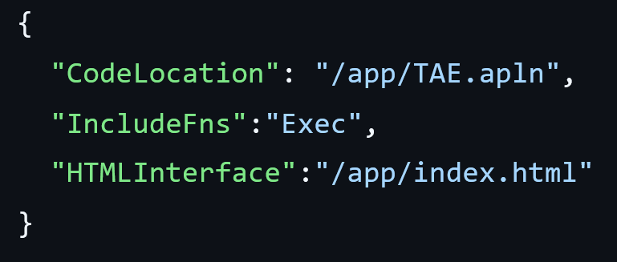
TryAPL
Originally implemented in 2012 using MiServer
Rewritten to use Jarvis in 2021

Slide 24
ACBL
Jay Whipple is very involved with the ACBL (American Contract Bridge League) and uses Jarvis for 3 applications:
Shark – implements the integration of game management and a remote third party game engine
BridgeWar – a third party needed privileged access to ACBL player information. API took 30 minutes to set up
ACBL Results Gateway – ACBL uploads hundreds of game files daily which are then validated and game results returned.

Slide 25
BIG
Mark and Dexter used Jarvis to speed development of new dashboard capabilities, cutting development time to a fraction of what was able to be done in C#.

Slide 26
CITA
Continuous Integration Testing in APL
Uses Jarvis for its dashboard functions

Slide 27
Multi-tiered Jarvis
Problem: A client in needed to run thousands of scenarios, each taking a non-trivial amount of time.
Solution: Have one Jarvis act as a load-balancer for 20 other Jarvis instances, using HttpCommand to forward requests. Implemented a polling mechanism to see when results were ready.

Slide 28
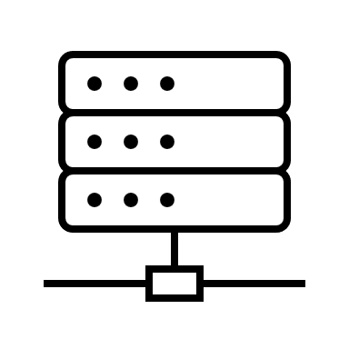
.
.
.

Slide 29
Holden Hoover
Holden has developed 2 Jarvis applications:
His APL Forge winning Radar Ingest System (RIS) application that ingests airplane tracking data (emitted by airplanes in the air) from an array of antennas (that could be located around the world). This application used Jarvis for its GUI and Web API to view the data collected.
STARAPL is an application he developed for a school voting system, to let people login with their school email accounts (Google Account OAuth) and then vote on various options (using the STAR Voting Method). After everyone voted, the results could then be calculated and displayed. STARAPL used Jarvis for the Web UI (which was available on the "public internet" while the poll was open). STARAPL also did have an API as well, for the Web UI to interact with.

Slide 33
The Plan Visualized… (from Dyalog'22)

Slide 34
The Plan Visualized…
In the beginning, there was an Application…
Database
App

Slide 35
Run the app as a service
Database
Jarvis
App

Slide 36
Run it in a container
Database
Docker Container
Jarvis
App

Slide 37
Split into Front and Back Ends
We'll call this "Two-Tier"
Database
Front End
Docker Container
Jarvis
Read Operations
App
Write Operations
Docker Container
Jarvis
App
Back End

Slide 38
Try it in the cloud
"The Cloud" (AWS)
Database
Docker Container
Jarvis
Read Operations
App
Write Operations
Docker Container
Jarvis
App

Slide 39
Scale it up
"The Cloud" (AWS)
Database
Docker Container
Jarvis
Read Operations
App
Docker Container
Write Operations
Jarvis
App
Docker Container
Jarvis
Docker Container
App
Jarvis
App

Slide 40
Load balance it
"The Cloud" (AWS)
Database
Docker Container
Jarvis
Read Operations
Load Balancer
App
Docker Container
Write Operations
Jarvis
App
Docker Container
Jarvis
Docker Container
App
Jarvis
App

Slide 41
Secure it
"The Cloud" (AWS)
Database
Docker Container
Jarvis
Read Operations
Load Balancer
App
Docker Container
Write Operations
Jarvis
App
Docker Container
Jarvis
Docker Container
App
Jarvis
App

Slide 42
Takeaways
In general people have found Jarvis flexible and easy to use
The core design has held up – still at major version 1.
If you need it to do something – ask!

