Slide 1
Dyalog and AI
Brian Becker Mark Wolfson APL Tools Architect CTO Dyalog LTD Buyers Intelligence Group

Slide 2
Agenda
Brian
Documentation
Explanation
Generation
Integration
Mark
Business cases for looking at AI
Security Concerns
Recent Efforts
Notes:
Development
Documentation – how can we make our documentation easier to navigate and search
Explanation – "tell me what this piece of code or this repository does"
Generation – write a function to do ____
Delivery
Integration – providing you with tools and techniques to use AI in your applications

Slide 3
What is an LLM?

Slide 4
AI Landscape
Anthropic Claude 3.5/3.7 OpenAI o3 and o1
DeepSeek R1
Google Gemini
Meta Llama
xAI Grok
Explosive Growth
More powerful LLMs
Multimodality
Anthropic Model Context Protocol (MCP)
It's not going to slow down
LLM Leaderboard
MCP provides a standardized way to connect LLMs with the context they need
AI systems that work with text, images, and audio together
Notes:
LLMs – Anthropic Claude 3.5/3.7, OpenAI o3 and o1, DeepSeek R1, Google Gemini, Meta Llama, xAI Grok
Multimodality - AI systems that work with text, images, and audio together
MCP - open protocol that enables seamless integration between LLM applications and external data sources and tools. Whether you’re building an AI-powered IDE, enhancing a chat interface, or creating custom AI workflows, MCP provides a standardized way to connect LLMs with the context they need.

Slide 5
Challenges
Interface complexity
Ecosystem limitations
Documentation gaps
Limited resources
Keeping apace
Notes:
Interface complexity: Connecting Dyalog APL to modern AI libraries and frameworks (typically written in Python, C++, or Julia) will likely require building robust interfaces or wrappers
Ecosystem limitations: the AI ecosystem has developed primarily around other languages, leaving APL users with fewer native tools, libraries, and pre-trained models.
Documentation gaps: AI integration examples specific to Dyalog APL are limited compared to mainstream languages, requiring more experimentation and custom development.
Limited resources: Not a lot of institutional AI knowledge
Keeping apace – AI is moving quickly

Slide 6
Two Questions
What can we do to use AI to help our users?
What can we do to help our users use AI?
Notes:
Using AI to improve the user's development and learning experience
Giving our users tools that help them integrate AI into their applications

Slide 7
If you put tomfoolery into a computer, nothing comes out of it but tomfoolery. But this tomfoolery, having passed through a very expensive machine, is somehow enobled and no-one dares criticize it.
Pierre Marie Gallois

Slide 8
доверяй, но проверяй
Trust, but verify
Russian proverb popularized by Ronald Reagan
And sometimes, don't even trust, yet…
Notes:
Read carefully

Slide 9
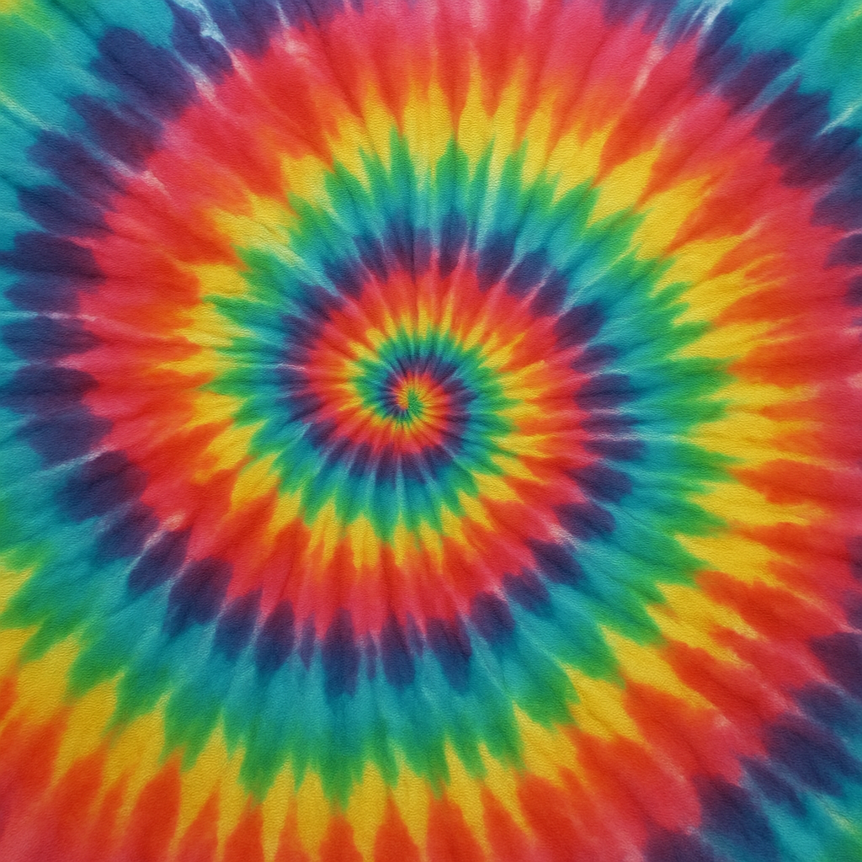
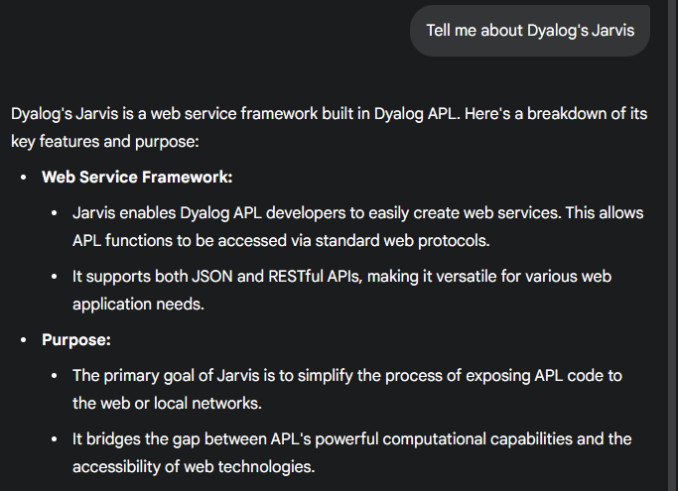
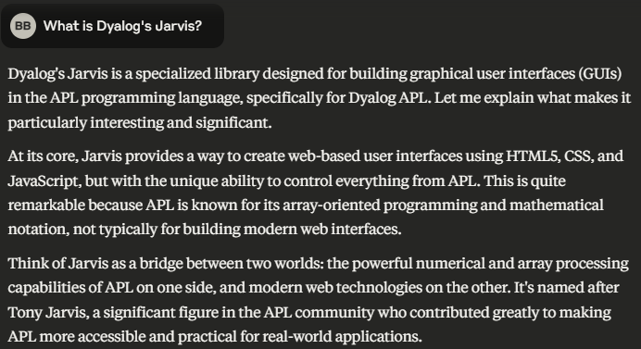
Who needs LSD when you have AI?
HALLUCINATIONS
Notes:
Claude
Gemini

Slide 10
The sun will come out tomorrow
Annie
Notes:
ChatGPT chess playing evolution
LLMs are getting better all the time

Slide 11
Documentation
Explanation
Generation
Integration

Slide 12
Documentation
The current state
mkdocs – v20.0 et al
RAG – Retrieval-Augmented Generation
Notebooklm demo
Notes:
Current state – share my frustrations when I was first learning Dyalog – too many places to look, poor indexing, etc
mkdocs – demo HttpCommand and/or Link documentation – better searching
RAG – demo notebooklm.google.com

Slide 13
Documentation
Explanation
Generation
Integration

Slide 14
Explanation
"What does this do?"
Notes:
Cursor demo
Gemini demo
Claude demo

Slide 15
Cursor
Notes:
Open cursor and show the HttpCommand summary

Slide 16
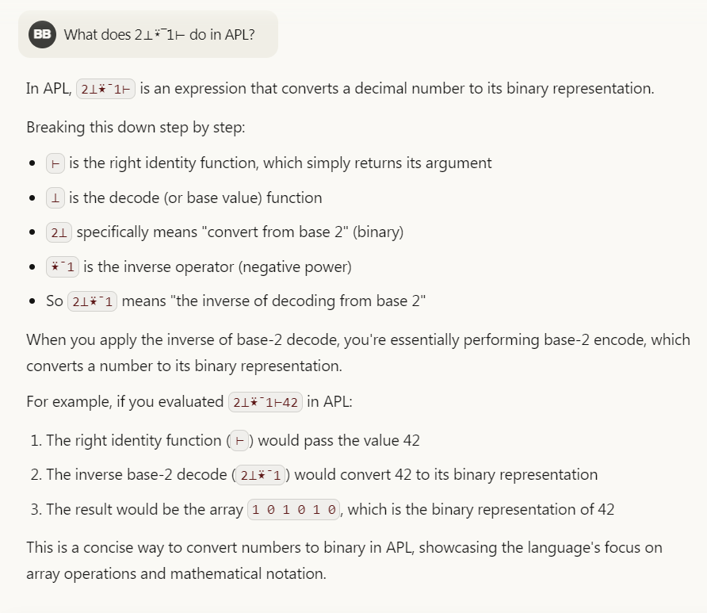
Claude

Slide 17
Documentation
Explanation
Generation
Integration

Slide 18
Generation
Produce some code that does _______.
Write a test for _______.
Python, JavaScript, HTML, CSS – piece of cake
APL, not so much (yet)

Slide 19
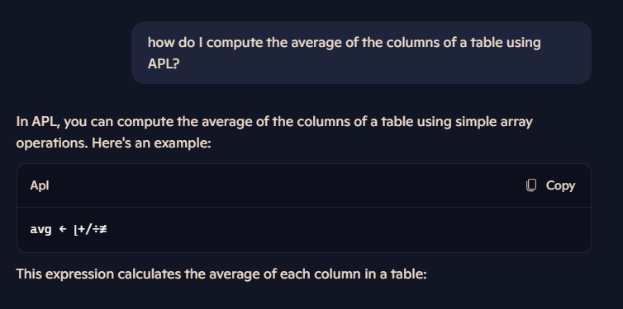
Copilot

Slide 26
A couple days later…

Slide 27
Generational Thoughts
How useful is it?
to the APL Newcomer
to an experienced APLer
But there's hope
More APL content to train LLMs
LLMs are improving, they handle mathematics fairly well and APL is arguably more syntactically consistent than math.
RAG – Retrieval Augmented Generation
Notes:
Newcomers may not be able to discern hallucinations
Experienced APLers have needs beyond the current state of LLMs

Slide 28
Documentation
Explanation
Generation
Integration

Slide 29
Integration
curl https://api.anthropic.com/v1/messages \ --header "x-api-key: $ANTHROPIC_API_KEY" \ --header "anthropic-version: 2023-06-01" \ --header "content-type: application/json" \ --data \ '{ "model": "claude-3-7-sonnet-20250219", "max_tokens": 1024, "messages": [ {"role": "user", "content": "Hello, world"} ] }'
data←(model:'claude-3-7-sonnet-20250219' max_tokens:1024 messages:((role:'user' ⋄ content:'Hello, world')))
headers←(('x-api-key' '%my-API-key%') ('anthropic-version' '2023-06-01'))
url←'https://api.anthropic.com/v1/messages'
HttpCommand.Do 'post' url data headers
Tools and techniques for you to integrate AI
OpenAI compatibility
HttpCommand / REST APIs
WebSockets for streaming
Demo OpenAI and Anthropic
Notes:
OpenAI compatibility – many LLMs expose an API similar to OpenAI's
OpenAI demo
Anthropic function calling demo

Slide 30
Some Practical Issues
Where to apply resources?
Who pays for it?
Liability concerns

Slide 31
What can you do?
Help us help you
Tools
Techniques
Publish code

Slide 32
AI at BIG

Slide 33
AI that could be useful for BIG
Generative AI using large language models
Used for creating content
Can create assistants that can be used for analysis of results
Machine Learning
Learns patterns from examples to automate tasks
Can compare images to find similarities

Slide 34
Business use cases for BIG
Optimizing model inventory per vendor
Picking the correct products to order to restock from sales
Automate reorders
Based on attributes and images, find closest match products between vendors
Redistribute inventory between stores (retailer)
Redistribute inventory between stores (vendor)

Slide 35
Local AI or Commercial AI
Privacy and security
Scalability
Resource considerations

Slide 36
Current Progress
Local models installed on separate VM
Using ChromeDB as vector database
Rewriting Python utilities in Dyalog APL

