Slide 1
MiServer 3 UI controls
Dan Baronet

Slide 2
Basic structure
∇ Compose
[1] :Access Public
[2] Add _.element
[3] Add _.otherelement
[4] Add _.WidgetX
[5] …

Slide 3
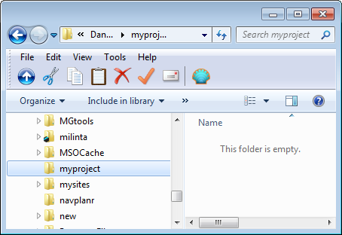
Create a folder where the server will reside

Slide 4
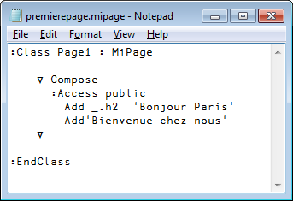
Add a file

Slide 5
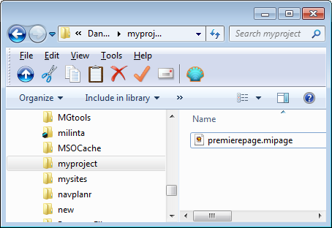
View of the folder

Slide 6
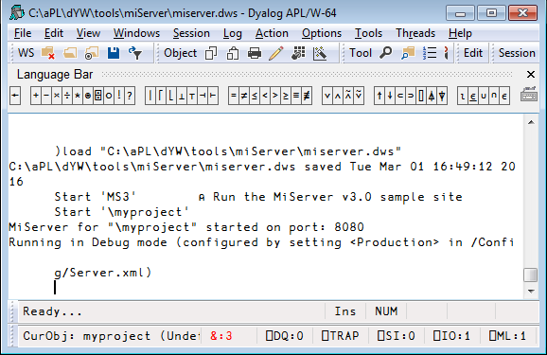

Slide 7
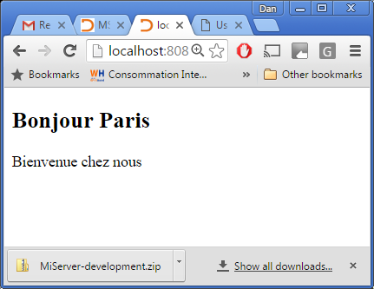

Slide 8
MS3
miserver.dyalog.com

Slide 9
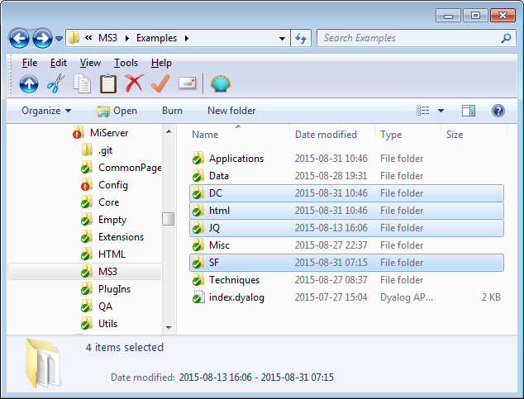

Slide 10
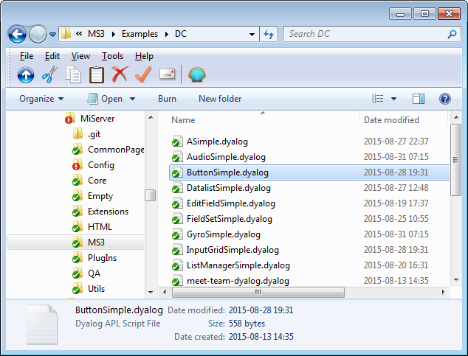

Slide 11
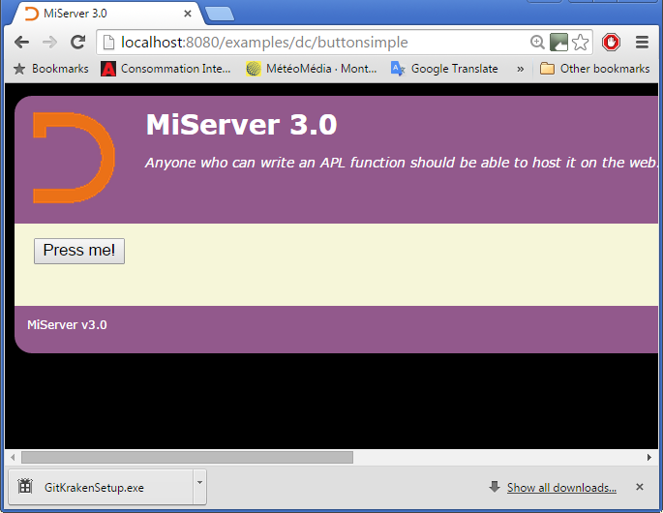

Slide 12
