Slide 1
Parallel Programming
With Futures and Isolates
Morten Kromberg, CXO

Slide 2
Futures and Isolates
Goal: Allow the APL user to explicitly express parallelism in a natural way
In the interpreter, futures and isolates enable coarse-grained task parallelism
  Tasks with a duration of at least 100ms
In a compiler, futures can be used to express fine-grained data parallelism

Slide 3
Isolates
An Isolate tastes, smells, looks like a Dyalog namespace, except that...
Expressions executed in the isolate run in a separate process from the main interpreter thread (”in parallel”)

Slide 4
Isolates in Action
I3←¤¨3⍴⊂''
I3.X←(1 2 3)(4 5)6
I3.({(+/⍵)÷≢⍵}X)
2 4.5 6
X←1 2 3
X←6
X←4 5

Slide 5
Futures
The result of an expression executed in an Isolate is a Future
Futures can be passed as arguments to functions without blocking
Structural functions can work on arrays containing futures without blocking
Primitives which need to reference the value will block

Slide 6
Last Piece: The Parallel Operator
Monadic operator parallel (∥) derives a function which:
creates an empty isolate
executes the operand inside the isolate
returns a future (and discards the isolate)
sums←{+/⍳⍵}∥¨⍳100 ⍝ returns 100 futures - IMMEDIATELY
≢sums ⍝ structural functions do not ”realize” futures
100
≢partitions←(100⍴25↑1)⊂sums ⍝ Partitioned Enclose
4
≢¨partitions ⍝ 4 groups, each containing 25 futures
25 25 25 25
+/ +/∥¨partitions ⍝ 4 parallel +/’es
171700
(We used 1+4+100 parallel threads to compute the end result)

Slide 7
Deterministic Parallelism
Inserting or removing Parallel operators does not change the meaning of the code. Thus, parallelism does not interfere with the notation.
sums←{+/⍳⍵}∥¨⍳100
partitions←(100⍴25↑1)⊂sums
+/+/∥¨partitions
171700
sums←{+/⍳⍵} ¨⍳100
partitions←(100⍴25↑1)⊂sums
+/+/ ¨partitions
171700
(as long as your functions have no side effects)
(… and there are no errors)

Slide 8
How it Works…
Computers
Dyalog Processes
Namespaces
CONGA / TCP Sockets
Another Computer
isolate.StartServer 'ip=10.0.0'
A 2-Core Computer
Isolate
Process 1
A Dyalog
Application
Isolate
Process 1
Isolate 1
1
2
3
4
Isolate 3
Isolate
Process 2
Isolate
Process 2
iss←¤¨4⍴⊂⍬
AddServer '10.0.0.4'
Isolate 2
Isolate 4

Slide 9
Demo

Slide 10
Enhancements in V14.1
Interrupts should no longer stop “infrastructure” threads
Errors in your application will not suspend infrastructure threads, even when “suspend threads on error” is enabled
Windows: support for bound executables
Workspace Explorer no longer crashes on isolates
(this fix also back ported to 14.0) ☺
Indirect enhancement: “External Workspaces” can be used to improve the performance of isolate initialization
StartServer function now allows filtering client network addresses
See documentation…

Slide 11
The Model Implementation
Futures are fully implemented in the Dyalog interpreters starting with v14.0 (2014)
The creation and management of isolates is still modelled using APL code, most importantly:
Proposed Primitive Construct | Name in Current Model | Comment
¤ | ø | New Isolate
∥ | II | Parallel
∥¨ | IÏ | Parallel Each

Slide 12
The Full Model Implementation
Proposed Construct | Name in Model | Alternative Name (for ”Anglos” ☺) | Comment
¤ | ø | isolate.New | Isolate.New
∥ | II | isolate.ll | Parallel
∥¨ | IÏ | isolate.llEach | Parallel Each
∥⌸ | IIÐ | isolate.llKey | Parallel Key
∥⍤ | IIö | isolate.llRank | Parallel Rank
∘.∥ | o_II | isolate.llOuter | Parallel Outer
... Plus server/infrastructure management functions.
See http://docs.dyalog.com, http://videos.dyalog.com

Slide 13
Configuration Options
Option Name | Default | Description
drc | # | Location of CONGA namespace to use
homeport | 7051 | The lowest port number that will be used
homeportmax | 7151 | The highest port number to try listening on
isolates | 99 | Number or isolates allowed per process
listen | 0 | 1 to allow isolates to issue callbacks to parent process
maxws | '64000' | By default, uses the same setting as the current APL session
onerror | 'signal' | Signal errors to the line waiting for results
processes | 1 | The number of processes to start per processor
processors | 4 | Number of processors (default determined automatically)
runtime | 1 | Whether to run isolates using the runtime engine
workspace | 'isolate' | Workspace to load when starting new isolates

Slide 14
Some Restrictions
An expression executed in an isolate MUST return a result
  The result may not be a Function or a Class.
  If you pass namespace refs (either way), the spaces will be copied. Actual refs between processes are not possible.
  Shy results will become bold by the process of being a future (however briefly).

Slide 15
More limitations / Gotchas
Beware of isolates sharing a process
Don’t create excessive numbers of isolates:
ISOLATE ERROR: All processes are in use
{+/⍳⍵}IÏ ⍳500
∧
Remember refs cannot cross process borders
  Namespaces will always be COPIED
  e.g. ref←is1.ns

Slide 16
Future Work
Start-up logging
Start an isolate or invoke a call on a specific process
Ability to terminate an asynchronous call
Add ability to return functions or classes
Management mechanism for “batches” of work
Fault tolerance: ll.EachX to transfer work to remaining isolates on network failure etc

Slide 17
Longer Term Futures
Aaron Hsu’s ”co-dfns” Compiler will also support [single assignment] futures
  https://github.com/arcfide/Co-dfns
Lazy Evaluation Operator ⍰ (aka “Schrödinger”) to produce futures which do not start evaluating until you ask for the value
Promises – or “explicit futures”

Slide 18
Practical Experience...
Typical results with the current naive model, achieved by domain experts performing minor refactoring of own code:
2-2.5x faster on ”quad” process machines (2 cores)
3-5x faster on 8 processes (quad core)
=> Memory is the bottleneck; mileage will vary.
... Waiting for the compiler which aims to target GPUs, and other optimizations.

Slide 19
And Isolates are Fun, Too ☺!
Example: Start an isolate server on each of two Raspberry Pi-controlled robots, then under Windows/Linux/Mac:
{isolate.AddServer '192.168.0.',⍕⍵}¨100 101
bots←ø¨ bot bot ⍝ clone bot driver API
500 bots.Drive (45 0)(0 45)
This means: call the Drive function on each bot in parallel,
With a left argument of 500ms
With right arg of (45 0) for first and (0 45) for 2nd bot (power settings for right and left wheels)

Slide 20
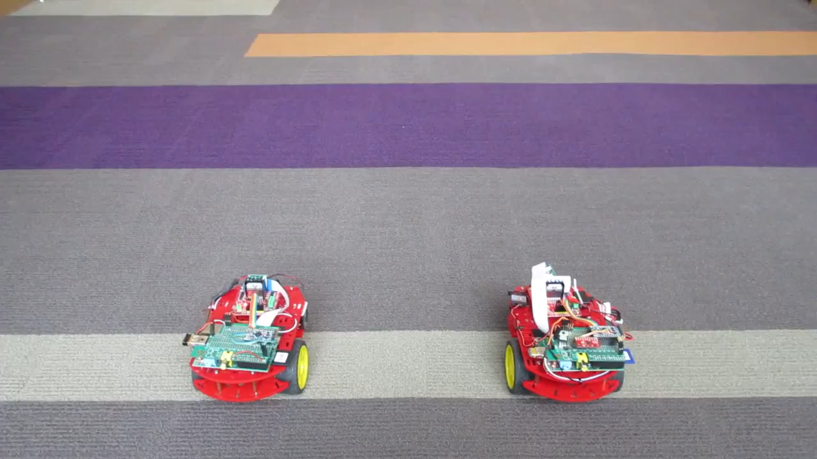
Dancing Robots

Slide 21
For More Information
User Guide at http://docs.dyalog.com
Videos at http://video.dyalog.com
Or search for “dyalog futures and isolates” on YouTube or Google ☺

