Slide 1
Recent Language Enhancements
Dan Baronet

Slide 2
Many new features
Mechanism_for_implementing_efficient_key_values
Notes:
⎕ML 1 assumed throughout these slides

Slide 3
Many new features
keys←?1e6⍴1e6
fast←1500⌶keys
srch←keys∘⍳ ⍝ old mechanism
find←¯3↑keys
cmpx 'keys⍳find' 'srch find' 'fast⍳find'
keys⍳find → 5.6E¯4 | 0% ⎕⎕⎕⎕⎕⎕⎕⎕⎕⎕⎕⎕⎕⎕⎕⎕⎕⎕⎕⎕⎕⎕⎕⎕⎕⎕⎕⎕⎕⎕⎕⎕⎕⎕⎕⎕⎕⎕⎕⎕
srch find → 2.4E¯7 | -100%
fast⍳find → 2.4E¯7 | -100%
fast,←4242424 ⍝ you can add a key without having to re-hash the whole key set
cmpx 'keys⍳find' 'srch find' 'fast⍳find'
keys⍳find → 5.5E¯4 | 0% ⎕⎕⎕⎕⎕⎕⎕⎕⎕⎕⎕⎕⎕⎕⎕⎕⎕⎕⎕⎕⎕⎕⎕⎕⎕⎕⎕⎕⎕⎕⎕⎕⎕⎕⎕⎕⎕⎕⎕⎕
srch find → 1.2E¯7 | -100%
fast⍳find → 1.2E¯7 | -100%
fast↓⍨←¯1 ⍝ drop also OK
cmpx 'keys⍳find' 'srch find' 'fast⍳find'
keys⍳find → 5.5E¯4 | 0% ⎕⎕⎕⎕⎕⎕⎕⎕⎕⎕⎕⎕⎕⎕⎕⎕⎕⎕⎕⎕⎕⎕⎕⎕⎕⎕⎕⎕⎕⎕⎕⎕⎕⎕⎕⎕⎕⎕⎕⎕
srch find → 2.4E¯7 | -100%
fast⍳find → 3.7E¯7 | -100%
fast[1000]←42 ⍝ but this ruins it
cmpx 'keys⍳find' 'srch find' 'fast⍳find'
keys⍳find → 5.5E¯4 | 0% ⎕⎕⎕⎕⎕⎕⎕⎕⎕⎕⎕⎕⎕⎕⎕⎕⎕⎕⎕⎕⎕⎕⎕⎕⎕⎕⎕⎕⎕⎕⎕⎕⎕⎕⎕⎕⎕⎕⎕⎕
srch find → 2.4E¯7 | -100%
fast⍳find → 5.5E¯4 | -1% ⎕⎕⎕⎕⎕⎕⎕⎕⎕⎕⎕⎕⎕⎕⎕⎕⎕⎕⎕⎕⎕⎕⎕⎕⎕⎕⎕⎕⎕⎕⎕⎕⎕⎕⎕⎕⎕⎕⎕⎕
Notes:
⎕ML 1 assumed throughout these slides

Slide 4
New Features
performance – idioms, parallel features, compiler and other speed ups
language features – trains, rank and key operators, tally, index of, and others
development environment – new user commands, changes to the IDE, introducing the RIDE
Notes:
We will concentrate on the language enhancements

Slide 5
New Features
interfaces – R Project for Statistical Computing, .NET enhancements
tools and utilities – Chart Wizard, JSON, XML, WPF
customer support – new MyDyalog Web site
Notes:
We will concentrate on the language enhancements

Slide 6
Performance Improvements
⌊0.5+NA is a new idiom
Many Boolean Operations are faster

Slide 7
Performance Improvements
^.=, +.= (ints)
b⊂[⎕io]x
s⍴x (non pointer)
⍋b (bool or 1 byte items)
+/ (int vectors), ⌈/ (vectors)
x⍳y, y∊x, ∪x (4 bytes major cells)
x(8⌶)y
…and many more

Slide 8
Component file system
The performance of reading and writing APL components has been improved
Component files ⎕NREAD can read several components at once, e.g.
⎕FREAD 1 (⍳10) ⍝ atomic & safe
Components can be compressed
Notes:
LZ4 compression method by component

Slide 9
Various IDE enhancements
There are 2 new user commands:
  ]Box to box output
  ]Rows to limit the output
  Skip blank lines/comments when tracing
  Allow search to wrap
  Chart wizard
  Align comments

Slide 10
Language Enhancements
Named monadic ops
Right currying for dyadic ops
Variant with ⎕XML
⎕RL true random seed
Roll (?) 0
Mix “upgrade”
Iota extended to higher rank left argument

Slide 11
Misc.
Many user command changes (e.g. grouping, presentation)
External functions tips with syntax
New I-beams
WPF: data binding
Notes:
See release Notes for details

Slide 12
New Language features
Rank (⍤)
Key (⌸)
Tally (≢)
2 new characters (⍤ and ⌸)

Slide 13
Named monadic operators
Up until now you could not name operators:
spawn ← &
SYNTAX ERROR
spawn ← &
^

Slide 14
Named monadic operators
But now you can name monadic operators
spawn ← & ⋄ each ← ¨
⎕←⎕DL spawn each ⍳7
10 11 12 13 14 15 16
)si
&12
&13
&14
&15
&16

Slide 15
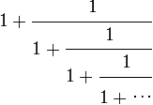
Right currying for dyadic operators
You can also bind a function with a dyadic operator to turn it into a monadic operator:
tilSame ← ⍣=
⍝ Golden number:
+∘÷ / 100⍴1
1.618033988749895
1 +∘÷ tilSame 1
1.618033988749897
Notes:
Why are the answers different? Hint: []CT

Slide 16
Variant with ⎕XML
⎕XML has always been accepting a left argument specifying options Whitespace, Markup or UnknownEntity.
These can now be specified using Variant (⍠) as in
XWS← ⎕XML ⍠ 'Whitespace' 'Strip'
instead of
XWS← 'whitespace' 'strip'∘⎕XML

Slide 17
Random seed
Up until now there was no way to set a true random seed.
⎕rl←67890 ⋄ ?1000
279
⎕rl←67890 ⋄ ?1000
279
Now you can:
⎕rl←0 ⋄ ?1000
830
⎕rl←0 ⋄ ?1000
507
⎕rl←0 ⋄ ?1000
154

Slide 18
Roll (?) 0
Up until now ?0 was a DOMAIN error.
It now returns a floating point number between 0 and 1.
E.g.
?0
0.127931
Notes:
⎕rl←0 and ?0 are not related

Slide 19
Roll (?) 0
⎕rl←0 ⋄ ?0
0.52748508
⎕rl←0 ⋄ ?0
0.59372336
⎕rl←0 ⋄ ?0
0.37650812
? 0 10 100
0.31132960 8 42

Slide 20
Tally
Tally simply returns the number of major cells.
It is a scalar.
Examples:
≢ ⍳8 8 | ≢ 9 1 | ≢ 2 8 ⍴ 5 2

Slide 21
Tally
Tally solves a number of problems Shape was creating.
n ← ⍳3
1 (⍴n) ⍴ 5
DOMERR
1 (≢n) ⍴5
5 5 5
avg←{(+⌿⍵)÷⍴⍵}
avg 7
avg←{(+⌿⍵)÷≢⍵}
avg 7
7
Nothing!
Notes:
2==_1 (⍴n)

Slide 22
Function Trains
Function Trains are a series of 2 (Atop) or 3 functions (Fork).
The general case is
F G H ⍝ fork
Or
G H ⍝ Atop
Where H may be another 3 train function.

Slide 23
Function trains
A 3 function train is of the form
F G H
e.g.
+ – x
Which is
(la + ra) – (la x ra)
Used within an expression you must use ()s, e.g.
3 (+ - x) 1
1
Notes:
() are needed just like in other data expressions that need them, e.g. 1 (2 3 4) or 1 (+∘(1∘÷)⍣99) 1

Slide 24
Function trains
A 2 function train is of the form
G H
e.g.
– x
Which is
– (la x ra)
Used within an expression you must use ()s, e.g.
3 (- x) 10
¯30

Slide 25
Function trains
Careful!
y F G H z or y G H z
Is not the same as
y (F G H) z or y (G H) z
e.g.
4 + - ÷ 2 ⍝ 4 + ¯0.5
3.5
4 (+ - ÷) 2 ⍝ (4+2) - (4÷2)
4

Slide 26
Function trains
Careful!
operators bind before trains.
+/ ÷ +.×
Really is
(+/) ÷ (+.×)

Slide 27
Mix (↑)
Mix always has padded the individual elements to accommodate the largest one:
⍴⎕← ↑ 9 (1 2)
9 0
1 2
2 2
⍴⎕← ↑ 9 (2 2 ⍴ ⍳4)
9 0
0 0
1 2
3 4
2 2 2
Notes:
Regardless of rank with scalars

Slide 28
Mix (↑)
But Mix always has had a problem with mixing ranks:
↑ (1 2 3) (2 2⍴5)
RANK ERROR
Vector
Matrix

Slide 29
Mix (↑)
In V14 Mix no longer has a problem with mixing ranks:
↑ (1 2 3) (2 2 ⍴ 5)
1 2 3
0 0 0
5 5 0
5 5 0
Notes:
Vector + matrix = no problem

Slide 30
The Rank Operator (⍤)
Breaks the function calls to “cells” of the arg
A “cell” is a sub array of the original array
In general functions are either scalar (rank 0) or “structural” (rank non 0, often infinite)
For example (+) is a rank 0 function and match (≡) is rank infinite.
Notes:
The concept of rank was unknown originally

Slide 31
Rank
Sub-arrays are sections from the major axes.
For example:
A row is a (major) cell of a matrix
A matrix is a cell in a 4-D array
A scalar is always a cell of ANY array
An array is (the only of that type) cell of itself
Notes:
A major cell is a cell on the leading axis

Slide 32
Rank
Rank reassembles the individual results according to “Mix” rules
Notes:
A major cell is a cell on the leading axis

Slide 33
Rank
Examples:
Vector or 5 elements.
There are 5 rank 0 (scalars) cells in this rank 1 array.

Slide 34
Rank
Example:
Matrix of 2 rows, 3 columns.
There are 2 rank 1 (vectors)
cells in this rank 2 array.

Slide 35
Rank
Example:
Matrix of 2 rows, 3 columns.
There is 1 rank 2 array (itself)
And there are 6 (2 x 3) rank 0 (scalars)

Slide 36
Rank
Example:
3D array of 2 planes,
3 rows and 4 columns.
It can be seen as 2 planes

Slide 37
Rank
Example:
It can be seen as 6
(2 x 3) rows

Slide 38
Rank
Example:
It can be seen as 24
(2 x 3 x 4) scalars

Slide 39
Rank Examples
]disp m←2 3⍴1 ';' 3 (⍳3)'sad' 0
┌→────┬───┬─┐
↓1 │; │3│
├~────┼───┼─┤
│1 2 3│sad│0│
└~───→┴──→┴─┘
≡⍤1 ⊢m ⍝ apply ≡ on each row
≡1 ‘;’ 3
≡(⍳3)‘sad’ 0
1
¯2
Notes:
We need to separate 1 from m as usual

Slide 40
Rank Examples
  Some things can be done with [n]
  im←3 4⍴⍳12 ⍝ add 100×⍳4 to each row
im +[2] 100 200 300 400
101 202 303 404
105 206 307 408
109 210 311 412
im (+⍤1) 100 200 300 400
101 202 303 404
105 206 307 408
109 210 311 412
Notes:
No need to worry about index origin; 3 vectors on the left, 1 on the right, they are conformable

Slide 41
Rank Examples
  im←3 4⍴⍳12
  im (+⍤1) 100 200 300 400
101 202 303 404
1 2 3 4 + 100 200 300 400
1 2 3 4
5 6 7 8
9 10 11 12
105 206 307 408
5 6 7 8 + 100 200 300 400
109 210 311 412
9 10 11 12 + 100 200 300 400
Notes:
3 vectors & 1 vector

Slide 42
Rank Examples
  Some things can be done with [n]
  im←3 4⍴⍳12 ⍝ add 100×⍳3 to each col
im +[1] 100 200 300
101 102 103 104
205 206 207 208
309 310 311 312
im (+⍤1 0) 100 200 300
101 102 103 104
205 206 207 208
309 310 311 312
Notes:
3 vectors, 3 scalars

Slide 43
Rank Examples
  Im ← 3 4 ⍴ ⍳12
  im (+⍤1 0) 3 ⍴ 100 200 300
101 102 103 104
1 2 3 4 + 100
1 2 3 4+100
5 6 7 8+200
9 10 11 12+300
5 6 7 8 + 200
205 206 207 208
9 10 11 12 + 300
309 310 311 312
Notes:
3 vectors on the left, 3 scalars on the right

Slide 44
Rank Examples
  ca ← 2 3 4 ⍴ ⎕a
ca (⍪⍤2 1) 2 4 ⍴ 'abcdefgh'
ABCD
EFGH
IJKL
abcd
MNOP
QRST
UVWX
efgh
Same as
ca ,[2] 2 4 ⍴ 'abcdefgh'
Notes:
No need to use 1 since ‘abcd’ is already 1

Slide 45
Rank Examples
  Some things cannot be done with [n]
  cm ← 3 4 ⍴ ⎕a
  ⍝ catenate ‘abc’ to each row
cm (,⍤1) 'abc'
ABCDabc
EFGHabc
IJKLabc
cm {⍺,((1↑⍴⍺),⍴⍵)⍴⍵} 'abc'

Slide 46
Rank Examples
  ca ← 2 3 4 ⍴ ⎕a
ca (⍪⍤2 1)'abcd'
ABCD
EFGH
IJKL
abcd
MNOP
QRST
UVWX
abcd
ca (⍪⍤2) 'abcd'
ABCD
EFGH
IJKL
abcd
MNOP
QRST
UVWX
abcd
Notes:
No need to use 1 since ‘abcd’ is already 1, the lower rank is used

Slide 47
Rank Examples
  ca ← 2 3 4 ⍴ ⎕a
ca (,⍤2) 'abc'
ABCDa
EFGHb
IJKLc
MNOPa
QRSTb
UVWXc
ca {⍺,((1↑⍴⍺),⍴⍵)⍴⍵}'abc'

Slide 48
Rank Examples
  1 2 3 (⍴⍤0) 1 2 3
  1 0 0
  2 2 0
  3 3 3
↑ 1 2 3 ⍴¨ 1 2 3
Notes:
New “mix” behaviour. ⍤0 is "each"

Slide 49
Rank Examples
  Recreate a structure with same shape
Instead of doing
((¯1↓⍴cm),⍴t)⍴t←'abc'
abc
abc
abc
Do
cm (⊢⍤1) 'abc'
abc
abc
abc

Slide 50
Rank Examples
Matrix inverse is limited to matrices.
⍴ fa←÷ 10 20 ∘.+ iv ∘.+ iv← ⍳4
2 4 4
⌹ fa ⍝ doesn’t work on 2<⍴⍴
RANK ERROR
⍴ r← ↑ ⌹¨ ⊂[2 3] fa
2 4 4
r ≡ (⌹⍤2) fa
1
Notes:
Awkward to use [2 3], this is the matrix in a 3D array – we need to split, apply ⌹ then reassemble

Slide 51
Rank: reassemble results
Like Mix:
↑ (1 2 3) (2 2⍴5)
1 2 3
0 0 0
5 5 0
5 5 0

Slide 52
Rank: reassemble results
Like Mix:
ia ← ↑ (1 2 3) (2 2⍴5)
ia ≡ (⊃⍤0) (1 2 3) (2 2⍴5)
1

Slide 53
Key
Key solves problems related to a common situation.
When we want to apply a function to items of the same nature.
For example we want to know the indices of each unique name in a group or the sum of their associated scores, etc.

Slide 54
Key
Example:
names ⍝ 12, some repeat
Pete Jay Bob Pete Pete Jay Jim Pete Pete Jim Pete Pete
(∪ names) ∘.≡ names
1 0 0 1 1 0 0 1 1 0 1 1 ⍝ 6 Pete
0 1 0 0 0 1 0 0 0 0 0 0 ⍝ 2 Jay
0 0 1 0 0 0 0 0 0 0 0 0 ⍝ 1 Bob
0 0 0 0 0 0 1 0 0 1 0 0 ⍝ 2 Jim
scores
66 75 71 100 22 10 67 77 55 42 1 78

Slide 55
Key
Example:
b← ↓ (∪ names) ∘.≡ names
]disp b/¨⊂⍳12
┌→──────────────┬───┬─┬────┐
│1 4 5 8 9 11 12│2 6│3│7 10│
└~─────────────→┴~─→┴→┴~──→┘
+/¨b/¨⊂scores
399 85 71 109

Slide 56
Key
Example:
]disp {⊂⍵}⌸ names
┌→──────────────┬───┬─┬────┐
│1 4 5 8 9 11 12│2 6│3│7 10│
└~─────────────→┴~─→┴→┴~──→┘
names {+/⍵}⌸ scores
399 85 71 109

Slide 57
Key
Example:
⍴ ⎕← {⍺ ⍵}⌸ names
Pete 1 4 5 8 9 11 12
Jay 2 6
Bob 3
Jim 7 10
4 2

Slide 58
Key
Example:
avg ← +⌿ ÷ ≢ ⍝ a train
names {avg ⍵}⌸ scores
57 42.5 71 54.5

Slide 59
Key
The monadic definition of key is
array F ⌸ ⍳≢array
This is the same as
F ⌸ array

Slide 60
Dyadic iota
It has been modified to work on “higher rank than vector” arrays.
Previously, doing matrix ⍳ anything was a RANK error. Now it is allowed, assuming the LENGTHs match.
⍴ cm3 ← ↑'πR' 'Jean' 'Jak'
3 4
cm3 ⍳ ↑'Don''πR' 'Jak' 'Dan '
4 1 3 4

Slide 61
Dyadic iota
X2 ← 2 6 ⍴ ⍳12
⍴ X3 ← 0 100 1000 ∘.+ X2
3 2 6
X3 ⍳ 100 1 ∘.+ X2
2 4
⍴⍴ X3 ⍳ X2
0
The result of iota is always an array of the same shape as the (-(⍴⍴⍺)-1)↓⍴⍵
Notes:
X2 has the same shape as major cells of X3.

Slide 62
Dyadic iota
Previously finding names in a matrix was done like this:
(↓matrix) ⍳ ↓names
Now it can be simply done like this:
matrix ⍳ names
But the last dimensions MUST agree or a LENGTH error will be reported

Slide 63
Exercises – Choices
Topics
parallel features (isolates)
trains, rank and key operators, tally, index of
new user commands, changes to the IDE, the RIDE
R Project for Statistics, .NET enhancements
Chart Wizard, JSON, XML, WPF
MyDyalog

Slide 64
Parallel features
An Isolate is a namespace where code executes in parallel with the current process.
Code executed within it returns immediately a future, a reference to a result.
They can be handled without blocking as long as no reference is made to the value.

Slide 65
Parallel Features
Instructor:
Start APL
]demo C:\APL\training\conf2014\isolates\1

Slide 66
Exercices – Trains
Write functions to
find the average
find the geometric average
hint: {(×/⍵) * ÷≢⍵}
add 1÷x to x
find the sum of the product. Hint: {+/⍺×⍵}
ravel and add 15% to its argument
find the square of the SINE. Hint {(1○⍵)*2}
split a list at a specific position
Notes:
; ×/ * 1÷≢; ⊢+÷; +/x; 1.15x, ; 2 *⍨ 1○⊢ or ×⍨ 1○⊢; see workspace trains for other answers

Slide 67
Exercises - Trains
Find the range (max-min) of a list
Transform Fahrenheit from Celsius (or vice versa)
Sort a list
Perform integer division
Sum all the elements of an array
Find the numbers making up a rational fraction, e.g. 2/9

Slide 68
Exercises – Iota
)LOAD newfeatures
Find the position in employees of each row in matrix names
Find which plane (the index) of 3D array cities is matrix P1
Find which planes (the indicies) of 3D array cities is 3D array cities2
Notes:
refer to ws supplied for variables

Slide 69
Exercises – Key
Find the position of each unique name in colours
  … each enclosed
  … with the colour names
  … with their number of occurrences
Find the sum of the scores associated with each colour
  With each colour
Notes:
⊢⌸colours, (⊂⊢)⌸colours

Slide 70
UCMDs, IDE, the RIDE
New UCMDS:
FindOutput (14.1)
Caption (14.1)
PivotTable
Box
Boxing
SpaceNeeded
Chart
CopyReg (14.1)

Slide 71
UCMDs, IDE, the RIDE
You can now align the comments at the cursor position
Skip comments
Skip blank lines

Slide 72
The RIDE
(Remote Interface Dev Envir)
The RIDE is a separate program allowing you to interact with a Dyalog APL (remote) session.
You can download the RIDE from my.dyalog.com, downloads section.

Slide 73
The RIDE
Once installed you can "talk" to session that are RIDE enabled.
To make a session RIDE enabled you should start it with the –ride switch as in
$ dyalog –ride
You can then start RIDE and you should be able to connect to it.

Slide 74
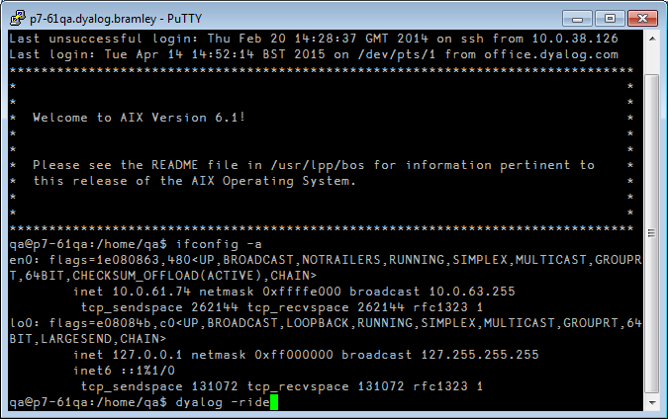
The RIDE - Example

Slide 75
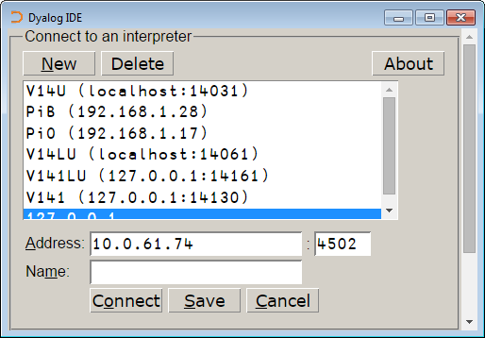
The RIDE - Example

Slide 76
The Compiler (experimental)
Works only on dfns
encode←{(⎕A,⎕D)⍳⍵}
⍝ ⎕A, ⎕D evaluated at compile time
No thread switching will occur between lines of code after a function has been compiled.

Slide 77
The Compiler (experimental)
⎕FX 'r←foo y' ... ⍝ define foo
foo 99 ⍝ execute the uncompiled code
2 (400⌶) 'foo' ⍝ compile it
foo 99 ⍝ execute the compiled code
Use ]runtime to see CPU usage

Slide 78
R
This assumes you have R installed.
R is supported under Windows and Linux.
R functions can be called directly from within a Dyalog APL session
the contents of APL variables can be transferred to and from equivalent R variables

Slide 79
R
You can get R from the Web. Search for R for your operating system
(http://www.r-project.org/ )
NOTE: you should use the Dyalog APL version matching your operating system size.
If your system is 64-bit you should use Dyalog APL 64-bit (Unicode).

Slide 80
R
Sample session (r.x executes in R)
⎕←r.x '1+2' ⍝ Add two scalars
⎕←r.x 'c(1,2,3)*c(10,20,30)' ⍝ V1×V2
10 40 90
⎕←r.x 'matrix(1:12,3)' ⍝ ⍉4 3⍴⍳12
1 4 7 10
2 5 8 11
3 6 9 12
Notes:
,byrow=TRUE to get the 4 3⍴⍳12

Slide 81
R
There are many statistical programs for use, e.g. 'rnorm' for normal distributions.
r.p puts a value in R, e.g. 'variable' r.p value
r.g gets a value from R, e.g. r.g 'variable'
See the R Interface Guide (PDF) in the help folder of Dyalog APL.

Slide 82
R - exercises
)LOAD rconnect
Get a normal distribution for a vector of 1000 elements, with mean=100 and standard dev=10 (use 'rnorm')
Assign it to variable X
Move the data back to R
Apply 'summary' to it.

Slide 83
.NET Enhancements
Two new enhancements:
Overloads
Casts

Slide 84
.NET Enhancements
Overloads
To force APL to call the double version of function foo() regardless of the type of the argument val:
(foo ⍠('OverloadTypes'Double))val
or more simply:
(foo ⍠Double)val
⎕USING←'System' ⋄ Double
(System.Double)

Slide 85
.NET Enhancements
Casts
⎕USING←'System' ⍝ make Bool array of 2 elem
BA←Array.CreateInstance Boolean 2
BA.GetValue 0 ⍝ get the 0th element
0
⍝ attempt to set the 0th element to 1 (AKA true)
BA.SetValue 1 0
EXCEPTION: Cannot widen from source type to target type

Slide 86
.NET Enhancements
Casts
To rectify the situation, APL must be told to cast the argument to a Boolean as follows:
(BA.SetValue ⍠ ('CastToTypes'(Boolean Int32)))1 0
BA.GetValue 0 ⍝ get the 0th element
1

Slide 87
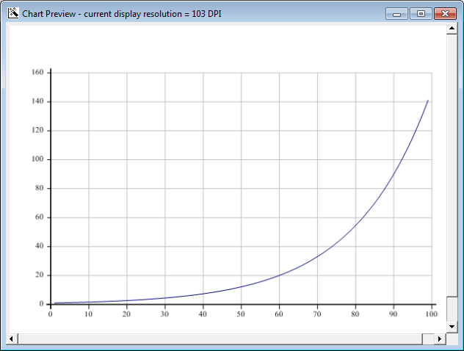
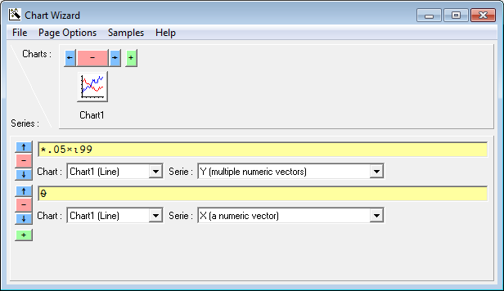
The Chart Wizard
]chart *0.05×⍳99

Slide 88
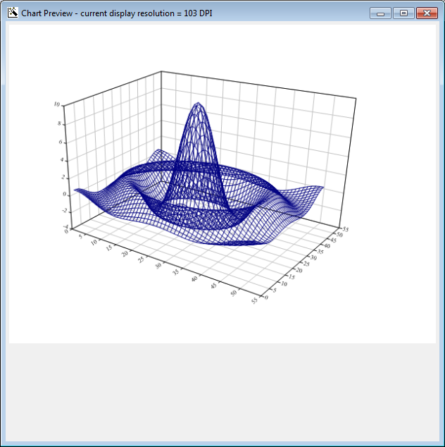

The Chart Wizard
x←¯10 10 {⍺[1]++\0,⍵⍴(|-/⍺)÷⍵} 50
z←x∘.{{10×(1○⍵)÷⍵}((⍺*2)+⍵*2)*.5}x
y←x x z
(put cursor over 'y' and hit this button: )

Slide 89
JSON
]list tools -recursive
Type Name Versions Size Last Update
<DIR> tools\code 2015/04/07 10:45:09
…
tools\code\partScan 4340 2014/05/24 6:44:44
tools\code\textUtils 6758 2014/05/24 6:44:44
<DIR> tools\data 2015/04/07 10:45:09
tools\data\Clock 1339 2014/08/05 20:10:39
tools\data\Person 9958 2014/08/05 20:10:39
tools\data\Tools 11661 2014/05/24 6:44:44
tools\data\names 36318 2014/12/14 15:46:36
<DIR> tools\Inet 2015/04/07 10:45:09
tools\Inet\HTMLdoc 10108 2014/05/24 6:44:44
tools\Inet\JSON 24825 2014/12/09 7:31:34
<DIR> tools\special 2015/04/07 10:45:09
tools\special\asymmetric 8270 2014/12/14 15:47:39
…

Slide 90
JSON
]load tools\Inet\JSON
#.JSON
]box on
Was OFF
⎕←v1←JSON.toAPL '[[1,1],[1,2],[1,3],[2,1],[2,2],[2,3]]'
┌───┬───┬───┬───┬───┬───┐
│1 1│1 2│1 3│2 1│2 2│2 3│
└───┴───┴───┴───┴───┴───┘
JSON.fromAPL v1
[[1,1],[1,2],[1,3],[2,1],[2,2],[2,3]]
JSON.fromAPL ⎕←JSON.toAPL '[null,[]]'
┌──────┬┐
│[Null]││
└──────┴┘
[null,[]]

Slide 91
JSON
⎕←v1←JSON.toAPL '{"z1":"dsa"}'
#.[Namespace]
v1.⎕nl-2
┌──┐
│z1│
└──┘
v1.z1
dsa
JSON.fromAPL v1
{z1:"dsa"}

Slide 92
JSON
]load tools\Inet\JSON
#.JSON
]box on
Was OFF
⎕←v1←JSON.toAPL '[[1,1],[1,2],[1,3],[2,1],[2,2],[2,3]]'
┌───┬───┬───┬───┬───┬───┐
│1 1│1 2│1 3│2 1│2 2│2 3│
└───┴───┴───┴───┴───┴───┘
JSON.fromAPL v1
[[1,1],[1,2],[1,3],[2,1],[2,2],[2,3]]
JSON.fromAPL ⎕←JSON.toAPL '[null,[]]'
┌──────┬┐
│[Null]││
└──────┴┘
[null,[]]

Slide 93
XML
]load tools\Inet\JSON
#.JSON
]box on
Was OFF
JSON.fromXML ⎕← JSON.toXML'{"z1":"dsa","cxz":[1,2,[33,44]]}'
<json type="object"><z1>dsa</z1><cxz type="array"><item type="number">1</item><item type="number">2</item><item type="array"><item type="number">33</item><item type="number">44</item></item></cxz></json>
{z1:"dsa",cxz:[1,2,[33,44]]}

Slide 94
WPF
WPF is a glorified version of .NET Windows forms.
In Dyalog you can bind variables to windows properties.

Slide 95
WPF Applications
Use WPF to create a window displaying stock quotes in a moving text window.
In the workspace stockTicker there is a program, runMarketBG, that will simulate market activity in the background.

Slide 96
WPF Applications
The program also updates regularly a variable, STString, containing the latest stock changes.
You should write a WPF program to display this string in a long panel (a window) updated every once in a while to reflect changes.
You should run runMarketBG before running your program.
Notes:
Using data binding is a bonus

Slide 97
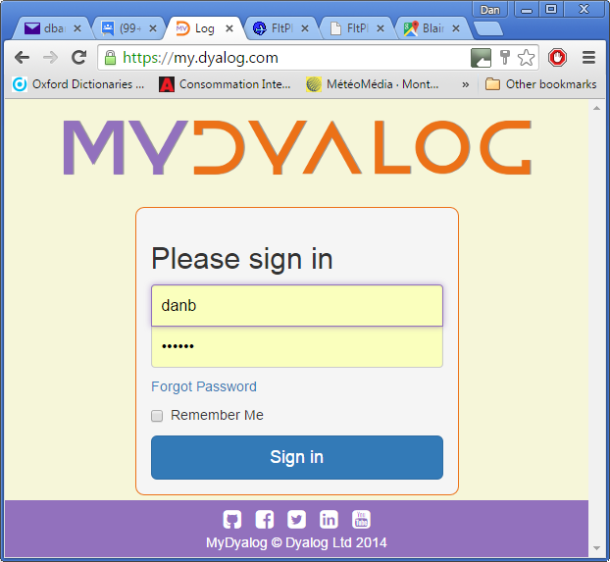
my.dyalog.com

Slide 98
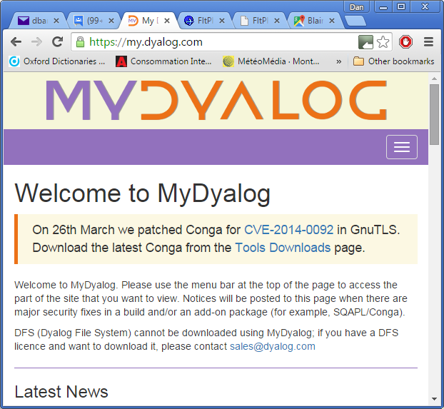
my.dyalog.com

Slide 99
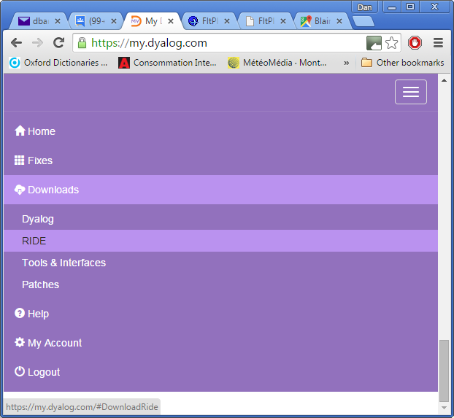
my.dyalog.com

