Slide 1
Feuille de Route [Technique]
Morten Kromberg, CXO

Slide 2
What is a CXO?
Wikipedia:
  A chief experience officer (CXO) is the officer responsible for the overall user experience (UX) of an organization.
  The chief experience officer ensures the organization has good customer service, so customers are able to have a positive experience.
Not just about running a good help desk, but understanding whether our products, services and documentation meet the needs of existing and future users.

Slide 3

Goals as CXO
Spend more time understanding user requirements
As always: Professional Application Developers
… but with new resources, also focus on:
  People using APL for prototyping and as a “tool of thought”
  Potential users from outside the existing array language community.
Describe and prioritise requirements.
Agree on the road map with CEO & CTO.
Let Jay manage the core technology
group and try not to interfere.
We hope to hire 1 new C/C++ and
1 new APL resource in 2016

Slide 4
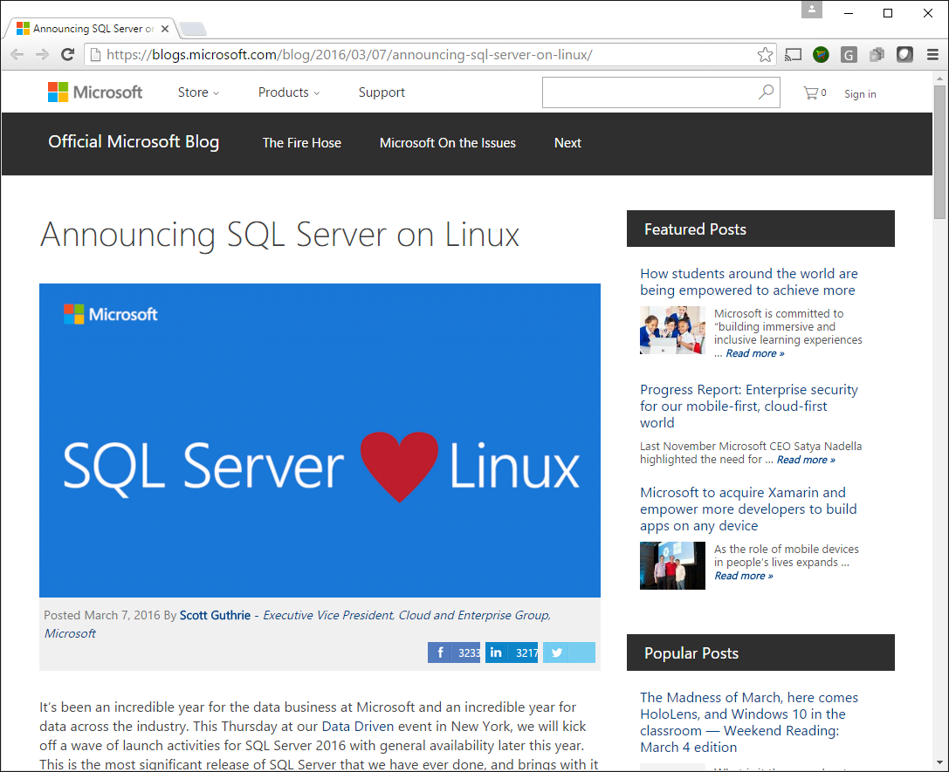

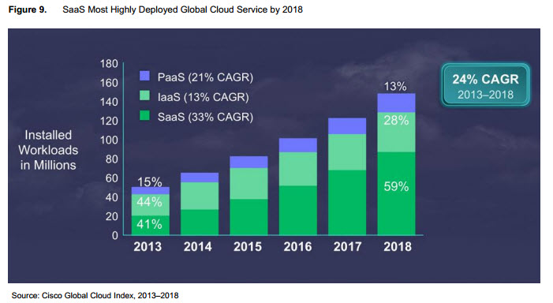
Trends
Microsoft Windows Desktop (“Win32”) is fading
New platforms, in particular Linux, are getting more important
Parallel processing is becoming important
Both Cloud- and GPU-based
IoT (Internet of Things): Android & Arm Linux

Slide 5
Prepare for the Future
Microsoft Windows Desktop (“Win32”) is fading
New platforms, in particular Linux, are getting more important
Parallel processing is becoming important
Both Cloud- and GPU-based
IoT platforms: Android, ARM Linux
Support cross-platform Development
  Remote IDE for APL on all platforms
  Cross-platform UI and integration tools, which do NOT require platform-specific frameworks such as Microsoft.Net
Add new platforms
  Recent: ARM Linux and Apple OSX
  To come: Android (perhaps iOS)
Compilers & Tools to Support Parallelism
  2 compiler research projects
  Futures & Isolates
  Vector database

Slide 6
Performance
Tuning the interpreter
Co-Dfns compiler
Dyalog byte code execution engine

Slide 7
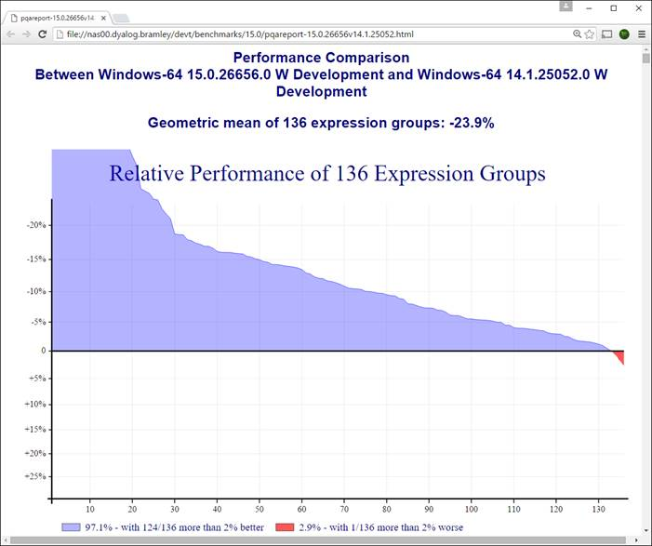
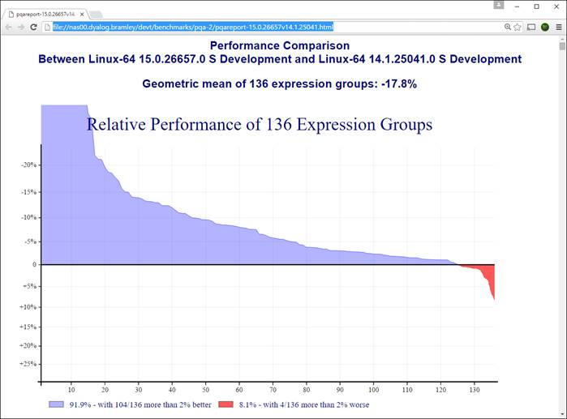
Performance (1 of 3)
Tuning the Interpreter
New algoritms
New C compilers on all platforms
  Windows: VS2005 => VS2015
  Linux: gcc 4.3.3 (2009) => 5.3 (2015)
  AIX xlc has been “current”

Slide 8
Performance (2 of 3)
Co-dfns compiler (Aaron Hsu / Indiana U)
Support for Boolean vectors in the compiler
Basically Complete Scalar Runtime
  Most mixed functions, and operators
Full GPU execution by default in most cases
Support for caching data on GPU
Improved reliability and stability fixes across the board
Better user documentation and interface
Still very experimental, first client project in 2016

Slide 9
Performance (3 of 3)
Optimised Byte Code Execution Engine
  aka “Compiler”
Gives a factor of 2 speed-up on code using small arrays
Version 15.0 work:
  support for nested dfns
  allow assignments to global variables
  Indicator in editor showing whether a function can be compiled or not

Slide 10
Cross-Platform Integration
Historically, Dyalog has integrated with Microsoft infrastructure: DDE, OLE/COM, and Microsoft.NET.
In the future, we need to support cross-platform mechanisms, such as:
Call APL as a shared library (.dll/.so)
Use APL as a “scripting language”
Support emacs, vim, Eclipse, etc
Web service frameworks + JSON

Slide 11
Integration (1 of 4)
Call APL as a shared library (.dll/.so)
“Reverse ⎕NA”
Allow C, or any language with a “foreign function interface”, to call APL

Slide 12
Integration (2 of 4)
Use APL as a “scripting language”
Support UNIX/Linux scripts starting with
#!dyalog
Support other editors (next slide)

Slide 13
Integration (3 of 4)
Support external editors & debuggers with plugins based on RIDE protocol:
Emacs
VIM
Eclipse (intern at Dyalog this summer)
Visual Studio
Will make it easier for many young people to get started using an editor they know.

Slide 14
Publish new RIDE Protocol
API is based on JSON, for example:
When the user presses <ED>, RIDE should send e.g.: ["Edit",{"win":123, "text":"a←b+c×d",
"pos":4, "unsaved":{"124":"f"}}]
The interpreter will respond with something like:
["OpenWindow",{"name":"f",
"text":["r←f a", "r←(+ ÷≢)a"],
"token":123, "currentRow":0, "debugger":false, "entityType":1, "offset":0,
"readOnly":false, "size":0,
"stop":[1], "tid":0, "tname":"Tid:0"}]

Slide 15
Integration (4 of 4)
Web service frameworks + JSON
Microsoft.NET Web Service Support
MiServer 3.0 Supports RESTful services
Conga HTTP support & other goodies
CXO’s Dream: APL to serve web requests “out of the box”

Slide 16
Cross Platform Tools
UI: MiServer & HTML Rendering Engine, Graphics with SharpPlot (& Javascript)
SQAPL (ODBC interface to SQL databases)
Vector Database: “vecdb” in pure APL
CONGA (TCP), Crypto Library
JSON & XML conversion functions
V15.0 File Functions
  NINFO, NMKDIR, NDELETE, …
Interfaces to R, Python

Slide 17
Demo: Future UI Development

Slide 18
Portable User Interfaces
Dyalog APL Server
Dyalog APL + RIDE
(Windows, UNIX, Mac,
Android, etc)
MiServer or other
HTML/JS Generator
MiServer or other
HTML/JS Generator
Internet
HTML Engine
Web Browser

Slide 19
Parallel Computing
Futures & Isolates
  Multicore machines, clusters, and “clouds”
  E.g. Parallel queries on large vector databases
Co-Dfns Compiler => GPU execution

Slide 20
Vector Database
vecdb is an inverted or columnar database
Similar architecture to JD, kdb (but very simple)
  Open source: https://github.com/Dyalog/vecdb
Will be able to perform parallel queries

Slide 21
Integration with Other Languages
Continue with Microsoft.Net
Foreign Function Interfaces in&out
Additional integration with:
R
Python
Julia?
MatLab?

Slide 22
Demo: Python “Bridge”

Slide 23
[New] Goals for the CXO
Work with CEO to create training materials
Work with (and as a member of) the APL Tools Team to create tools, tutorials and samples
Venture outside the APL community to attract new users
Special focus on the new users
Revisit the usability of the entire Dyalog system and take inspiration from other tools

Slide 24
Evangelism
“Dyalog is a modern, array-first,
multi-paradigm programming language,
which supports functional, object-oriented and imperative programming,
based on an APL language kernel.”

Slide 25
One of our customers writes:
Dyalog est un langage de programmation moderne, "array-first", "multi-paradigm", basé sur un kernel de langage APL.
Originellement, [xxx] incluait du code écrit en C, C++ et C#. Ce code a progressivement été remplacé par du Dyalog, afin de donner davantage de cohérence au système et nous permet de nous appuyer sur de réels experts en ce domaine pour tous les développements applicatifs.
D'autres langages (plus techniques) sont également utilisés dans l'interpréteur Dyalog lui-même et dans certaines librairies utilisées pour des services à basse technicité.
Javascript est également utilisé afin de produire des graphiques hautement interactifs.

