Slide 1
Technical Road Map
Spring 2016
Morten Kromberg, CXO

Slide 2
What is a CXO?
Wikipedia:
  A chief experience officer (CXO) is the officer responsible for the overall user experience (UX) of an organization.
  The chief experience officer ensures the organization has good customer service, so customers are able to have a positive experience.
Not just about running a good help desk, but understanding whether our products, services and documentation meet the needs of existing and future users.

Slide 3

Goals as CXO
Spend more time understanding user requirements
As always: Professional Application Developers
… but with new resources, also focus on:
  People using APL for prototyping and as a “tool of thought”
  Potential users from outside the existing array language community.
Describe and prioritise requirements.
Agree on the road map with CEO & CTO.
Let Jay manage the core technology
group and try not to interfere.
We hope to hire 1 new C/C++ and
1 new APL resource in 2016

Slide 4
Goals as CXO
Work with CEO to create training materials
Work with (and as a member of) the APL Tools Team to create tools, tutorials and samples
Venture outside the APL community and reach out to
  Dynamic and functional language communities
    Python, Julia, etc.
  “Domain Expert” communities
    Finance, Math, Engineering, maybe even Computer Science

Slide 5
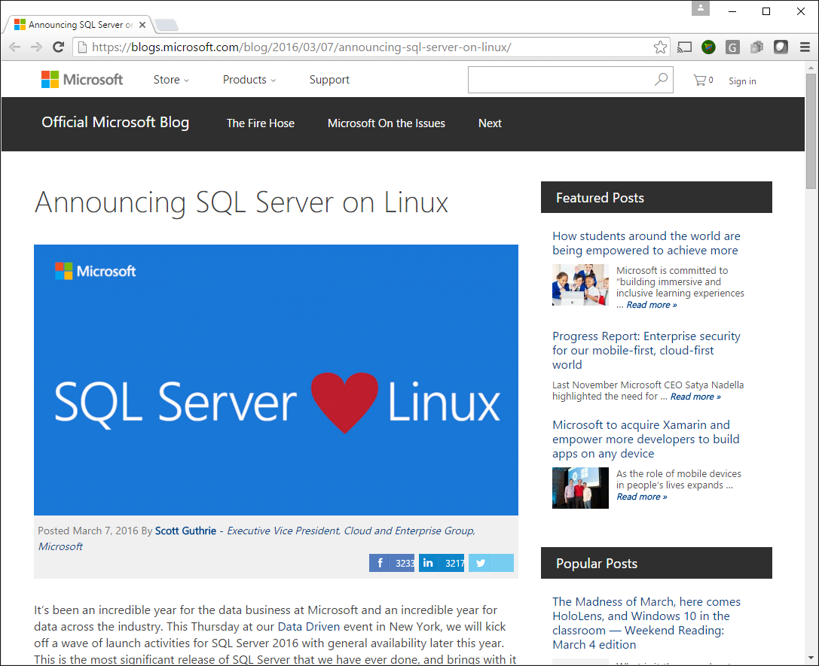

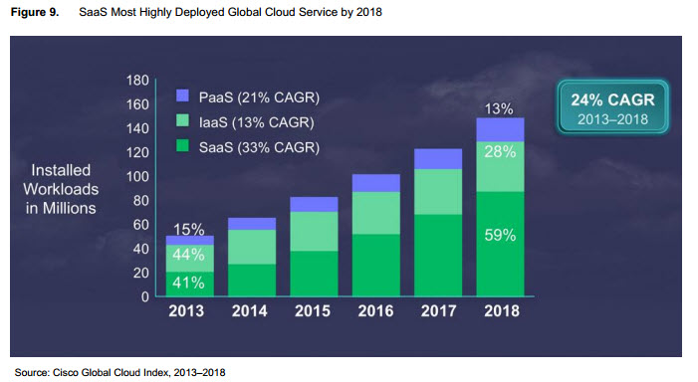
Trends
Microsoft Windows Desktop (“Win32”) is fading
New platforms, in particular Linux, are getting more important
Parallel processing is becoming important
Both Cloud- and GPU-based
IoT (Internet of Things): Android & Arm Linux

Slide 6
Prepare for the Future
Microsoft Windows Desktop (“Win32”) is fading
New platforms, in particular Linux, are getting more important
Parallel processing is becoming important
Both Cloud- and GPU-based
IoT platforms: Android, ARM Linux
Support cross-platform Development
  Remote IDE for APL on all platforms
  Cross-platform UI and integration tools which do not require platform-specific frameworks like Microsoft.Net
Add new platforms
  Recent: ARM Linux and Apple OSX
  To come: Android (perhaps iOS)
Compilers & Tools to Support Parallelism
  2 compiler research projects
  Futures & Isolates
  Vector database

Slide 7
Performance
Tuning the interpreter
Co-Dfns compiler
Dyalog byte code execution engine

Slide 8
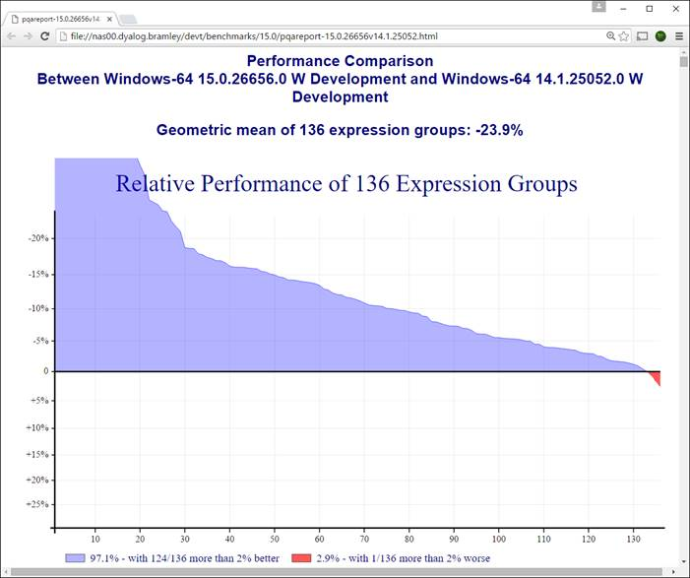
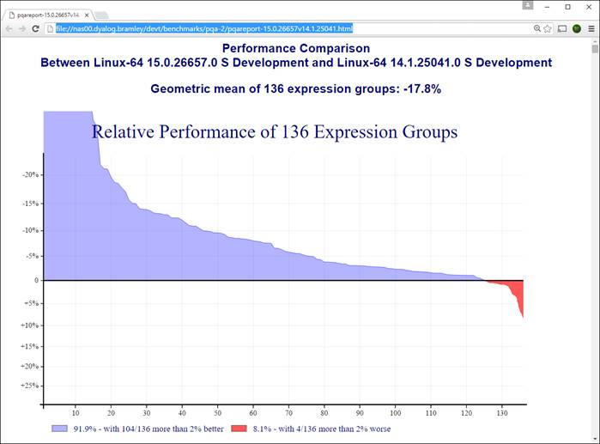
Performance (1 of 3)
Tuning the Interpreter
New algoritms
New C compilers on all platforms
  Windows: VS2005 => VS2015
  Linux: gcc 4.3.3 (2009) => 5.3 (2015)
  AIX xlc has been “current”

Slide 9
Performance (2 of 3)
Co-dfns compiler (Aaron Hsu / Indiana U)
Support for Boolean vectors in the compiler
Basically Complete Scalar Runtime
  Most mixed functions, and operators
Full GPU execution by default in most cases
Support for caching data on GPU
Improved reliability and stability fixes across the board
Better user documentation and interface
Still very experimental, first client project in 2016

Slide 10
Performance (3 of 3)
Optimised Byte Code Execution Engine
  aka “Compiler”
Gives a factor of 2 speed-up on code using small arrays
Version 15.0 work:
  support for nested dfns
  allow assignments to global variables
  Indicator in editor showing whether a function can be compiled or not

Slide 11
Cross-Platform Integration
Historically, Dyalog has integrated with Microsoft infrastructure: DDE, OLE/COM, and Microsoft.NET.
In the future, we need to support cross-platform mechanisms, such as:
Call APL as a shared library (.dll/.so)
Use APL as a “scripting language”
Support emacs, vim, Eclipse, etc
Web service frameworks + JSON

Slide 12
Integration (1 of 4)
Call APL as a shared library (.dll/.so)
“Reverse ⎕NA”
Allow C, or any language with a “foreign function interface”, to call APL

Slide 13
Integration (2 of 4)
Use APL as a “scripting language”
Support UNIX/Linux scripts starting with
#!dyalog
Support other editors (next slide)

Slide 14
Integration (3 of 4)
Support external editors & debuggers with plugins based on RIDE protocol:
Emacs
VIM
Eclipse (intern at Dyalog this summer)
Visual Studio
Will make it easier for many young people to get started using an editor they know.

Slide 15
Publish new RIDE Protocol
API is based on JSON:
When the user presses <ED>, RIDE should send e.g.: ["Edit",{"win":123, "text":"a←b+c×d",
"pos":4, "unsaved":{"124":"f"}}]
The interpreter will respond later with something like:
["OpenWindow",{"name":"f",
"text":["r←f a", "r←(+ ÷≢)a"],
"token":123, "currentRow":0, "debugger":false, "entityType":1, "offset":0,
"readOnly":false, "size":0,
"stop":[1], "tid":0, "tname":"Tid:0"}]

Slide 16
Integration (4 of 4)
Web service frameworks + JSON
Microsoft.NET Web Service Support
MiServer 3.0 Supports RESTful services
Conga HTTP support & other goodies
CXO Dream: APL to serve web requests “out of the box”

Slide 17
Cross Platform Tools
UI: MiServer & HTML Rendering Engine
SQAPL (ODBC/SQL)
CONGA (TCP)
JSON & XML
V15.0 File Functions
  NINFO, NMKDIR, NDELETE, …
Interfaces to R, Python

Slide 18
Demo: Future UI Development

Slide 19
Portable User Interfaces
Dyalog APL Server
Dyalog APL + RIDE
(Windows, UNIX, Mac,
Android, etc)
MiServer or other
HTML/JS Generator
MiServer or other
HTML/JS Generator
Internet
HTML Engine
Web Browser

Slide 20
Parallel Computing
Futures & Isolates
  Multicore machines, clusters, and “clouds”
  E.g. Parallel queries on large vector databases
Co-Dfns Compiler => GPU execution

Slide 21
Demo: Vector Database
vecdb is an inverted or columnar database
Similar architecture to JD, kdb (but very simple)
  Open source: https://github.com/Dyalog/vecdb

Slide 22
Integration with Other Languages
Continue with Microsoft.Net
Foreign Function Interfaces in&out
Additional integration with:
R
Python
Julia?
MatLab?

Slide 23
Demo: Python “Bridge”

Slide 24
Recap: [New] Goals for CXO
Work with CEO to create training materials
Work with (and as a member of) the APL Tools Team to create tools, tutorials and samples
Venture outside the APL community to attract new users
Special focus on the “newbies”
Revisit the usability of the entire Dyalog system and take inspiration from other tools

Slide 25
Dyalog 15.0 Highlights
Very Significant Speed-Ups
Windows Installation without Administrative Privileges
Cross-Platform Native File Functions
Support for Source Files in the interpreter
Data “outside the workspace”
Fast lookups & ⍨↓ as an idiom
Compiler / Byte Code Executor Enhancements

Slide 26
Evangelism
“Dyalog is a modern, array-first,
multi-paradigm programming language,
which supports functional, object-oriented and imperative programming,
based on an APL language kernel.”

