Slide 1
Dyalog APL: What It Is and How It Works?
Aarush Bhat
Dyalog Ltd.

Slide 2
Coming up next…
APL
A Programming Language
Notes:
Why do you have to type all that stuff to get things done?

Slide 3
What is APL?
Symbolic
Array-oriented Programming Language
for Communicating Algorithms
to Computers
and Humans
Notes:
APL is an array-oriented programming language that will change the way you think about problems and data. With a powerful, concise syntax, it lets you develop shorter programs that enable you to think more about the problem you're trying to solve than how to express it to a computer.

Slide 4
What is APL?
Symbolic
↓
↑
⌽
⍉

Slide 5
What is APL?
Symbolic
Array-oriented Programming Language
(5,6,7,8)

Slide 6
What is APL?
Symbolic
Array-oriented Programming Language
2+(5,6,7,8)
⁷ ⁸ ⁹ ¹⁰

Slide 7
What is APL?
Symbolic
Array-oriented Programming Language
2↓(5,6,7,8)
⁷ ⁸

Slide 8
What is APL?
Symbolic
Array-oriented Programming Language
2↑(5,6,7,8)
⁵ ⁶

Slide 9
What is APL?
Symbolic
Array-oriented Programming Language
⌽ (5,6,7,8)
⁸ ⁷ ⁶ ⁵

Slide 10
What is APL?
table
┌─┬─┬─┐
│T│r│y│
├─┼─┼─┤
│A│P│L│
├─┼─┼─┤
│n│o│w│
└─┴─┴─┘
Symbolic
Array-oriented Programming Language
⌽table
┌─┬─┬─┐
│y│r│T│
├─┼─┼─┤
│L│P│A│
├─┼─┼─┤
│w│o│n│
└─┴─┴─┘

Slide 11
What is APL?
table
┌─┬─┬─┐
│T│r│y│
├─┼─┼─┤
│A│P│L│
├─┼─┼─┤
│n│o│w│
└─┴─┴─┘
Symbolic
Array-oriented Programming Language
2↓⌽table
┌─┬─┬─┐
│w│o│n│
└─┴─┴─┘

Slide 12
What is APL?
table
┌─┬─┬─┐
│T│r│y│
├─┼─┼─┤
│A│P│L│
├─┼─┼─┤
│n│o│w│
└─┴─┴─┘
Symbolic
Array-oriented Programming Language
2 1↓⌽table
┌─┬─┐
│o│n│
└─┴─┘

Slide 13
What is APL?
table
┌─┬─┬─┐
│T│r│y│
├─┼─┼─┤
│A│P│L│
├─┼─┼─┤
│n│o│w│
└─┴─┴─┘
Symbolic
Array-oriented Programming Language
⍉2 1↓⌽table
┌─┐
│o│
├─┤
│n│
└─┘

Slide 14
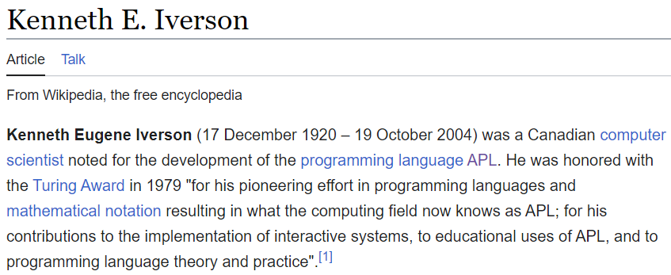
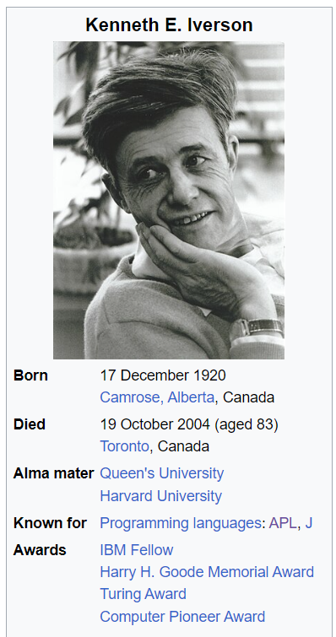
Notes:
Frustrated by the Inadequacies of math made A programming language in 1962

Slide 15
Symbols, symbols and symbols
Notes:
80

Slide 16
Myth

Slide 17
Myth: “APL is Unreadable”
$$\left(×/{!x}−1\right)÷!\left(+/x\right)−1$$
$$\frac{\prod_{i=1}^{n}{\left(x_{i}−1\right)!}}{\left(\left(\sum_{i=1}^{n}{x_{i}}\right)−1\right)!}$$
Математичка функција
دالة رياضية
数学函数

Slide 18
Myth: “APL is Unreadable”
x.map(e=>[...Array(e).keys()].slice(1).reduce((a,b)=>a*b,1)).reduce((a,b)=>a*b) /[...Array(x.reduce((a,b)=>a+b)).keys()].slice(1).reduce((a,b)=>a*b,1)
Fac=x=>[...Array(x+1).keys()].slice(1).reduce((a,b)=>a*b,1) x.map(e=>Fac(e-1)).reduce((a,b)=>a*b)/Fac(x.reduce((a,b)=>a+b)-1)
Sum=x=>x.reduce((a,b)=>a+b,0) Prd=x=>x.reduce((a,b)=>a*b,1) Rng=x=>[...Array(x).keys()] Fac=x=>Prd(Rng(x+1).slice(1)) Prd(x.map(e=>Fac(e-1)))/Fac(Sum(x)-1)

Slide 19
Myth: “APL is Unreadable”
x.map(e=>[...Array(e).keys()].slice(1).reduce((a,b)=>a*b,1)).reduce((a,b)=>a*b) /[...Array(x.reduce((a,b)=>a+b)).keys()].slice(1).reduce((a,b)=>a*b,1)
Fac=x=>[...Array(x+1).keys()].slice(1).reduce((a,b)=>a*b,1) x.map(e=>Fac(e-1)).reduce((a,b)=>a*b)/Fac(x.reduce((a,b)=>a+b)-1)
Sum = x => x.reduce((a, b) => a + b, 0) Prd = x => x.reduce((a, b) => a * b, 1) Rng = x => [... Array(x).keys()] Fac = x => Prd(Rng(x + 1).slice(1)) Prd(x.map(e => Fac(e - 1))) / Fac(Sum(x) - 1)
Sum ← +/
Prd ← ×/
Rng ← ι Fac ← Prd 1 ↓ (Rng +∘1)
(Prd Fac¨x - 1) ÷ Fac(Sum x) - 1

Slide 20
Myth: “APL is Unreadable”
x.map(e=>[...Array(e).keys()].slice(1).reduce((a,b)=>a*b,1)).reduce((a,b)=>a*b) /[...Array(x.reduce((a,b)=>a+b)).keys()].slice(1).reduce((a,b)=>a*b,1)
Fac=x=>[...Array(x+1).keys()].slice(1).reduce((a,b)=>a*b,1) x.map(e=>Fac(e-1)).reduce((a,b)=>a*b)/Fac(x.reduce((a,b)=>a+b)-1)
Sum = x => x.reduce((a, b) => a + b, 0) Prd = x => x.reduce((a, b) => a * b, 1) Rng = x => [... Array(x).keys()] Fac = x => Prd(Rng(x + 1).slice(1)) Prd(x.map(e => Fac(e - 1))) / Fac(Sum(x) - 1)
Sum ← +/
Prd ← ×/
Rng ← ι Fac ← Prd 1 ↓ (Rng +∘1)
(Prd Fac¨x - 1) ÷ Fac(Sum x) - 1

Slide 21
Myth: “APL is Unreadable”
x.map(e=>[...Array(e).keys()].slice(1).reduce((a,b)=>a*b,1)).reduce((a,b)=>a*b) /[...Array(x.reduce((a,b)=>a+b)).keys()].slice(1).reduce((a,b)=>a*b,1)
Fac=x=>[...Array(x+1).keys()].slice(1).reduce((a,b)=>a*b,1) x.map(e=>Fac(e-1)).reduce((a,b)=>a*b)/Fac(x.reduce((a,b)=>a+b)-1)
Sum = x => x.reduce((a, b) => a + b, 0) Prd = x => x.reduce((a, b) => a * b, 1) Rng = x => [... Array(x).keys()] Fac = x => Prd(Rng(x + 1).slice(1)) Prd(x.map(e => Fac(e - 1))) / Fac(Sum(x) - 1)
Sum ← +/
Prd ← ×/
Rng ← ι Fac ← Prd 1 ↓ (Rng +∘1)
(Prd Fac¨x - 1) ÷ Fac(Sum x) - 1

Slide 22
Myth: “APL is Unreadable”
x.map(e=>[...Array(e).keys()].slice(1).reduce((a,b)=>a*b,1)).reduce((a,b)=>a*b) /[...Array(x.reduce((a,b)=>a+b)).keys()].slice(1).reduce((a,b)=>a*b,1)
Fac=x=>[...Array(x+1).keys()].slice(1).reduce((a,b)=>a*b,1) x.map(e=>Fac(e-1)).reduce((a,b)=>a*b)/Fac(x.reduce((a,b)=>a+b)-1)
Sum = x => x.reduce((a, b) => a + b, 0) Prd = x => x.reduce((a, b) => a * b, 1) Rng = x => [... Array(x).keys()] Fac = x => Prd(Rng(x + 1).slice(1)) Prd(x.map(e => Fac(e - 1))) / Fac(Sum(x) - 1)
Sum ← +/
Prd ← ×/
Rng ← ι Fac ← Prd 1 ↓ (Rng +∘1)
(Prd Fac¨x - 1) ÷ Fac(Sum x) - 1
Notes:
Initial value

Slide 23
Myth: “APL is Unreadable”
x.map(e=>[...Array(e).keys()].slice(1).reduce((a,b)=>a*b,1)).reduce((a,b)=>a*b) /[...Array(x.reduce((a,b)=>a+b)).keys()].slice(1).reduce((a,b)=>a*b,1)
Fac=x=>[...Array(x+1).keys()].slice(1).reduce((a,b)=>a*b,1) x.map(e=>Fac(e-1)).reduce((a,b)=>a*b)/Fac(x.reduce((a,b)=>a+b)-1)
Sum = x => x.reduce((a, b) => a + b, 0) Prd = x => x.reduce((a, b) => a * b, 1) Rng = x => [... Array(x).keys()] Fac = x => Prd(Rng(x + 1).slice(1)) Prd(x.map(e => Fac(e - 1))) / Fac(Sum(x) - 1)
Sum ← +/
Prd ← ×/
Rng ← ι Fac ← Prd 1 ↓ (Rng +∘1)
(Prd Fac¨x - 1) ÷ Fac(Sum x) - 1

Slide 24
Myth: “APL is Unreadable”
x.map(e=>[...Array(e).keys()].slice(1).reduce((a,b)=>a*b,1)).reduce((a,b)=>a*b) /[...Array(x.reduce((a,b)=>a+b)).keys()].slice(1).reduce((a,b)=>a*b,1)
Fac=x=>[...Array(x+1).keys()].slice(1).reduce((a,b)=>a*b,1) x.map(e=>Fac(e-1)).reduce((a,b)=>a*b)/Fac(x.reduce((a,b)=>a+b)-1)
Sum = x => x.reduce((a, b) => a + b, 0) Prd = x => x.reduce((a, b) => a * b, 1) Rng = x => [... Array(x).keys()] Fac = x => Prd(Rng(x + 1).slice(1))
Prd(x.map(e => Fac(e - 1))) / Fac(Sum(x) - 1)
Sum ← +/
Prd ← ×/
Rng ← ι Fac ← Prd 1 ↓ (Rng +∘1)
(Prd Fac¨x - 1) ÷ Fac(Sum x) - 1

Slide 25
Myth: “APL is Unreadable”
x.map(e=>[...Array(e).keys()].slice(1).reduce((a,b)=>a*b,1)).reduce((a,b)=>a*b) /[...Array(x.reduce((a,b)=>a+b)).keys()].slice(1).reduce((a,b)=>a*b,1) Fac=x=>[...Array(x+1).keys()].slice(1).reduce((a,b)=>a*b,1) x.map(e=>Fac(e-1)).reduce((a,b)=>a*b)/Fac(x.reduce((a,b)=>a+b)-1)
Sum = x => x.reduce((a, b) => a + b, 0) Prd = x => x.reduce((a, b) => a * b, 1) Rng = x => [... Array(x).keys()] Fac = x => Prd(Rng(x + 1).slice(1)) Prd(x.map(e => Fac(e - 1))) / Fac(Sum(x) - 1)
Sum ← +/
Prd ← ×/
Rng ← ι Fac ← Prd 1 ↓ (Rng +∘1)
(Prd Fac x - 1) ÷ Fac(Sum x) - 1

Slide 26
Myth: “APL is Unreadable”
x.map(e=>[...Array(e).keys()].slice(1).reduce((a,b)=>a*b,1)).reduce((a,b)=>a*b) /[...Array(x.reduce((a,b)=>a+b)).keys()].slice(1).reduce((a,b)=>a*b,1) Fac=x=>[...Array(x+1).keys()].slice(1).reduce((a,b)=>a*b,1) x.map(e=>Fac(e-1)).reduce((a,b)=>a*b)/Fac(x.reduce((a,b)=>a+b)-1)
Sum = x => x.reduce((a, b) => a + b, 0) Prd = x => x.reduce((a, b) => a * b, 1) Rng = x => [... Array(x).keys()] Fac = x => Prd(Rng(x + 1).slice(1)) Prd(x.map(e => Fac(e - 1))) / Fac(Sum(x) - 1)
Sum ← +/
Prd ← ×/
Fac ← !
(Prd Fac x - 1) ÷ Fac(Sum x) - 1

Slide 27
Myth: “APL is Unreadable”
x.map(e=>[...Array(e).keys()].slice(1).reduce((a,b)=>a*b,1)).reduce((a,b)=>a*b) /[...Array(x.reduce((a,b)=>a+b)).keys()].slice(1).reduce((a,b)=>a*b,1) Fac=x=>[...Array(x+1).keys()].slice(1).reduce((a,b)=>a*b,1) x.map(e=>Fac(e-1)).reduce((a,b)=>a*b)/Fac(x.reduce((a,b)=>a+b)-1)
Sum = x => x.reduce((a, b) => a + b, 0) Prd = x => x.reduce((a, b) => a * b, 1) Rng = x => [... Array(x).keys()] Fac = x => Prd(Rng(x + 1).slice(1)) Prd(x.map(e => Fac(e - 1))) / Fac(Sum(x) - 1)
Sum ← +/
Prd ← ×/
Fac ←
(Prd Fac x - 1) ÷ Fac(Sum x) - 1
!
!

Slide 28
Myth: “APL is Unreadable”
x.map(e=>[...Array(e).keys()].slice(1).reduce((a,b)=>a*b,1)).reduce((a,b)=>a*b) /[...Array(x.reduce((a,b)=>a+b)).keys()].slice(1).reduce((a,b)=>a*b,1) Fac=x=>[...Array(x+1).keys()].slice(1).reduce((a,b)=>a*b,1) x.map(e=>Fac(e-1)).reduce((a,b)=>a*b)/Fac(x.reduce((a,b)=>a+b)-1)
Sum = x => x.reduce((a, b) => a + b, 0) Prd = x => x.reduce((a, b) => a * b, 1) Rng = x => [... Array(x).keys()] Fac = x => Prd(Rng(x + 1).slice(1)) Prd(x.map(e => Fac(e - 1))) / Fac(Sum(x) - 1)
( ×/ ! x - 1) ÷ ! ( +/ x) - 1

Slide 29
Myth: “APL is Unreadable”
x.map(e=>[...Array(e).keys()].slice(1).reduce((a,b)=>a*b,1)).reduce((a,b)=>a*b) /[...Array(x.reduce((a,b)=>a+b)).keys()].slice(1).reduce((a,b)=>a*b,1) Fac=x=>[...Array(x+1).keys()].slice(1).reduce((a,b)=>a*b,1) x.map(e=>Fac(e-1)).reduce((a,b)=>a*b)/Fac(x.reduce((a,b)=>a+b)-1)
Sum = x => x.reduce((a, b) => a + b, 0) Prd = x => x.reduce((a, b) => a * b, 1) Rng = x => [... Array(x).keys()] Fac = x => Prd(Rng(x + 1).slice(1)) Prd(x.map(e => Fac(e - 1))) / Fac(Sum(x) - 1)
$$\left(×/{!x}−1\right)÷!\left(+/x\right)−1$$
(×/!x-1)÷!(+/x)-1

Slide 30
But, where is this used?

Slide 31
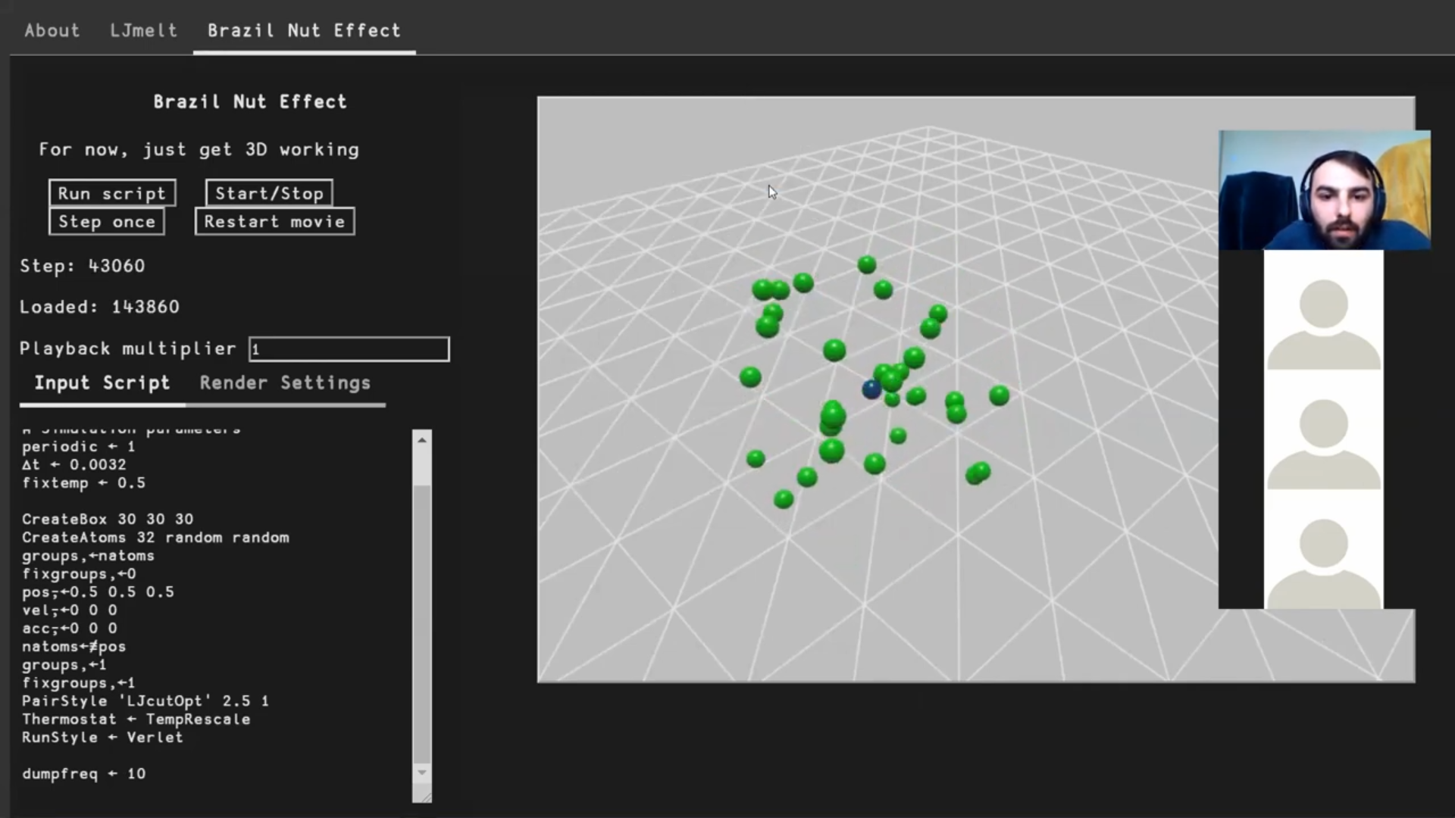
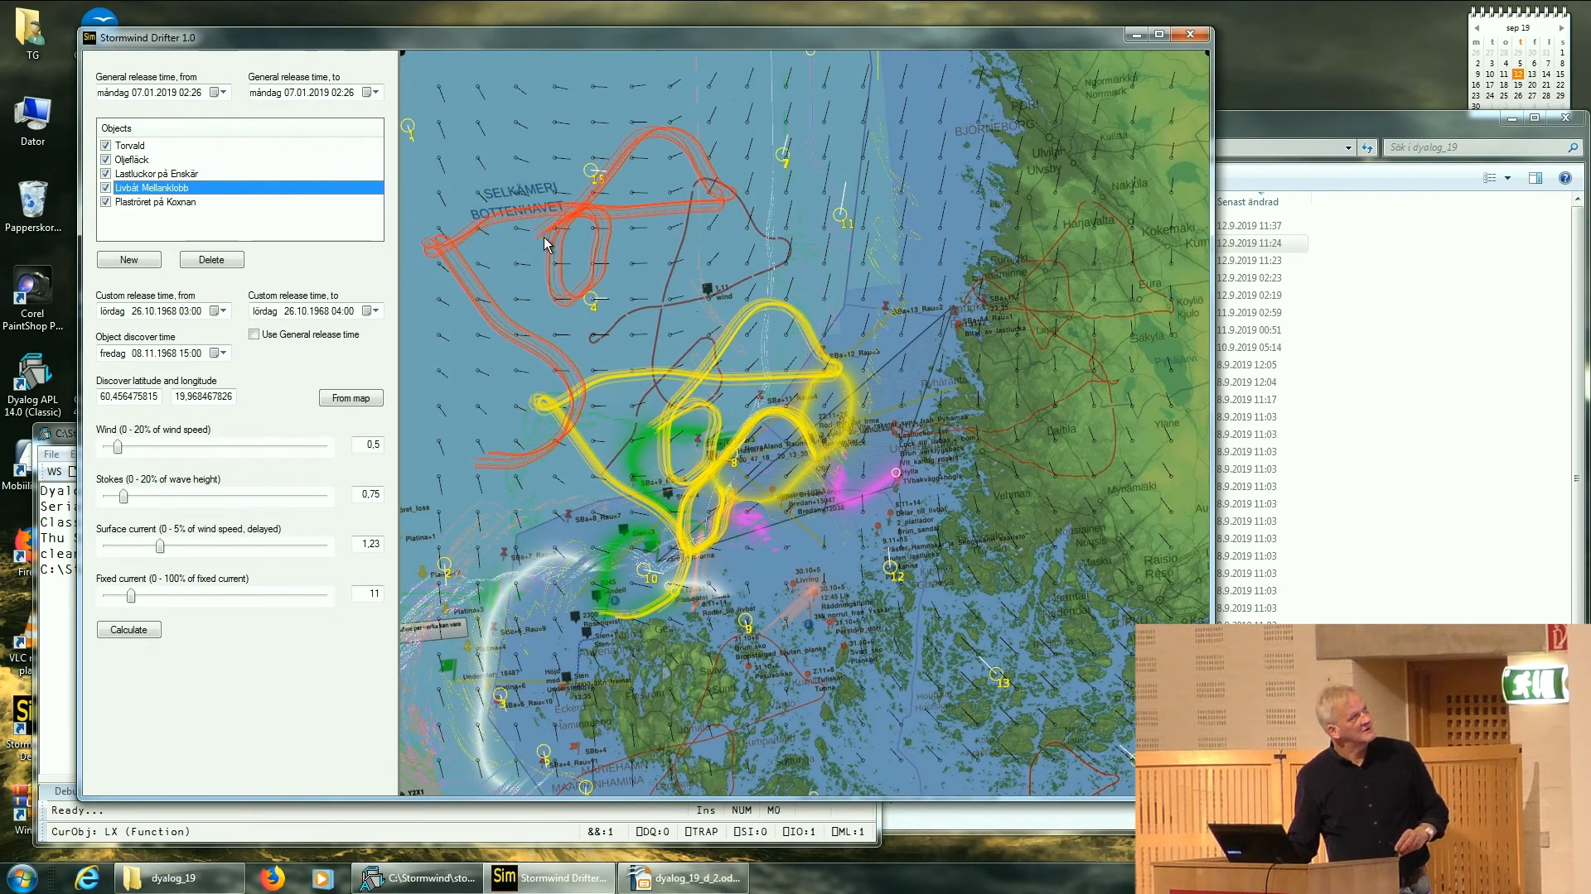
APL in Research

Slide 32
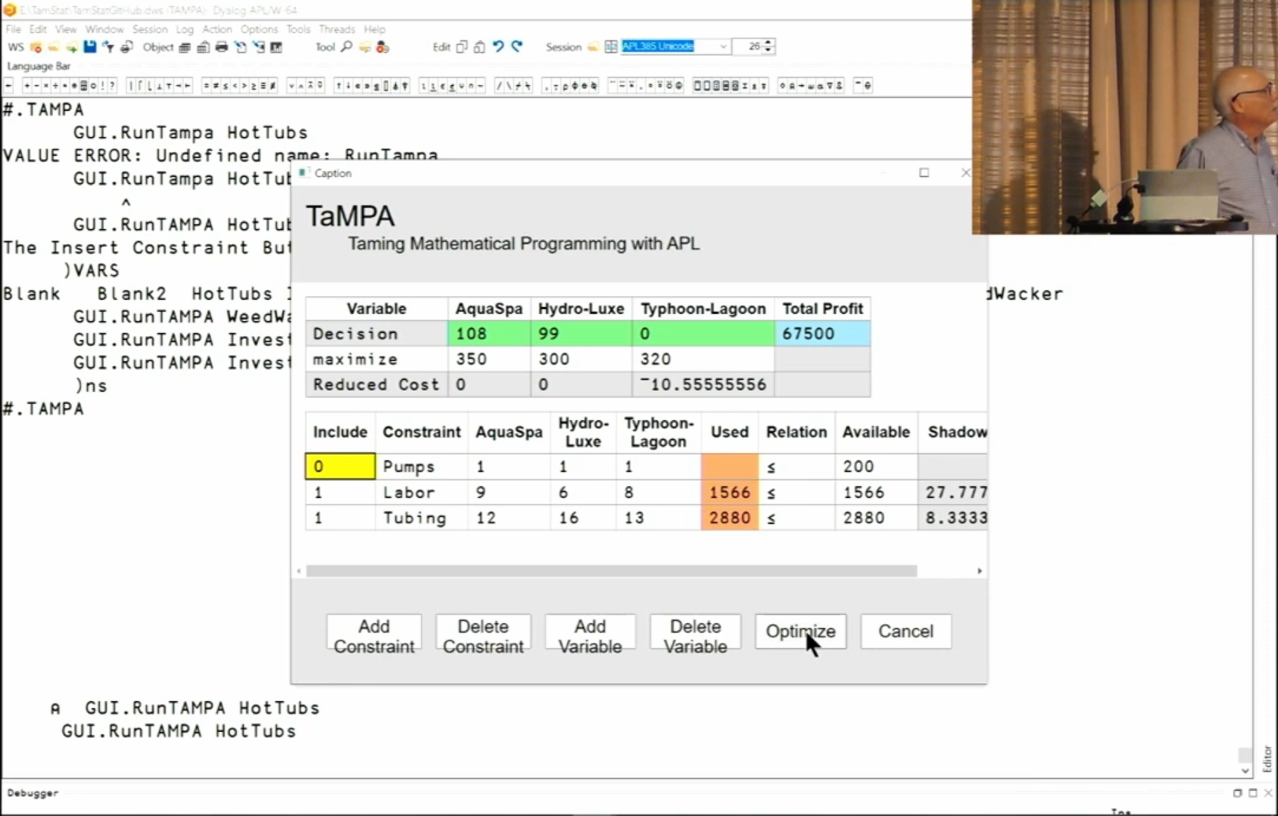
APL in Academia

Slide 33
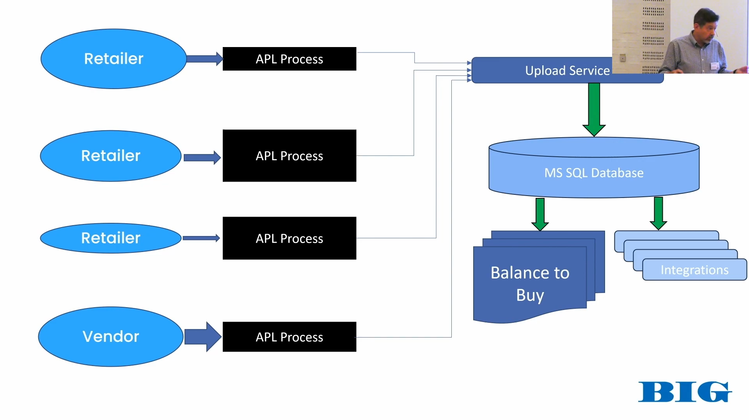
APL in Industry

Slide 34
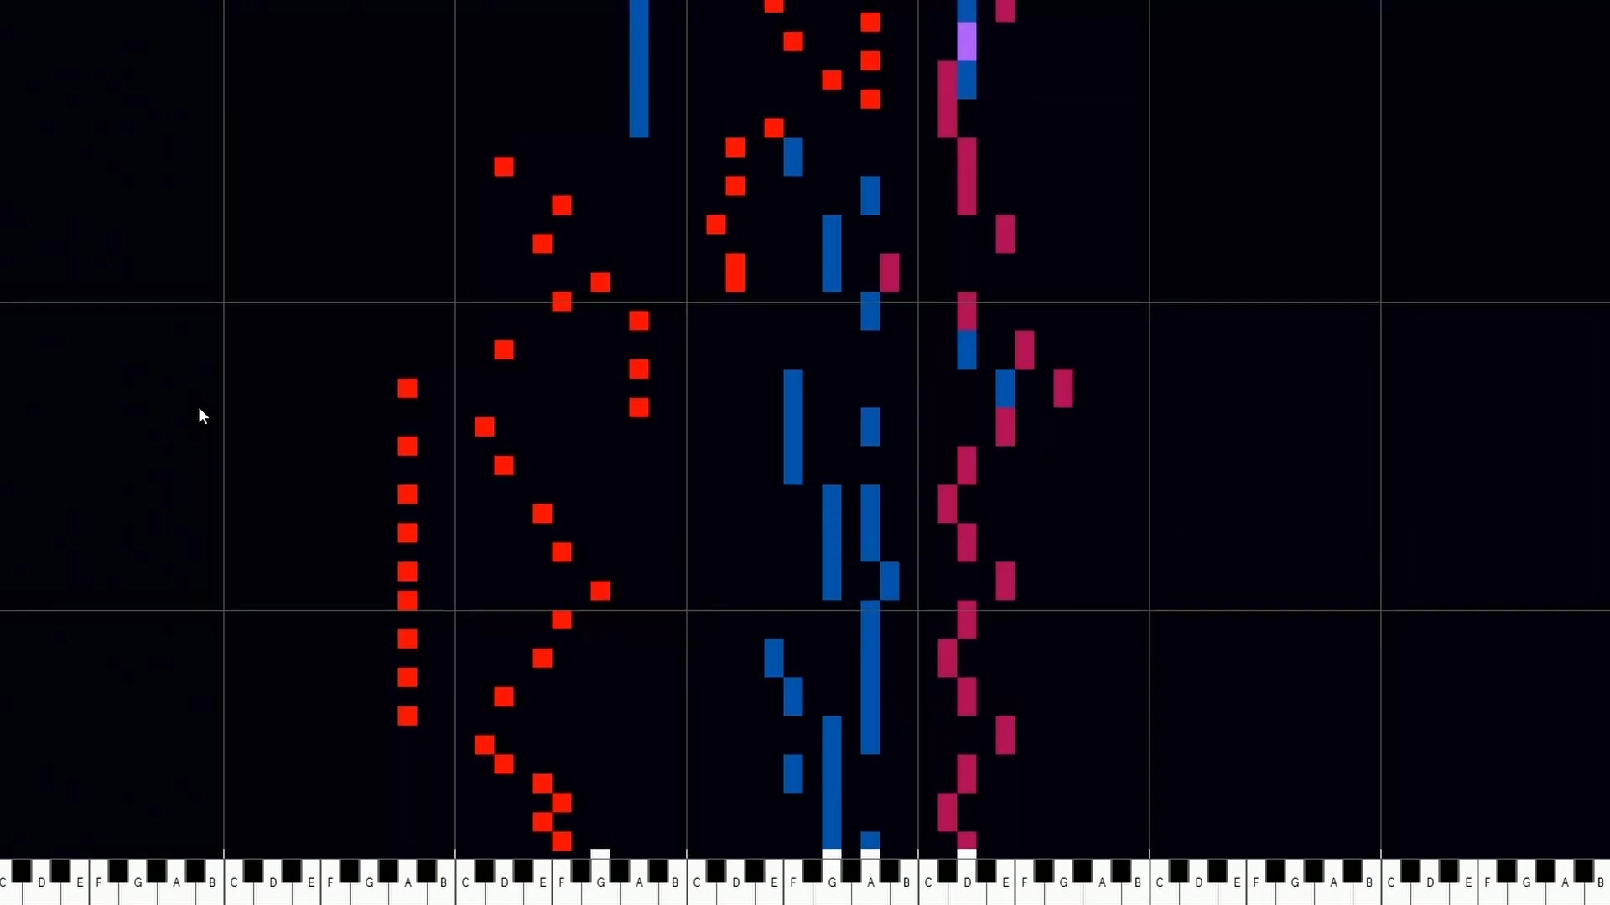
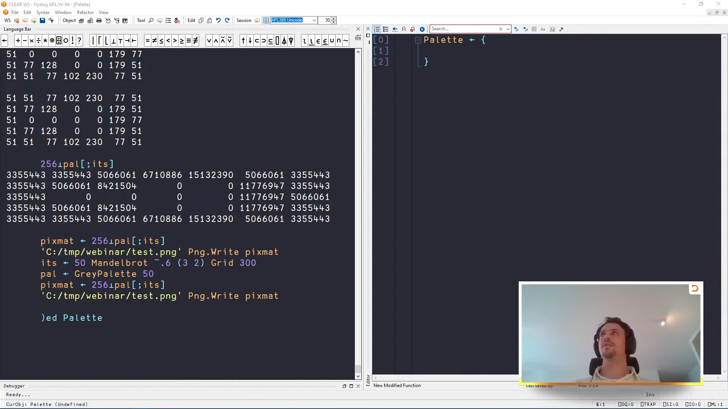
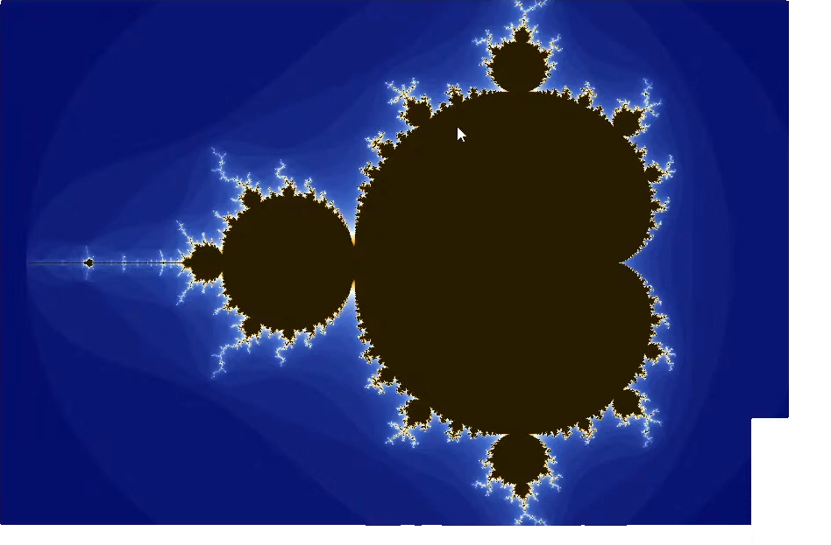
And more…

Slide 35
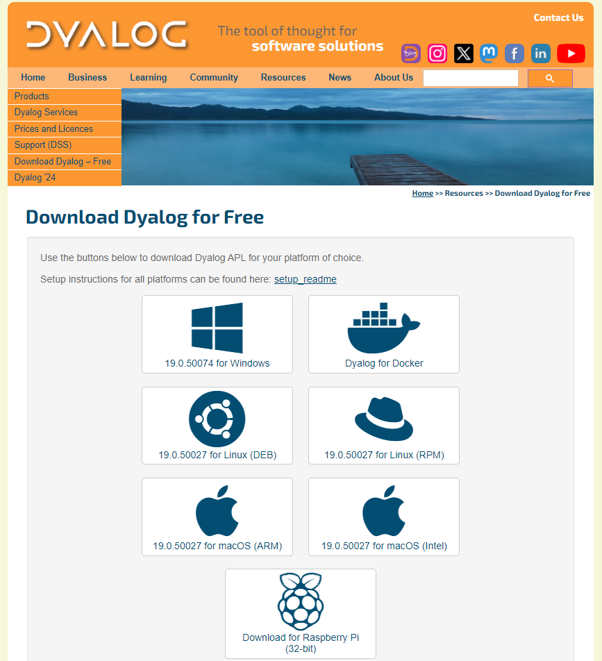
Dyalog Interpreter

Slide 36
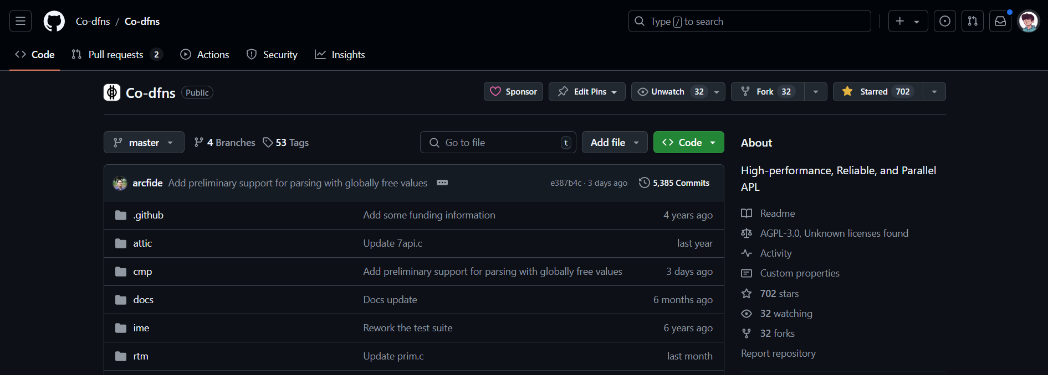
Co-dfns Compiler

Slide 37
Everyone should, at least once
https://tryapl.org/
Notes:
I think everybody should TRY APL

Slide 38
Dyalog APL
Dyalog IDE
For Windows
Dyalog IDE
For Unix
Tatin
Package Manager
Cider
Project Manager
6 platforms
Object Oriented
Functional
UI Tools
Interop-able
Multilingual
Notes:
TODO: Own IDE, a network stack, package manager, project manager, UI tools, Jupyter kernel, 6 platforms, Support. What else does a programming language need, oops, functional etc interopable with py and .net multilingual

Slide 39
Getting started
Chat in the APL Orchard
Ask a question on Stack Overflow (apl, dyalog)
Use the r/apljk subreddit
Learning APL by Stefan Kruger
Checkout on YouTube:
@DyalogLtd
@DyalogUserMeetings

Slide 40
So, Dyalog APL
Symbolic concise syntax
Array Oriented Programming language
Object oriented and functional programming
High performance
Cross platform

Slide 41
Notation as a Tool of Thought
A language that doesn’t affect the way you think about programming is not worth knowing. –Alan Perlis
Thank you!
Notes:
Why do you have to type all that stuff to get things done?

Slide 42
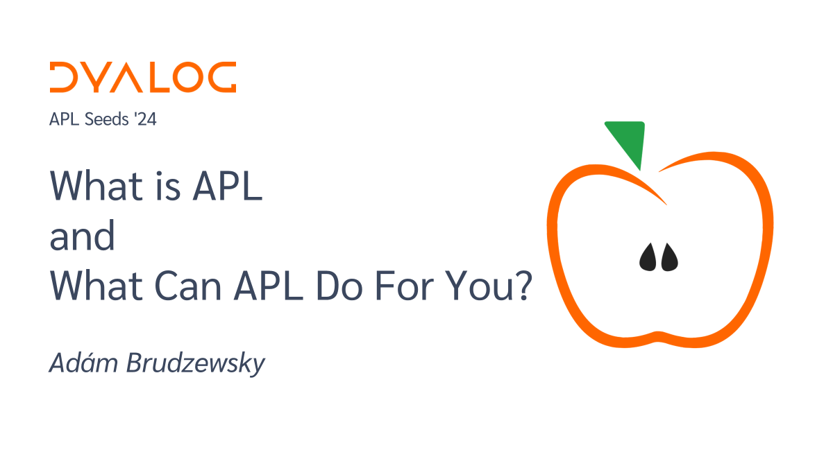
What is APL and What Can APL Do For You?
Adám Brudzewsky

