Slide 1
News from Dyalog – Spring 2022
Morten Kromberg

Slide 2
Agenda
Building the Team
The next Big Thing
The next, next Big Thing
Version 18.2 recap
Version 19.0 and beyond

Slide 3
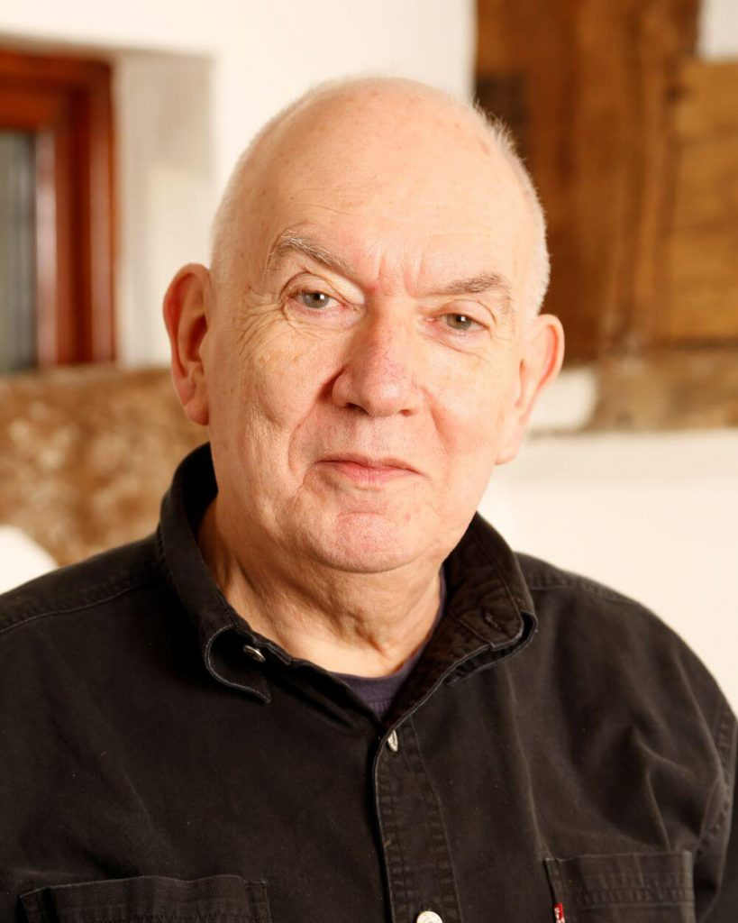
[Re]Building the Team
We stand upon the shoulders of Giants
John Scholes (1948-2019)
Roger Hui (1953-2021)

Slide 4
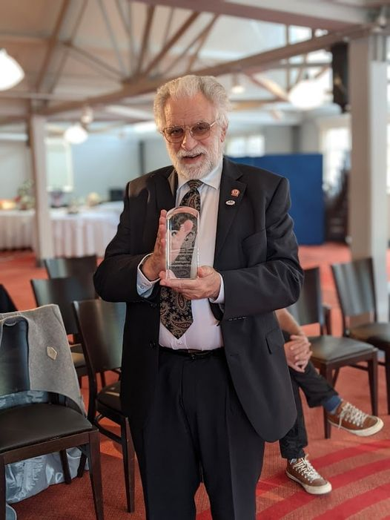
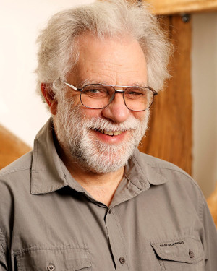
Still Going Strong…
Geoff Streeter wrote Dyalog APL v1.0 in 1981-1983 together with John Scholes
Geoff is in good health
(Now working 3-4 days / week)
And still volunteering at night…
BUT: He has announced that he intends to retire in April'23

Slide 5
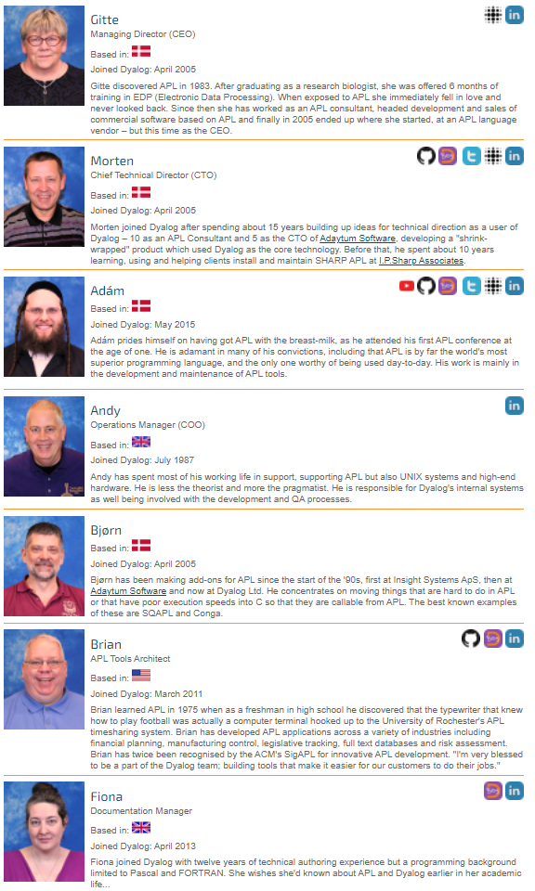
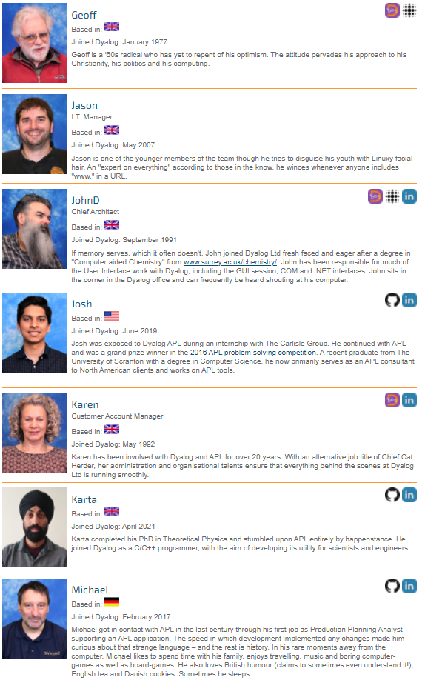
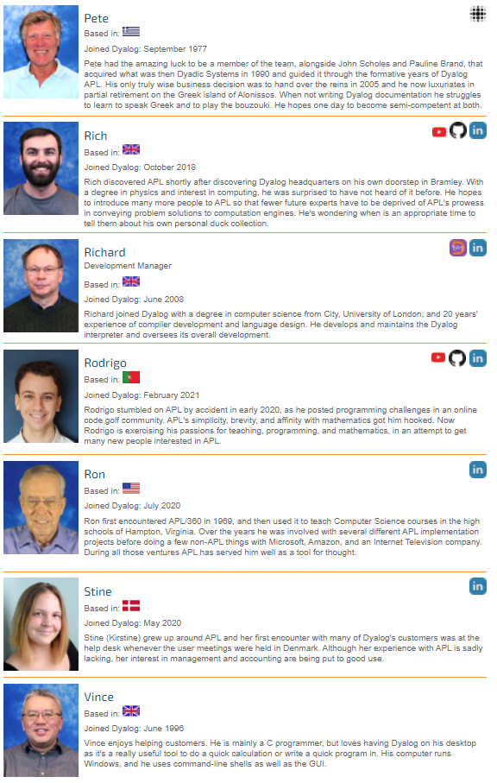

Slide 6
Dyalog … The Next Generation
Adam APL
Rich Education
Josh Consultant
Rodrigo Education
Stine Accounting
Shuhao Interpreter
Karta Interpreter

Slide 7
Next Generation, Continued…
?
?
We planned to recruit a tester and one more interpreter developer in 2022

Slide 8
Next Generation, Continued…
?
?
?
Now, we plan to recruit a tester and two more interpreter developers in 2022

Slide 9
Some quotes from recent applicants…

Slide 10
Passionate about APL, able to create non-trivial applications with it. Improving my tacit, leading-axis, and array-oriented skills daily. Active on Stack Overflow, the APL Orchard, and in the APLFarm, I enjoy teaching, helping, and problem solving with others when given the opportunity.

Slide 11
I’ve recently discovered APL and other various array languages and projects around them.
Would be amazing to work for Dyalog, implementing and improving core feature set. I’m aware don’t have great deal experience with large codebases but have enjoyed exploring Plan 9’s source code and understanding how sections fit together.

Slide 12
The area in computer science that interests me the most is programming language design and implementation. I have written a few interpreters in my spare time for Prolog and for APL. I am always interested in learning new topics in computer science and learning new ways to apply my knowledge. Last year I participated in the Dyalog APL Problem Solving Competition and won a phase 1 prize, and I am also participating this year again.

Slide 13
All these applicants (our two most recent hires before that) approached us to inquire about work at Dyalog.

Slide 14
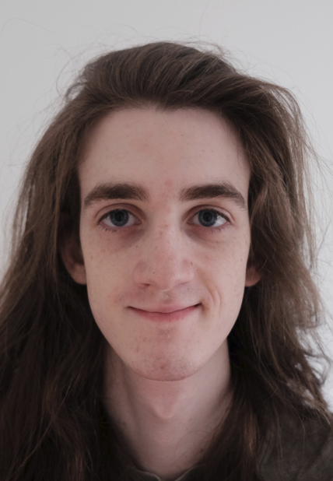
Dyalog … The Next Generation
?
?

Slide 15
The Next Big Thing
No, not more product features…
MUCH more documentation, samples and tutorials
(there will also be lots of features too, of course)

Slide 16
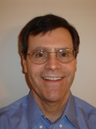
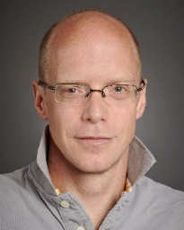
Training Materials
mastering.dyalog.com Rodrigo Girão Serrao
course.dyalog.com Rich Park
tutorial.dyalog.com Gary Bergquist + Andrew Sengul
xpqz.github.io/learnapl Stefan Kruger (IBM)
Adam Brudzewsky (here, there and everywhere)

Slide 17
The Next, Next Big Thing
Package Management

Slide 18
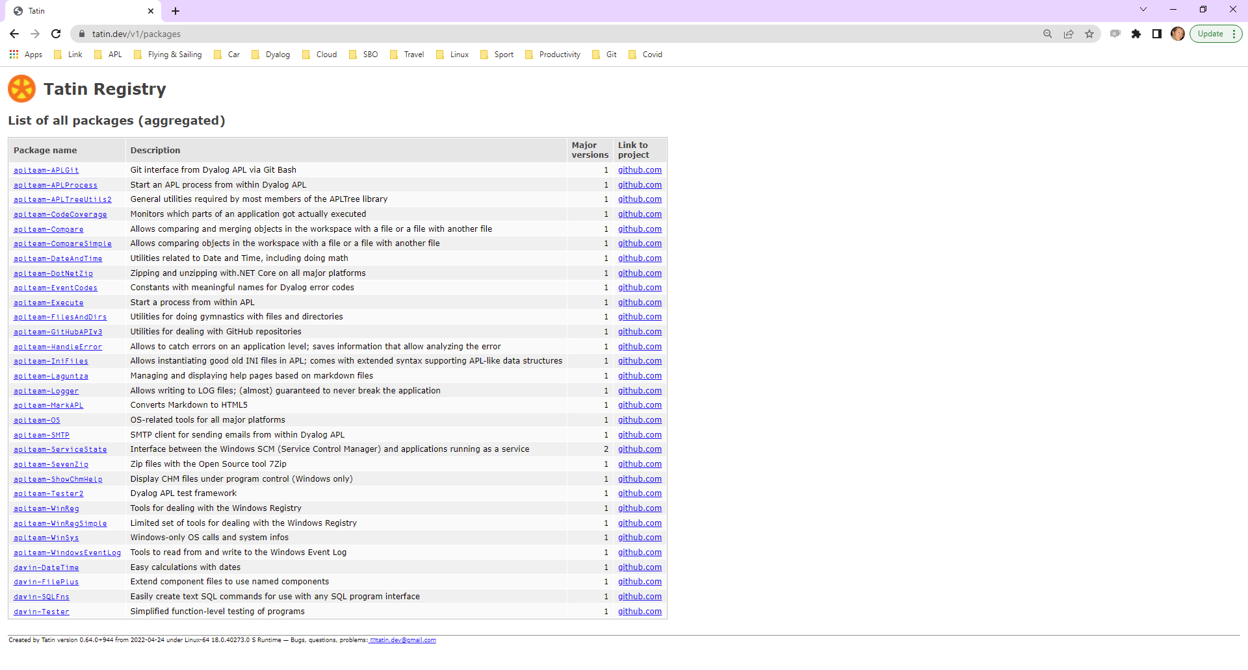
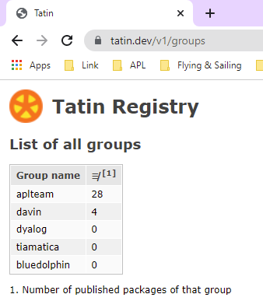

Slide 19
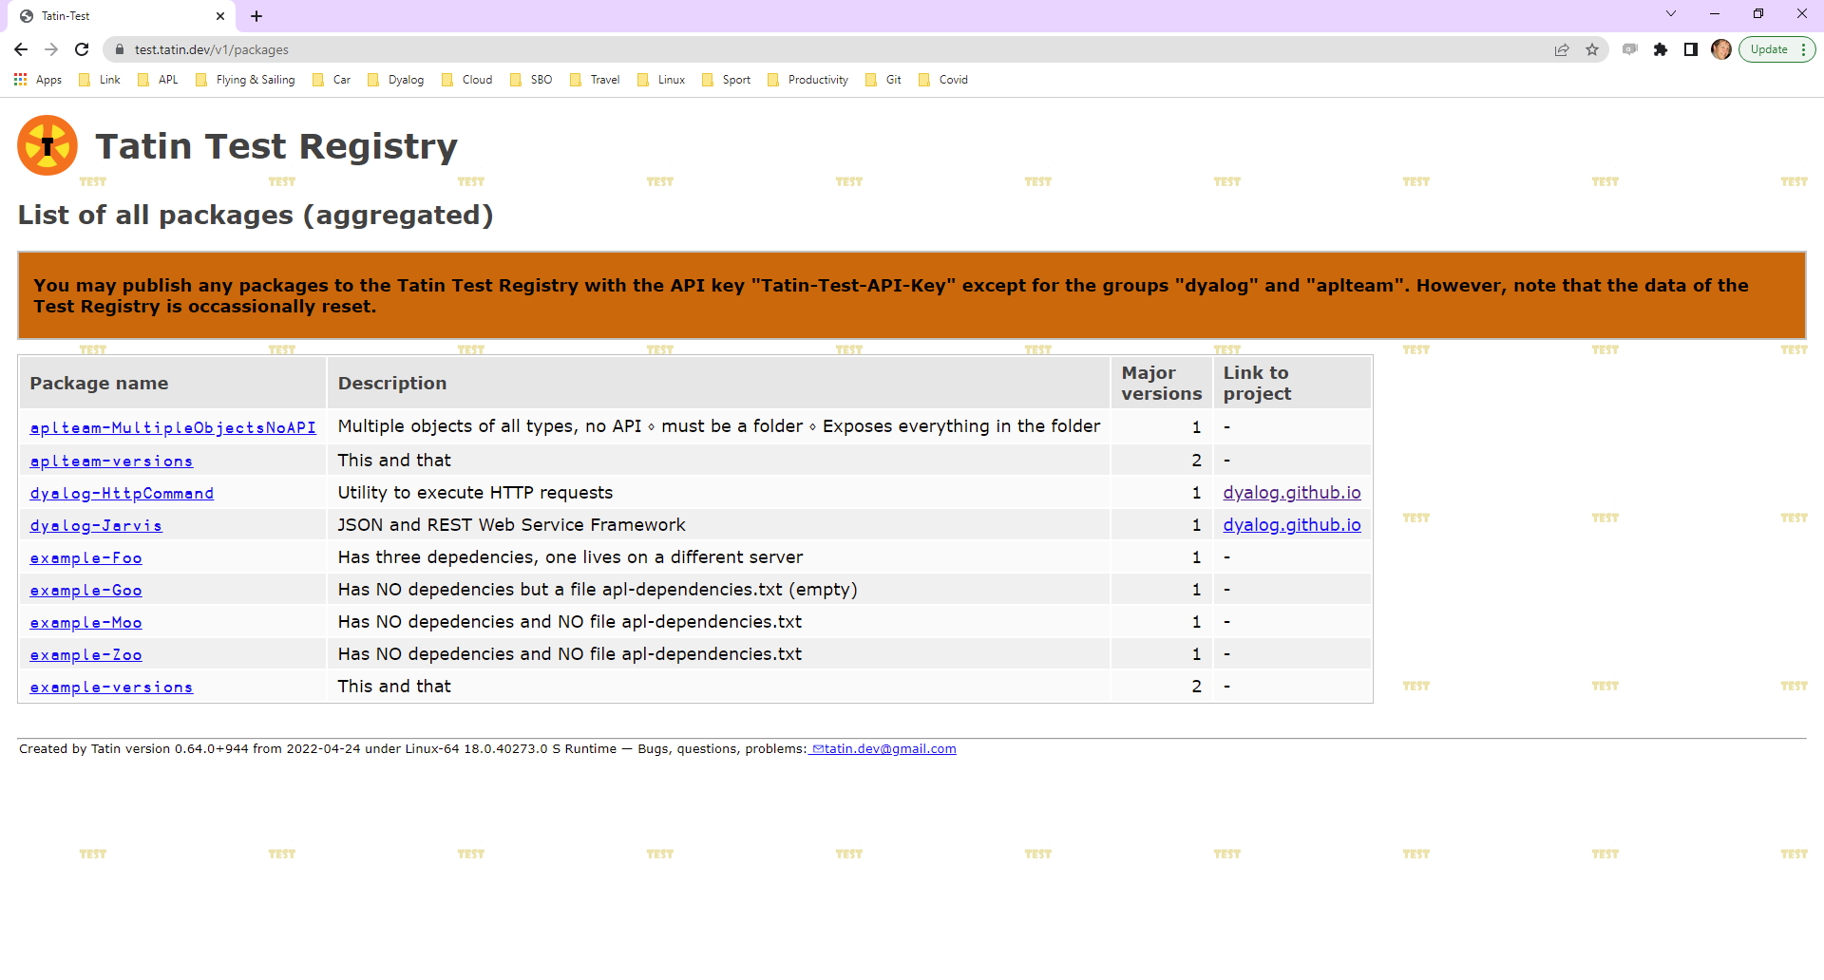

Slide 20
The other Big Thing
Package Management
Demo tomorrow

Slide 21
Recap of v18.2 (March 2022)
Windows Patches
Basic Licence
Launching from Text Files:
Shell Scripts
Text Source
LOAD Parameter
Windows Explorer Integration
Improved Docker Support
RIDE v4.4
Developer Productivity:
JSON tables/datasets
⎕ATX metadata one-stop-shop
Generating random numbers
New user commands

Slide 22
Windows Patches
Updates delivered as Microsoft Patch files (MSP) under Windows
Allows patching ALL components of Dyalog installation including APL code & docs
All components were already patched by re-installing on non-Windows platforms

Slide 23
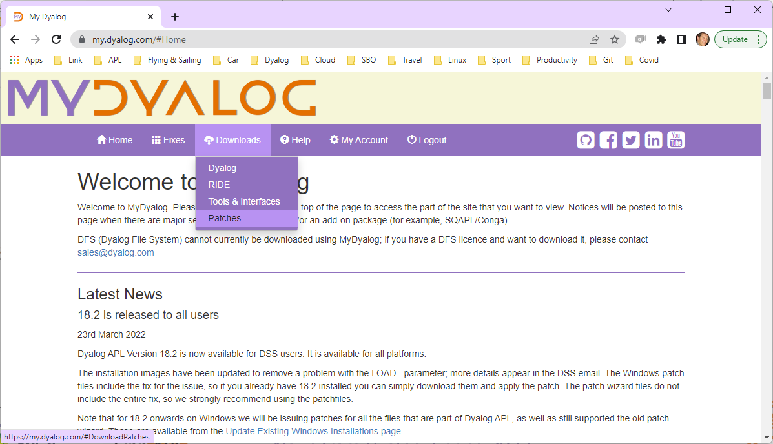
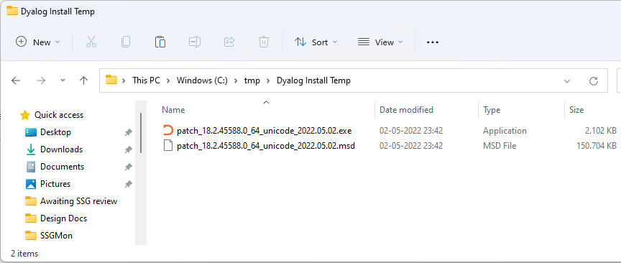
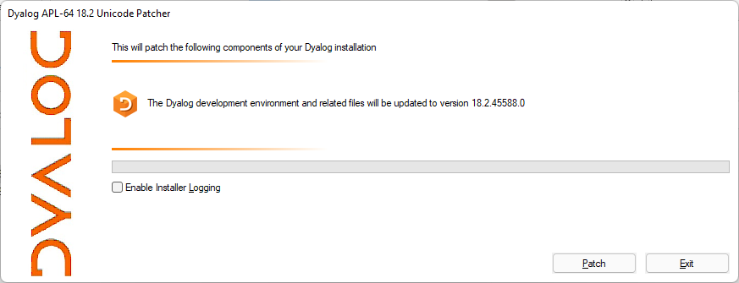

Slide 24
Basic Licence
Possibly the most important v18.2 "feature"!
Intended for:
non-commercial use
education
personal projects
experiments
sharing your experience
proof of concepts / trials
participating in programming competitions for cash prizes
fun

Slide 25
Basic Licence
Replaces non-commercial licence
Allows distribution of Dyalog along with your work, under the default royalty licence
Fee is 2% of gross APL-based revenue
No fees due if revenue < GBP 5,000 in a calendar year
Multiple alternative commercial licence schemes are available
For GBP 150 per year, you can subscribe to the Dyalog Support Service (DSS)

Slide 26
Launching from Text Files
Another important 18.2 theme …
Shell scripts
LOAD= parameter supports starting the interpreter directly from text source
Link properly settling down with v3.0
Windows Explorer Integration
Improved Docker support
… demo tomorrow …

Slide 27
RIDE v4.4
Debug multi-threaded applications
Language bar and Help adapts to Dyalog version
Save responses to prompts
… and many more tweaks and fixes, see https://github.com/Dyalog/ride/milestone/4?closed=1

Slide 28
Developer Productivity:
JSON tables/datasets
⍝ Convert "Inverted" Matrix to JSON fields ← 'Item' 'Price' 'Qty'
items ← 'Knife' 'Fork'
price ← 3 4
qty ← 23 45
fields⍪⍉↑items price qty
┌─────┬─────┬───┐ │Item │Price│Qty│ ├─────┼─────┼───┤
│Knife│3 │23 │
├─────┼─────┼───┤
│Fork │4 │45 │
└─────┴─────┴───┘
inverted ← 4 ⍝ Data Format Code data ← items price qty
table ← ⊂ inverted (data fields)
(⎕JSON⍠'Compact'0)table
[
{
"Item": "Knife",
"Price": 3,
"Qty": 23
},
{
"Item": "Fork",
"Price": 4,
"Qty": 45
}
]

Slide 29
Developer Productivity:
⎕ATX metadata one-stop-shop
Unifies:
⎕SIZE Size of Object
⎕NC Name Classification
⎕NR Nested Representation
⎕SRC Source
⎕AT Attributes
5179⌶ Loaded Object Info
Additional metadata:
Last edit UTC
Source "as typed"
Normalised source
Best available source
More to come…

Slide 30
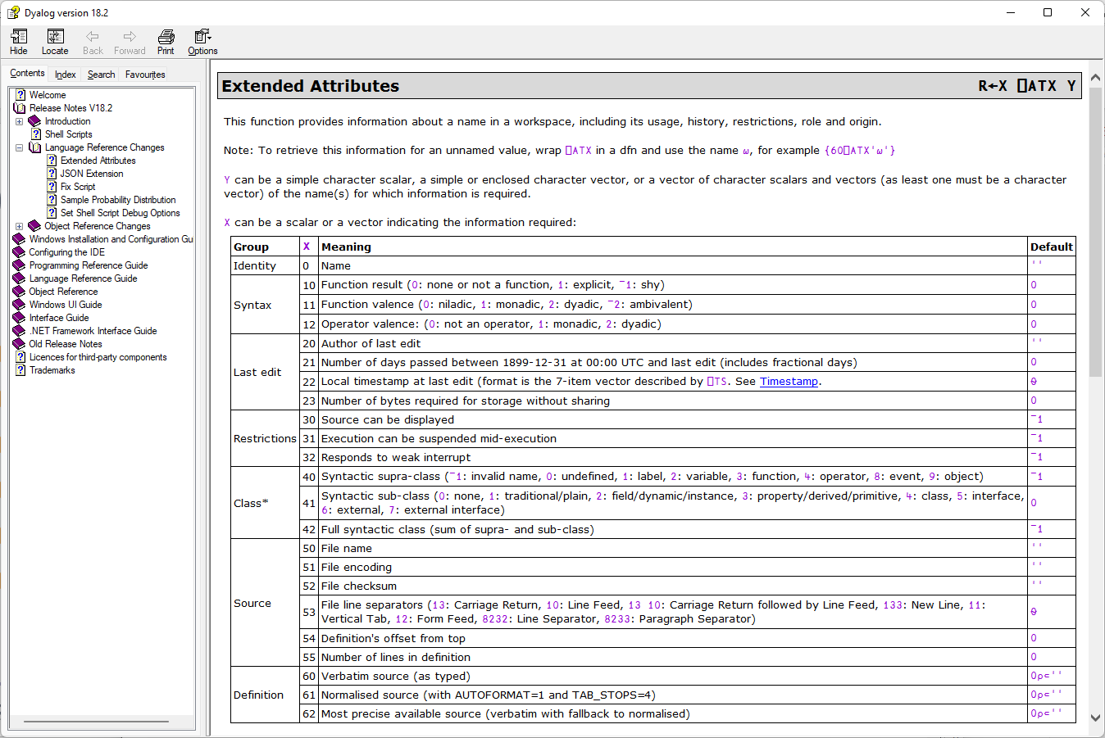

Slide 31
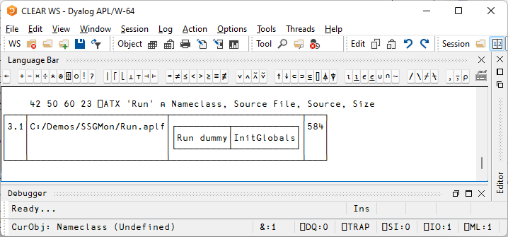

Slide 32
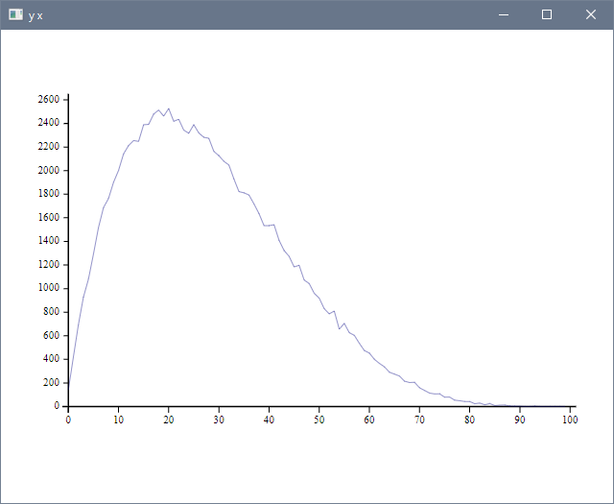
Developer Productivity:
Generating random numbers
Dist ← 16808⌶
val ← 2 5 Dist 'Beta' 1e5
res ← 100
bin ← ⌊res×val
x ← ¯1+⍳res
y ← {≢⍵}⌸x,bin
]plot y x

Slide 33
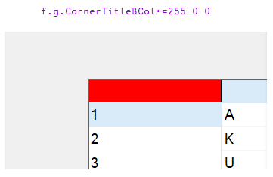
New Win32 GUI (⎕WC) features!!!
CornerTitleBCol on Grid
FireOnce on Timer

Slide 34
Developer Productivity:
New user commands

Slide 36
Service Orientation
A rapidly increasing share of new APL code (and some old code) is exposed as services
Jarvis wraps APL code as HTTP/JSON or RESTful services on any platform
https://github.com/dyalog/jarvis
Version 18.2 is easier to deploy and debug as a “headless” service
Allows improved docker containers
HTTP(s) / JSON

Slide 37
Summary – Version 18.2
Windows Patches
Basic Licence
Launching from Text Files:
Shell Scripts
Text Source
LOAD Parameter
Windows Explorer Integration
Improved Docker Support
RIDE v4.4
Developer Productivity:
JSON tables/datasets
⎕ATX metadata one-stop-shop
Generating random numbers
New user commands

Slide 38
Version 19.0 and Beyond
Everything mentioned in the following is a statement of intent…
Version 19.0 release target = 1 year after 18.2, or March 2023

Slide 39
Planned Features of v19.0
.NET 6 bridge
I/O re-implementation
Improve Installers
Keyboarding on all platforms
Arm64 (M1 Mac & Pi)
Monitoring / Heath Checks
Optimisation work
Portable File Functions
HTMLRenderer improvements
Session initialisation
Configuration

Slide 40
.NET 6 Bridge
Export APL code as .NET assemblies
Create executables under
Linux: Amd/Intel x64 and Pi on Arm64
macOS (x64 and M1)
Windows (x64 – maybe Arm64)
(maybe Android on Arm64 soon)
V19.0 should also support .NET 3.1, 5 and 7

Slide 41
.NET 6: Asynchronous Features
Asynchronous function calls have appeared in many languages
C# / .NET use is widespread
V19.0 work on the .NET bridge will hopefully include Async support
"futures" may be a natural solution
Already used by isolates for asynch processing

Slide 42
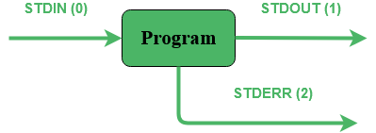
I/O re-implementation
(completion of support for shell scripts)
Allow control over whether I/O streams are connected to RIDE or redirected files
(allows RIDE debugging of APL shell scripts)
aplscript.apls <data

Slide 43
Installation Issues
Linux-style installation for macOS
(most Mac APL users are really using the Mac as a very cool UNIX workstation)
Remove "termcap" dependency
(Varies from one Linux to the next)
Make HTMLRenderer easily upgrade-able
(new version of Chromium without reinstalling APL)

Slide 44
Keyboarding on all platforms
Quite simply: We need to review how APL symbols are entered into APL - and other applications
The way Windows handles keyboards is changing – IME no longer works with all Windows 10 apps
"ctrl" as the APL key is more and more problematic
We need to provide more easily configureable options, and much better documentation

Slide 45
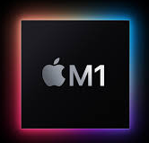
Arm64 (M1 Mac & Pi)
ARM64
64-bit ARM chips are appearing in important places that Dyalog should support:
New "M1" Macs
Raspberry Pi – 64 Bit
We will also look at, but are unlikely to add official support in v19.0
ARM based Windows
Android

Slide 46
Health Checks
Tools to monitor the state of APL processes
CPU consumption
Memory usage, Compaction counts, etc
Are any threads suspended?
)SI and Error information
Available via API and or protocols like SNMP
Important as APL becomes more widely used to implement multi-process services

Slide 47
Optimisation work
Identify and carefully implement most valuable (disabled) v18.0 optimisations
Continue work on adding new idioms, special cases of rank and other operators
(resume steady performance work, following new process)
PLEASE send us your application benchmarks!

Slide 48
[Portable] File Functions
⎕NCOPY to allow a regular callback, so you can cancel long-running ops
⎕NATTRIBUTES to set e.g. timestamps, read-only/hidden and other attributes
⎕NINFO recursion depth option

Slide 49
HTMLRenderer improvements
Find a way to easily upgrade the version of the Chromium Embedded Framework
Possibly turn the HTMLRenderer into an Open Source project
Multiple Modal Instances
(only allow access to one window if required)
Thread switching in OnHTTPReceive and OnWebSocketReceive to allow threaded GUI apps

Slide 50
Session initialisation mechanism
Re-implement the way that the session object (⎕SE) is populated at startup
Completely separate Dyalog content from user content with no risk of conflict
(and no need to reinstall own content when APL is upgraded)
Design a declarative way to add user-defined menu[item]s and widgets
User Command implementation will also be reviewed

Slide 51
Configuration
Move towards portable configuration
Remove need for a startup script under 'NIXes
Good defaults for all settings
All settings configurable via text files
Remove need for the Windows Registry
(Windows APL already has good defaults)
Move all "interpreter settings" to config files
Leave IDE settings in the Registry (as RIDE settings are in a JSON repository)
This might not make 19.0, but remains an important short term goal.

Slide 52
Recap - Planned Features of v19.0
.NET 6 bridge
I/O re-implementation
Improve Installers
Keyboarding on all platforms
Arm64 (M1 Mac & Pi)
Monitoring / Heath Checks
Optimisation work
Portable File Functions
HTMLRenderer improvements
Session initialisation
Configuration

Slide 53
Improving "Cross Platform" capability & similarity
.NET 6 bridge
I/O re-implementation
Improve Installers
Keyboarding on all platforms
Arm64 (M1 Mac & Pi)
Monitoring / Heath Checks
Optimisation work
Portable File Functions
HTMLRenderer improvements
Session initialisation
Configuration

Slide 54
Beyond 19.0
Array Notation
Multiple numeric towers
Under ⍢
Simple cross-platform user interfaces

Slide 55
Array Notation
Final Community review of spec before implementation
['Jan' 'Feb' 'Mar'
(101 102 103 104) (201 202 203 204) (301 302 303 304)]
┌→──────────────────────────────────────────────────────┐ ↓ ┌→──┐ ┌→──┐ ┌→──┐ │ │ │Jan│ │Feb│ │Mar│ │ │ └───┘ └───┘ └───┘ │ │ ┌→──────────────┐ ┌→──────────────┐ ┌→──────────────┐ │ │ │101 102 103 104│ │201 202 203 204│ │301 302 303 304│ │ │ └~──────────────┘ └~──────────────┘ └~──────────────┘ │ └∊──────────────────────────────────────────────────────┘

Slide 56
Under ⍢
Computational Under: Mathematical definition
⍺ f⍢g ⍵ ←→ (g⍣¯1) (g ⍺) f (g ⍵)
2 3 4 +⍢⍟ 2 4 6 8
Structural Under: Less strict, but "more useful"
1 ⎕C⍢(⊃¨) 'adam' 'karta' 'nathaniel'
Adam Karta Nathaniel
Also to come… Obverse: FFT⍫IFT (declared inverse)
Depth: f⍥n (f on depth-n sub-arrays)

Slide 57
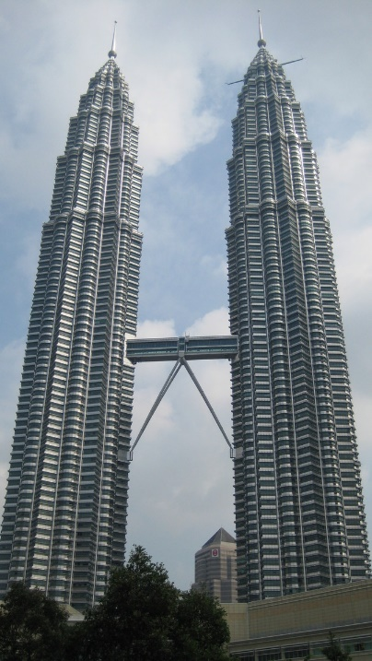
Enhancing APL: Multiple Towers
Goals:
Better control of DECIMAL data type
Accommodate INT64 and RATIONAL types
Model: Three Towers, selectable per array
Fast: BOOL, INT 8-16-32, DOUBLE, COMPLEX
Decimal: BOOL, INT 8-16-32-64, DECF
Unlimited: RATIONAL
Significant design remains to be done on notatation, rules for comparison and promotion. What is: (∪0.1D,(1÷10),1R10)

Slide 58
Quest for the Holy Grail
Lucasfilm, Ltd.

Slide 59
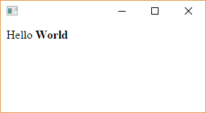
Simple Cross-Platform User Interfaces
'hr' ⎕WC 'HTMLRenderer' 'Hello <b>World</b>'
The challenge is generating the HTML/JS…
Our "DUI" has not yet caught on
Perhaps the community can help?

Slide 60
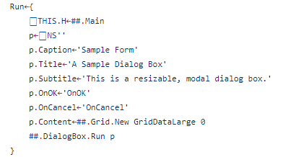
GitHub: the-carlisle-group / Abacus
Project to generate HTML from simple APL code

Slide 61
Web Assembly (WASM)
We could compile Dyalog APL to run in the browser. (some features would need to be disabled)

Slide 62
Conclusion
Although improving documentation, samples and training materials is at least as important
… and Packages …
… we are not about to run out of ideas for ways to improve Dyalog APL and it's tooling

