Slide 1
FinnAPL 2024
Dyalog Licences
Jada Andrade

Slide 2
Introduction
Who am I?
What do I do at Dyalog?
What will I be presenting on?
Notes:
Who Am I? – I mean this literally, not in a philosophical sense. My name is Jada, and I’m an administration assistant at Dyalog Ltd. I’m based in the UK, in the Bramley Office.
What Do I Do at Dyalog? – I handle the day-to-day administration of the business including licence renewals, invoicing, keyboard sales and general event facilitation. I’m also the ‘office manager’ so issues like maintenance and facility management fall under my remit. My educational background is in Law with Politics, so I’m also the de facto ‘head of legal’ (not a real title) which means I occasionally deal with compliance and contracts
What Will I Be Presenting On? – You can think of this presentation like 2 mini presentations in 1. The first half will be about the Dyalog APL Developer Licence restructure, which came into effect January 2024. The business and technical rationale for this – and what this means for our shared future as suppliers and users of Dyalog APL. The second half of this presentation will be about all an update on notable changes that have happened in Dyalog this year. The fun and exciting stuff.

Slide 3
The basics
Legal software use and distribution - https://www.dyalog.com/prices-and-licences.htm
Developer licences
Runtime licences
Special contracts
Notes:
The Basics – What is a Licence?
Everyone is this room knows what a software licence is but I’ll define it anyway. A software licence is essentially a contract between the user and the owner of a software which dictates the user’s rights to use the software and the criteria to have those rights. Without a licence, the user has no right to use the software.
•Developer Licence = Basic (free) and commercial licences - single user to run the Dyalog development environment
•Runtime Licence = a licence to distribute Dyalog with your work – e.g. Dyalog being used to implement a multi-user application or Dyalog is used as a platform for applications which you distribute outside of your organization.
Types of runtimes include Royalty based, server based etc. They can be priced based on several metrics including number of users, the number of servers or cores, the number of files being downloaded etc. – if the predefined licence types don’t fit a customer’s needs then we can make bespoke agreements based on another identifiable metric.
Special contracts = Bespoke, personalized agreements. We want to be accommodating, and it should be easy to have a licence structure that fits you. So, maybe be services not advertised or priced on our website because they’re dependant on the specific details that we may include in a special agreement such as application mirroring or an escrow clause. The point is – if there is a service we can provide for a fair price, then we will. Our ability to be flexible and meet our customers where they’re at is what sets us a part and the type of ‘white glove’ service we pride ourselves on.
Cloud based = contact us if you are thinking about creating or distributing a cloud based runtime. Again, this is one where after discussing how your cloud based application is used we can think of an agreeable metric. We don’t any current customers using a cloud based runtime pricing model, however we have had some inquiries so we’re looking in to metrics.

Slide 4
The current licence structure
Subscription based model
One licence type
32bit only – deprecated
One price - £1,375 per licence
Incremental price increase option
*Special Contracts – not affected
Notes:
•Subscription based model – All currently available Dyalog licences are on an annual subscription basis, and have been for a while now – meaning that rights to use the software are not indefinite and depend on the licensee paying fees every year.
Any historical licence holders?
•One licence type – The new licence is a single type of commercial developer licence. It’s multi-platform and includes 32-bit and 64-bit Unicode versions. Supported platforms are Microsoft Windows, macOS, and Linux. The multi-platform developer licence also includes DSS+. We have completely deprecated 32bit standalone products from our offerings. This means from 2024 onwards customers are no longer able to purchase purely 32bit products or services. Everything we offer is inclusive of both 32 and 64bit.
•One price – £1,375.00GBP per licence, per year.
•Incremental price increase option - Every 32-bit licence holder was also offered an alternative payment plan – a gradual price increase over 5 years to upgrade to multi-platform developer and runtime licences, to ease them into the new pricing. Our biggest concern was alienating customers with this price increase. Dyalog prices hadn’t changed in 15 years, and we wanted to ensure that the cost jump of going from 32bit to multiplatform wasn’t a hindrance to anyone’s use of APL.
Special contracts – mention preexisting agreements

Slide 5
The old licence structure
Licence Type | 32-bit | 64-bit
Microsoft Windows (cost per annum) | £850 | £1,275
macOS/Linux (cost per annum) | - | £1,275
Windows, Linux & macOS (cost per annum) | - | £1,375
AIX (cost per annum) | £1,275 | £1,875
Notes:
Slide 3 – The old licence structure
•This was the old licence structure.
•Disadvantages of the old structure:
-Decisions had to be made – and people aren’t always great at making decisions. It was sometimes difficult for customers to understand what they needed, especially if they weren’t the end user.
-It forced some customers to stay on the same platforms because they were cheaper – so it didn’t offer enough flexibility and was too constraining, and would force decisions due to budget constraints (which is not what development decisions should be made based on.) We had customers who’s end users WANTED to change to 64bit environment, but due to the number of 32bit licences they had and the price difference to change, their IT department were reluctant for many years to allow them to upgrade.
-Less room for change if the platform on which you needed to work on changed. For example, if you developed on Windows (so you had a Windows licence) but you later on discovered you actually need to test on Mac then you had to get another entire licence!

Slide 6
The new licence structure
Licence Type | 64-bit
Multiplatform Developer Microsoft Windows, Linux, macOS (cost per annum) | £1,375
AIX (cost per annum) | £1,875
1 January 2024
Simplified
Single Commercial Developer Licence Type
Notes:
As of the 1 January 2024, the old licence structure has been retired.
We have simplified the licence structure for commercial developer licences and now offer a single, multi-platform, developer licence. AIX is more expensive because it’s a particularly special platform.
Why did we feel the need to update the licence structure?

Slide 7
Rationale – Making it easier for customers
Less influence on architectural choices
Current development trends
Streamlined procurement
Notes:
•Less influence on architectural choices – we want to guide and encourage our customers towards the future. We want to remove hindrances such as financial considerations from the development process. The structure/pricing of licences shouldn’t affect the architectural choices our customers make, especially if end users in large corporations must plead their cases to ‘bean counters’ who care more about cost cutting. With a one size fits all licence type we are able to give developers as much choice and flexibility as possible. This allows us to continue legacy support while encouraging our customers to develop with the future in mind.
•In line with current development trends – Asked MK for the technical reasoning for this change and this is what he had to say. ‘Technology has moved on: majority of other software tools have already moved to 64-bit. Not only does this mean that it is difficult to install, maintain and test 32-bit versions of the components that Dyalog APL uses and integrates with, we also encounter more bugs in these components because most developers have mentally moved on, and find it hard to think about 32-bit limitations. Also, since the body of users is now very small, 32-bit components get much less testing in the field.’ With that in mind, the new licence model users will be able to have one licence that allows them to develop on different platforms – for example you can use the same licence on your LINUX machine at home as your Windows machine in the office. Users will be able to develop on one platform but be able to test or deploy on another platform. We’re hopeful that this will encourage development across all supported platforms for a richer/more diverse APL ecosystem.
•Streamlined procurement and renewal process for all parties - End users, resellers and procurement departments will no longer have to read an entire page of information regarding licence types – there will be one type of commercial licence available which will streamline the renewal and procurement process for all involved. Easier for all customers to navigate the website

Slide 8
Rationale – Future Proofing
Future proofing Dyalog
Investing in our growing team! More hands = getting more done!
Increased costs in running a business
Notes:
•Future proofing Dyalog – To ensure a future, Dyalog must grow and the greatest resource at our disposal is our people. Decades of technical, business and internal processes can’t be handed over in a short time. Which means we must…
•Investing in our growing team! – We believe the people are our future. Without young, capable and passionate people Dyalog won’t be around in the next 20 years – that is why we’re being proactive and growing the team in all departments – tools, testing, development, IT, administration etc. We want to continue to be the premier one stop shop for all your APL needs without having to outsource any aspect to people who just don’t care as much as we do.
•As we grow to meet more customer needs we’ve seen an increased costs in running a business – this is a fact of the global economy and inflation. Prior to this licence restructuring Dyalog hadn’t changed their prices in approximately 15 years! I would have been about 12 years old then. Increasing our prices ensures that we’re able to provide the best services possible to our customers.

Slide 9
How has this played out?
Active 32-bit licence holders contacted
Detailed information provided
Two options offered
Everyone has upgraded! Yay!
Notes:
•Active 32-bit licence holders contacted – Customers with active 32-bit licences have:
O All been contacted with detailed information regarding how many 32-bit licences they have, and
O been offered two options:
1. The cost of up-front payment to upgrade to multiplatform developer licences
2. A 5-year incremental price increase to upgrade to multiplatform developer licences slowly, with the cost spread out evenly over those 5 years.
• Everyone has upgraded! Yay! Only about 2 customers with multiple 32bit licences entered in the 5-year slow price increase.

Slide 10
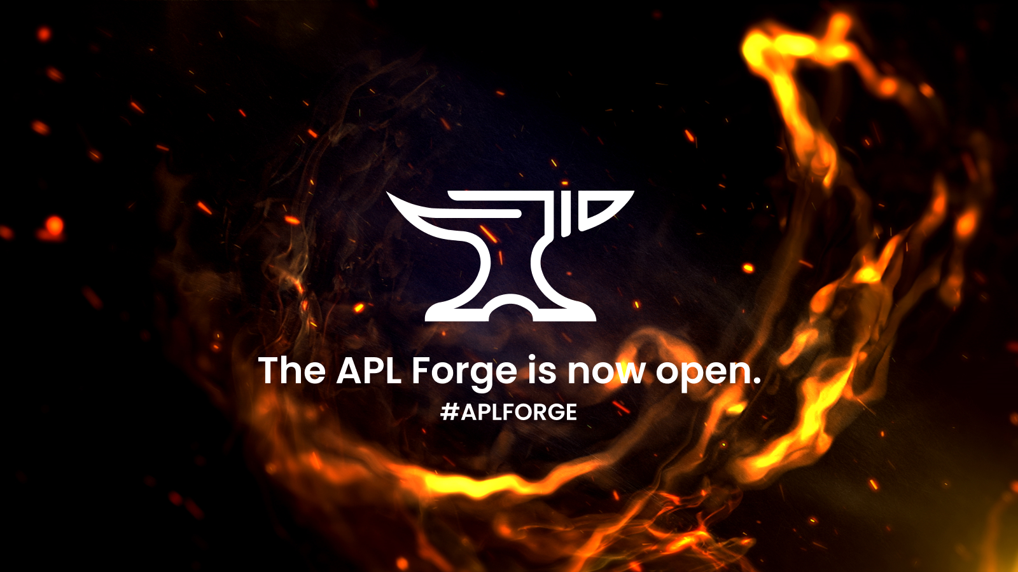
Dyalog is doing big things
The APL Forge
https://forge.dyalog.com/
Notes:
•The APL Forge is a new initiative launched this year to encourage the organic development of a diverse APL ecosystem.
O Annual competition for innovative open-source libraries, commercial applications and tools.
O Prizes: £2,500 GBP, an expenses-paid opportunity to present at our next user meeting, and a commercial licence valid for one year. We will also help you to take your application into production (if relevant).
O Eligibility: Individuals, groups, or companies can participate if they meet certain conditions – the criteria include being 16 years or older, registered for a free Basic licence for Dyalog, and not an employee, contractor, or otherwise directly associated with Dyalog Ltd.
O The deadline for submissions for the current round of the APL Forge is Monday 23 June 2025 at 12:00 UTC.
O More information on ideas for submissions, judging criteria, and previous winners can be found at the website.

Slide 11
Dyalog is doing big things
https://www.youtube.com/@DyalogUserMeeting
The APL Forge
Notes:
Highly recommend going to Dyalog User Meetings page on Youtube for all recorded User Meeting presentations.
First winner of the Forge: Holden Hoover’s presentation from Dyalog ’24 on his Real-Time Data System called the Radar Ingest System – an application that processes raw data from antennas to create a database of aircrafts.

Slide 12
Dyalog is doing big things
The APL Challenge
https://challenge.dyalog.com/
Notes:
•The APL Challenge it’s the successor to the annual Student Competition and is a completely different beast than the long running one you may be familiar with.
oThere are four rounds of the APL Challenge each year.
oYou don’t need to participate in an earlier round to participate in the current one.
oEach round has ten problems and runs for three months. The questions start off very easy and get progressively more complex.
oPrizes: three winners awarded $100 (USD), chosen at the discretion of Dyalog
oEligibility: Anyone can win a prize except Dyalog employees and associates.
oThe target audience for this is geared more towards beginner APL’ers, especially young people – the questions are designed to teach the participant APL principles as they go along without needing many resources outside of the problem questions themselves. Especially good opportunity for students so if you have any young family members that you would like to introduce APL to this is a great starting point! We want this competition to be as accessible as possible – which means having more available languages, including Finnish. Fi will explain more at the end.

Slide 13
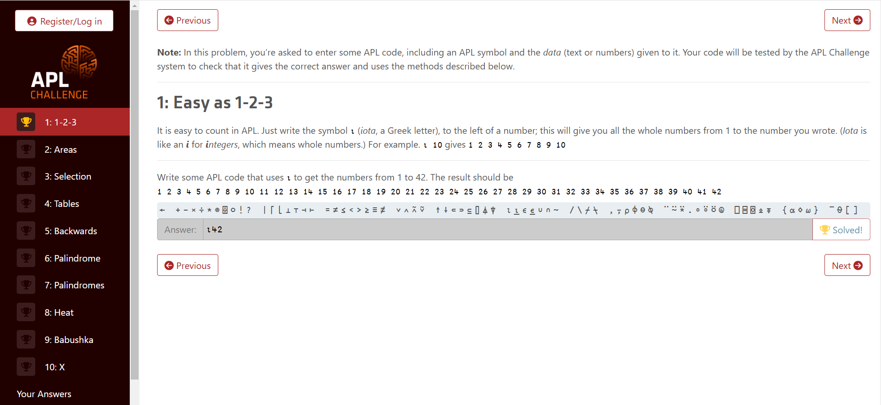
https://challenge.dyalog.com/

Slide 14
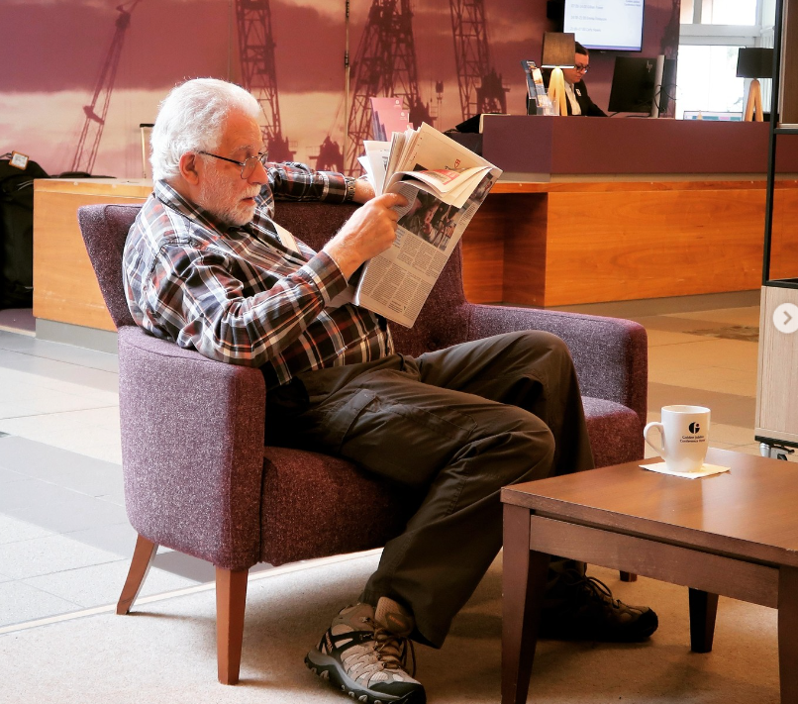
Dyalog is doing big things
New faces in 2024
Martina Crippa (DK/IT)
Karl Holt (DK)
Neil Kirsopp (DE)
Andrea Frederiksen (DK)
Brandon Wilson (JP/USA)
Notes:
•New faces in 2024 – As previously mentioned, team Dyalog has been growing in various departments. These are some of our latest additions as of this year. They’re all working on various projects including Kafka interfaces, KendoGrid component, APL+WIN migrations, assisting executive level employees, planning the next User Meeting in 2026 and hopefully in the future consulting!
•Many of them are finding their feet and seeing what type of niche they can fit in to, we have plans to send more people out to meet customers face to face – especially at events like the upcoming North American DYNAS and various APL meetups.
Some of you may know that Geoff (pictured here) has retired – however, many of the old guard are still here and will be for the foreseeable future, so we’re in good hands.

Slide 15
Dyalog is doing big things
The APL Forge
The APL Challenge
New faces in 2024
New CEO!
Notes:
• Stine Kromberg is the new Managing Director of the company, who will most likely be attending the Spring FinnAPL Meeting – so if you haven’t met her, please look forward to that. She’s committed to the same direction and the same values, continuing to support our users while helping to train the next generation. She is taking a hands-on approach to her management style, that is employee and customer orientated.
So while there a lot of new initiatives, lots of changes and new faces, we are staying on the same steady course.

Slide 16
Conclusion
No more standalone 32-bit products!
Social media: Get involved! Share knowledge!
Secure future!
Notes:
•So, in conclusion, times are changing and we’re adapting to that:
•Technology has moved on, and we have encouraged our customers to move on with it, to allow us to concentrate our efforts on modern platforms. Our efforts have been very successful!
•Therefore, we no longer offer any 32bit standalone products.
Social media: keep the online APL community alive and active! This is where the new APLers are, and they need your help.
Remember to check us out on social media – just search Dyalog APL
•New leadership, new deck hands on the ship. We are looking towards a secure future for our customers – which means growth, scale and development.

