Slide 1
Isolates in the Cloud
Morten Kromberg

Slide 2
Or: Parallel Cloud Computing with Dyalog APL

Slide 3
Parellelizable Code (Thanks to Sampo Lappo)
first_taxrate←0.5×¯1+⍳39 result←first_taxrate,⊃CALCULATE_GINI¨first_taxrate
2 seconds per CALCULATE_GINI
× 39 initial tax rates
= ~80 seconds

Slide 4
The Pieces …
External Client
Container Image
APL Code
& Data
Cluster (Elastic Container Services)
Service (scalable)
Task
Definition
Subnet
Capacity Provider (FARGATE)
Security Group
Running Task
Running Task
Running Task

Slide 5
Before we start…
Create an account at Amazon Web Services (AWS)
Install and configure the Command Line Interface (AWS-CLI)
Install Docker
All of these steps are described in the materials for Dyalog'22 workshop "SP2"

Slide 6
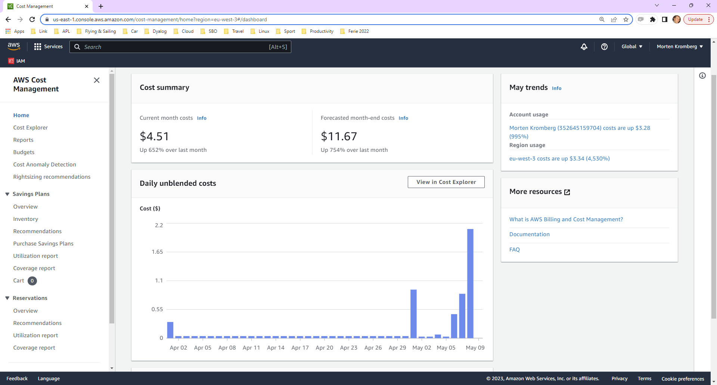
Yesterday: $2

Slide 7
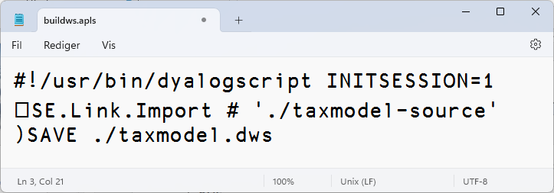
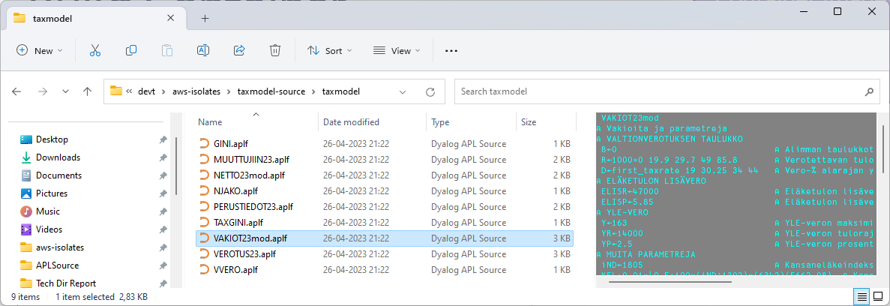
(Re)Create Workspace
Container Image
APL Code
& Data

Slide 8
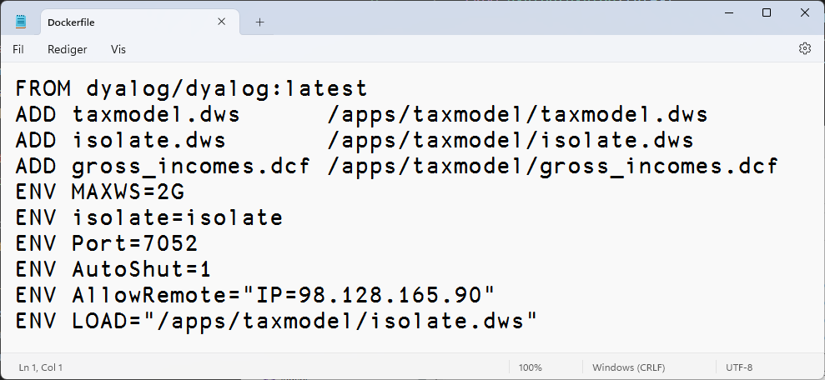
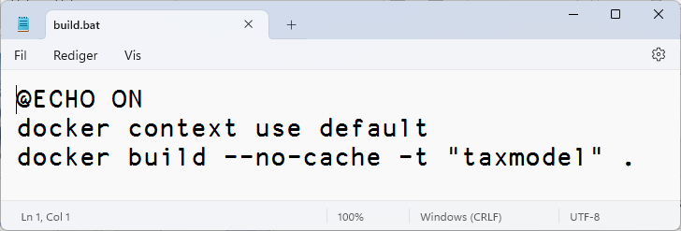
Build Container
Container Image
APL Code
& Data

Slide 9
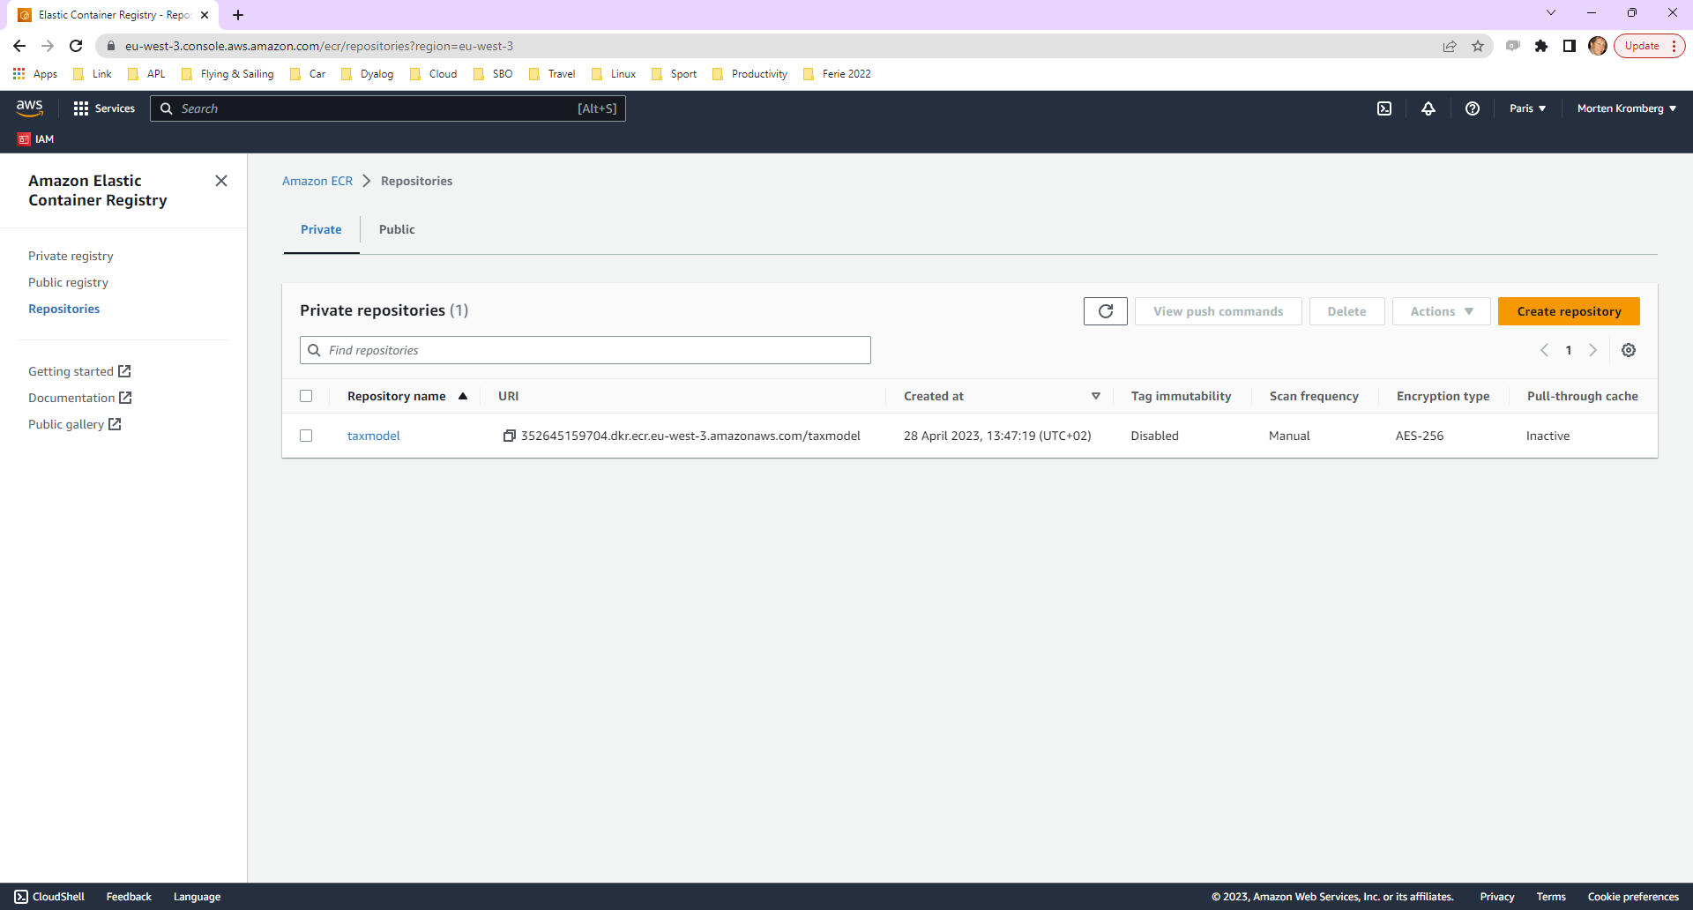
Push Container to Elastic Container Registry
Container Image
APL Code
& Data
✓

Slide 10
The Pieces …
External Client
Container Image
APL Code
& Data
✓
Cluster
Service (scalable)
Task
Definition
Subnet
Capacity Provider (FARGATE)
Security Group
Running Task
Running Task
Running Task

Slide 11
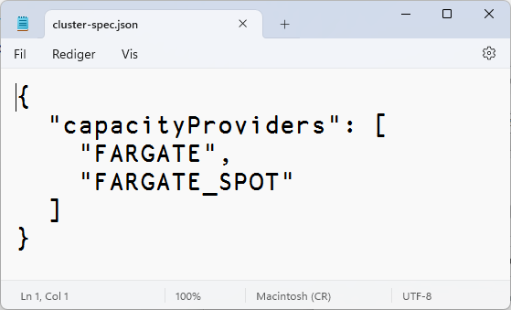
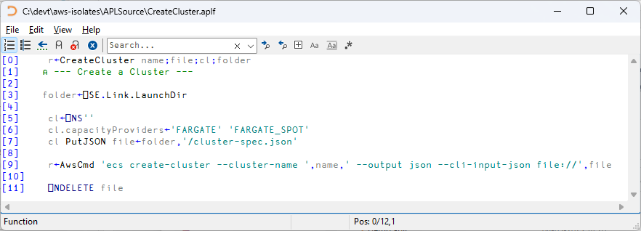
The Pieces …
Cluster

Slide 12
The Pieces …
External Client
Container Image
APL Code
& Data
✓
✓
Cluster
Service (scalable)
Task
Definition
Subnet
Capacity Provider (FARGATE)
Security Group
Running Task
Running Task
Running Task

Slide 13
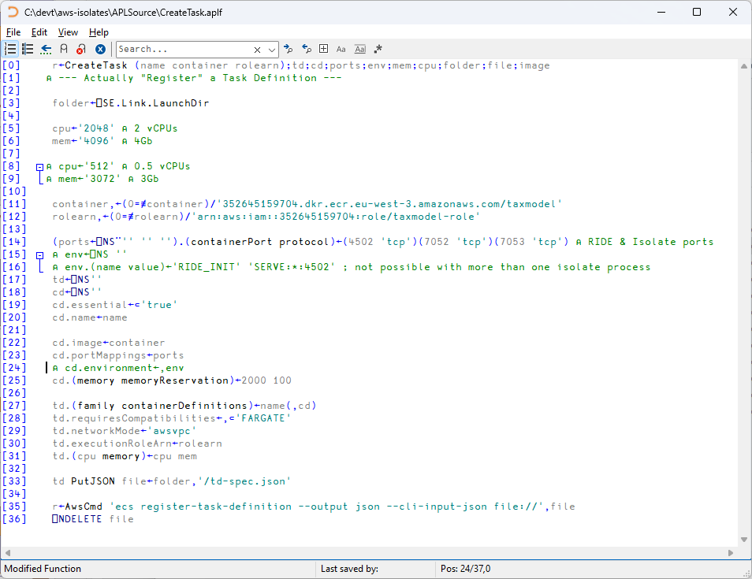
Task
Definition
Warning: ChatGPT does *NOT* know how to do this ☺
But Norbert Jurkiewicz does – Thanks Norbert!

Slide 14
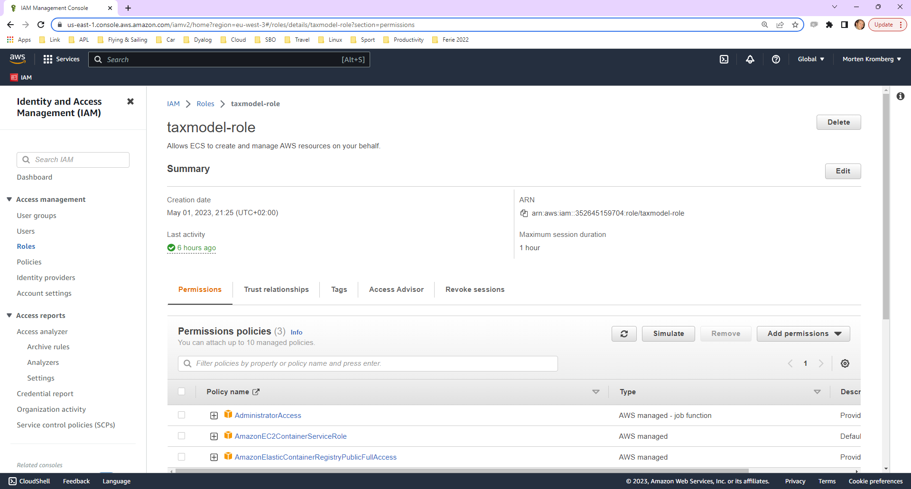

Slide 15
The Pieces …
External Client
Container Image
APL Code
& Data
✓
✓
Cluster
Service (scalable)
✓
Task
Definition
Subnet
Capacity Provider (FARGATE)
Security Group
Running Task
Running Task
Running Task

Slide 16
The Pieces …
Service (scalable)
∇ r←CreateService(cluster service task);net [1] ⍝ --- Create a Service --- [2] net←'--network-configuration "awsvpcConfiguration={subnets=[subnet-cccceda5], securityGroups=[sg-0c32ce61],assignPublicIp=ENABLED}"' ⍝ Don't ask [3] r←AwsCmd 'ecs create-service --cluster ',cluster, ' --service-name ',service, ' --task-definition ',task, ' --desired-count 0 --launch-type FARGATE ',net ∇

Slide 17
The Pieces …
External Client
Container Image
APL Code
& Data
✓
✓
Cluster
✓
✓
Service (scalable)
Task
Definition
Subnet
Capacity Provider (FARGATE)
Security Group
Running Task
Running Task
Running Task

Slide 18
The Pieces …
External Client
Container Image
APL Code
& Data
✓
✓
Cluster
✓
✓
Service (scalable)
Task
Definition
Subnet
✓
Capacity Provider (FARGATE)
Security Group
Running Task
Running Task
Running Task

Slide 19
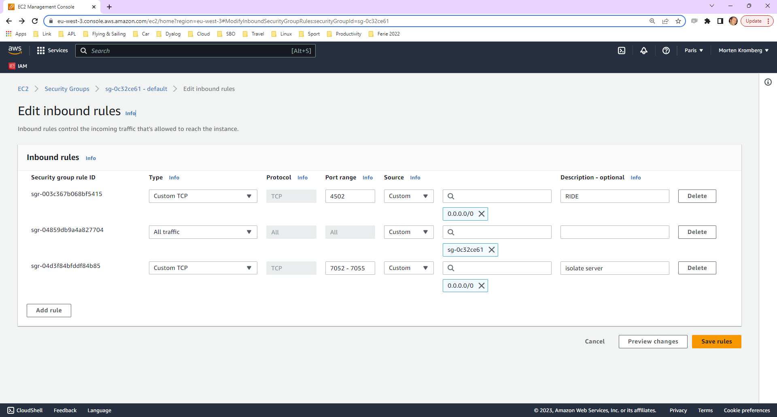

Slide 20
The Pieces …
External Client
Container Image
APL Code
& Data
✓
✓
Cluster
✓
✓
Service (scalable)
Task
Definition
Subnet
✓
Capacity Provider (FARGATE)
Security Group
✓
Running Task
Running Task
Running Task

Slide 21
All that remains is to launch the tasks
z←AwsCmd 'ecs update-service --cluster ',cluster,' --service ',service,' --desired-count ',⍕n
Capacity Provider (FARGATE)
Running Task
Running Task
Running Task

Slide 22
Let's go…

Slide 23
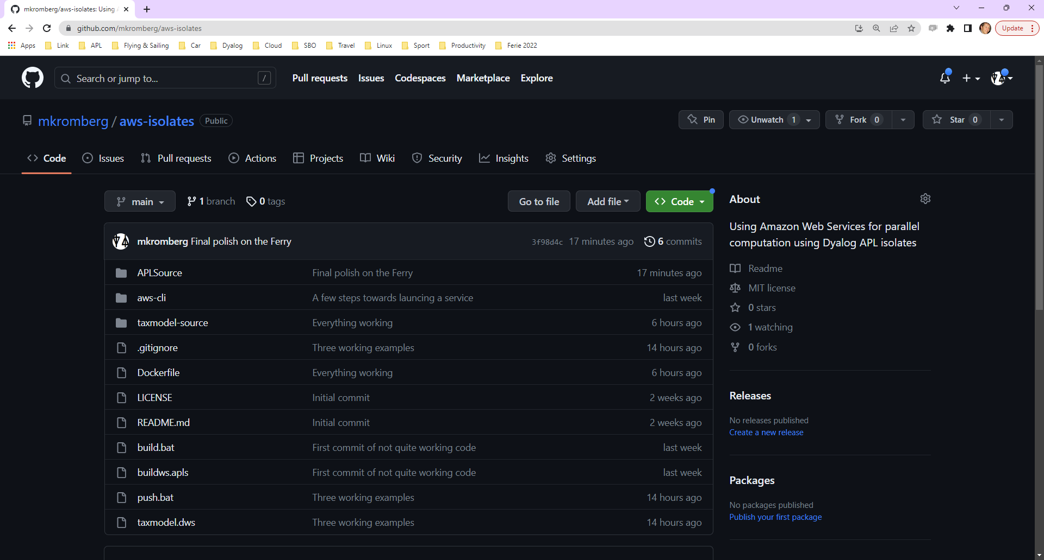

Slide 24
The Pieces …
External Client
Container Image
APL Code
& Data
Cluster
Service (scalable)
Task
Definition
Subnet
Capacity Provider (FARGATE)
Security Group
Running Task
Running Task
Running Task

