Slide 1
Fun with Total Array Ordering (TAO)
Adám Brudzewsky
(material by Jay Foad)
大道至簡
⍒⍋

Slide 2
Grading
⍋'APL' 1 3 2

Slide 3
Grading
⍋'APL' 1 3 2

Slide 4
Grading
[1,2,3] ⍋'APL' 1 3 2 'A' 'L' 'P' ⍨

Slide 5
Major Cells: Vector
┌→──┐ │APL│ └───┘

Slide 6
Major Cells: Matrix
┌→──┐ ↓AAA│ │PPP│ │LLL│ └───┘

Slide 7
Major Cells: Cube
┌→──┐ ↓AAA│ │AAA│──┐ │AAA│PP│ └───┘PP│──┐ │PPP│LL│ └───┘LL│ │LLL│ └───┘

Slide 8
Major Cells: mat
┌→─────┐ ↓John │ │Roger │ │Adam │ │Morten│ │Jay │ └──────┘

Slide 9
Major Cells: mat ⍋mat
┌→─────┐ 3 5 1 4 2 ↓John │ │Roger │ │Adam │ │Morten│ │Jay │ └──────┘

Slide 10
Major Cells: mat ⍋mat
┌→─────┐ 3 5 1 4 2
↓John │
│Roger │
│Adam │
│Morten│
│Jay │
└──────┘

Slide 11
Major Cells: mat mat[⍋mat;]
┌→─────┐ ┌→─────┐
↓John │ ↓Adam │
│Roger │ │Jay │
│Adam │ │John │
│Morten│ │Morten│
│Jay │ │Roger │
└──────┘ └──────┘

Slide 12
Sorting mat[⍋mat;]
{(⊂⍋⍵)⌷⍵} mat

Slide 13
Sorting mat[⍋mat;]
{(⊂⍋⍵)⌷⍵} mat

Slide 14
Sorting mat[⍋mat;]
{(⊂⍒⍵)⌷⍵} mat

Slide 15
Sorting mat[⍋mat;]
Sort ← {(⊂⍋⍵)⌷⍵}
Sort mat
Adam Jay John Morten Roger

Slide 16
Sorting
n ← 'Roger' 'Adam' 'Jay'
Sort n ⍝ 16.0
DOMAIN ERROR
Sort n ⍝ 17.0
┌────┬───┬─────┐ │Adam│Jay│Roger│ └────┴───┴─────┘

Slide 17
A bit of history
'Morten'
'Roger '

Slide 18
A bit of history
'Morten'
'Roger▉'

Slide 19
A bit of history
A ← 'Morten'
B ← 'Roger▉'
⍋ A ,[0.5] B
1 2
'Morten' ≺ 'Roger▉'

Slide 20
Total Array Ordering
some other
≺ ?
array array

Slide 21
Total Array Ordering
How would you order:
⎕ ← 0 'Jay' (2 3⍴'DYALOG') (⍳9)
┌→──────────────────────────────────┐
│ ┌→──┐ ┌→──┐ ┌→────────────────┐ │
│ 0 │Jay│ ↓DYA│ │1 2 3 4 5 6 7 8 9│ │
│ └───┘ │LOG│ └~────────────────┘ │
│ └───┘ │
└∊──────────────────────────────────┘

Slide 22
Total Array Ordering
How would you order:
⎕ ← 0 'Jay' (2 3⍴'DYALOG') (⍳9)
┌→──────────────────────────────────┐
│ ┌→──┐ ┌→──┐ ┌→────────────────┐ │
│ 0 │Jay│ ↓DYA│ │1 2 3 4 5 6 7 8 9│ │
│ └───┘ │LOG│ └~────────────────┘ │
│ └───┘ │
└∊──────────────────────────────────┘

Slide 23
Total Array Ordering

Slide 24
TAO

Slide 25
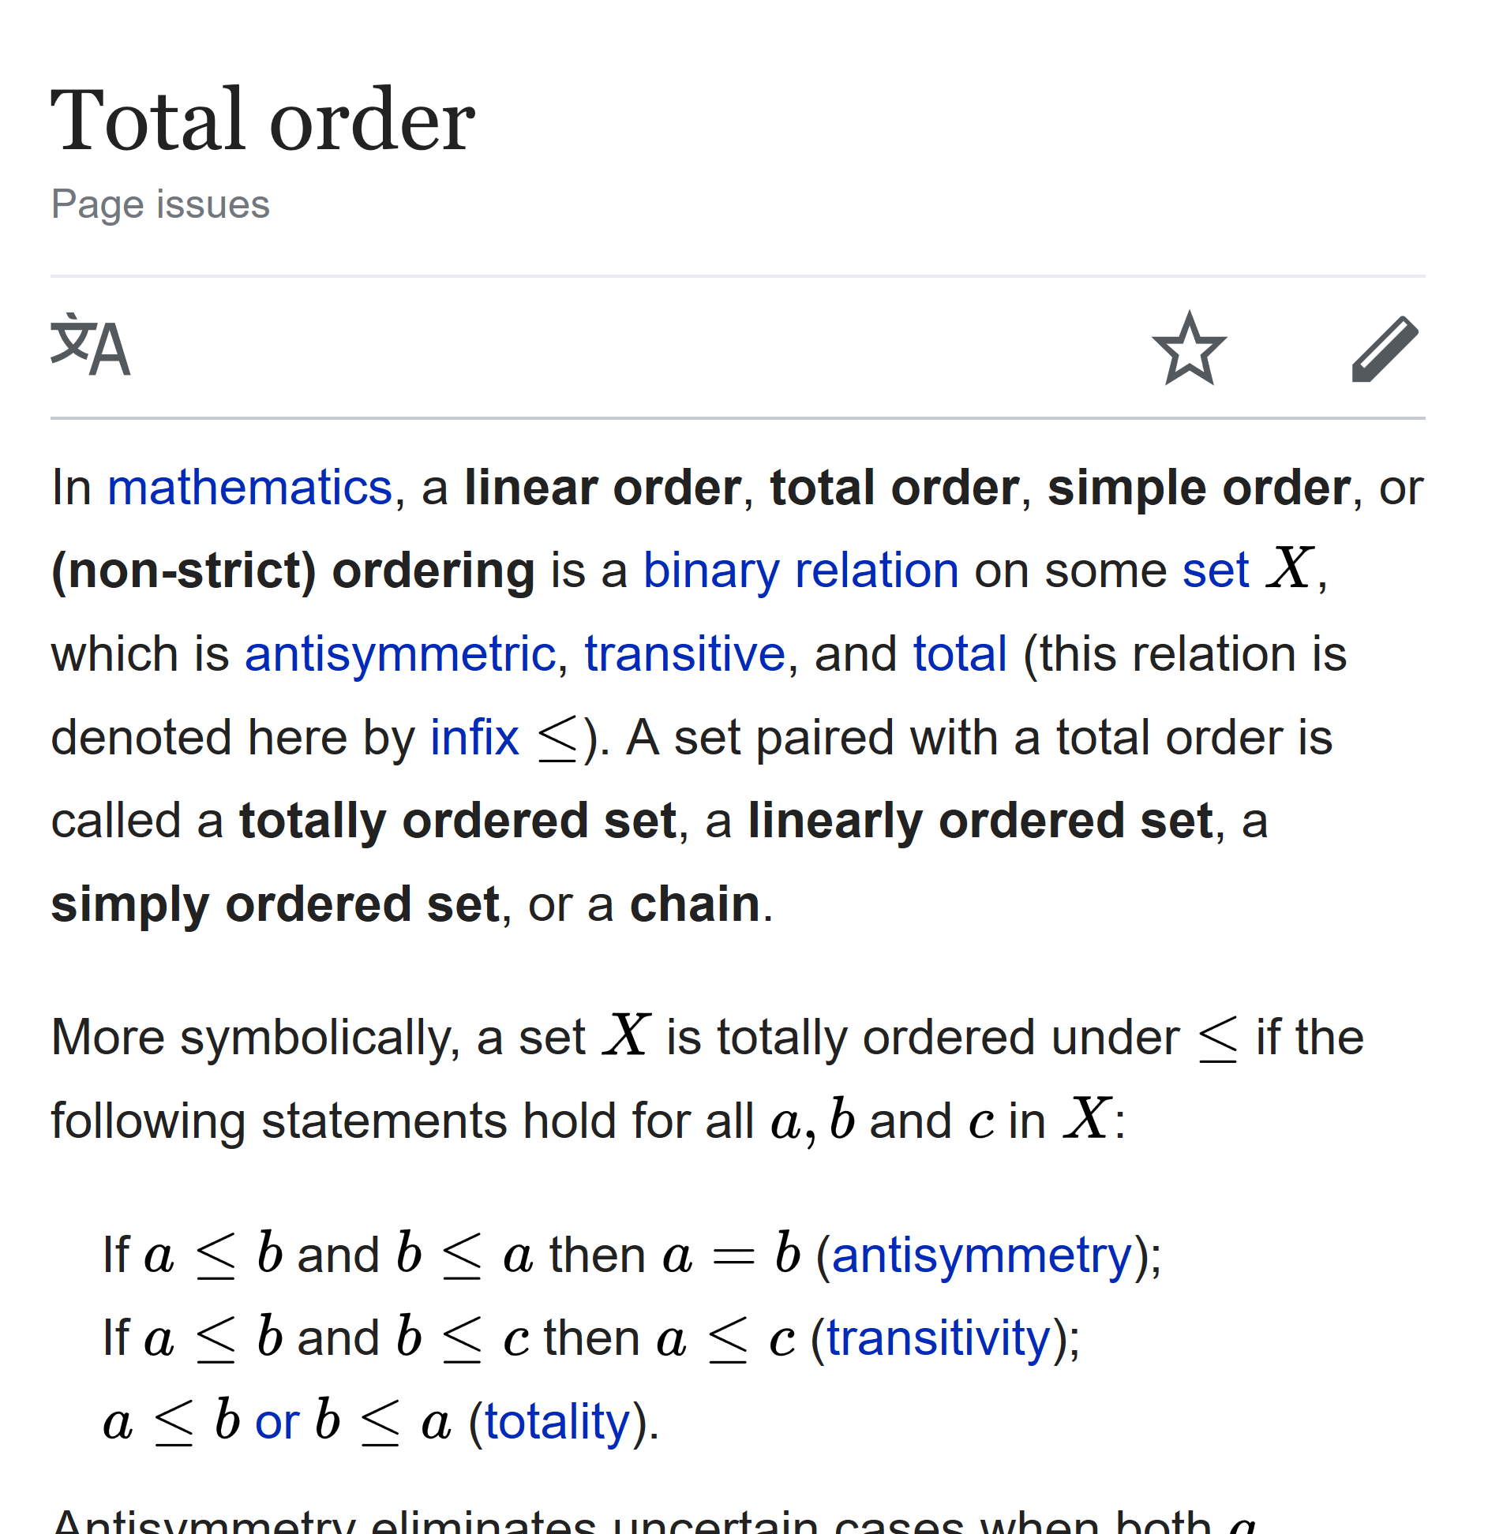
TAO Rules

Slide 26
TAO
some other
≺ ?
array array

Slide 27
TAO
some other
≺ ?
array array
no refs no refs

Slide 28
TAO Rules
Compatibility: simple arrays
Consistency: (⍺≼⍵)∧(⍵≼⍺) ⇔ ⍺=⍵
⍺≡⍵
⍬≢''

Slide 29
TAO Rules: simple scalars
character vs character: ✓
real number vs real number: ✓
complex: 1 ≺ 1J1 ≺ 2J¯1 ≺ 2
number vs character: 100 ≺ 'A'
null: ⎕NULL ≺ ¯100

Slide 30
TAO Rules: simple scalars
⎕NULL ≺ ¯1 ≺ 0J¯2 ≺ 0 ≺ 0J2 ≺ 1 ≺ 'A'

Slide 31
TAO Rules: same shape
┌→───┐ ┌→───┐ │Jay▉│ │John│ └────┘ └────┘

Slide 32
TAO Rules: same shape
┌→───┐ ┌→───┐
│Jay▉│ │John│ └────┘ └────┘
┌→─────────┐ ┌→─────────┐ │ ┌→─┐ │ │ ┌→─┐ │ │ │JF│ 3 1 │ │ │JD│ 2 7 │ │ └──┘ │ │ └──┘ │ └∊─────────┘ └∊─────────┘

Slide 33
TAO Rules: same shape
┌→───┐ ┌→───┐
│Jay▉│ │John│ └────┘ └────┘
┌→─────────┐ ┌→─────────┐
│ ┌→─┐ │ │ ┌→─┐ │
│ │JF│ 3 1 │ │ │JD│ 2 7 │
│ └──┘ │ │ └──┘ │
└∊─────────┘ └∊─────────┘

Slide 34
TAO Rules: same shape
┌→───┐ ┌→───┐
│Jay▉│ │John│ └────┘ └────┘
┌→─────────┐ ┌→─────────┐
│ ┌→─┐ │ │ ┌→─┐ │
│ │JF│ 3 1 │ │ │JD│ 2 7 │
│ └──┘ │ │ └──┘ │
└∊─────────┘ └∊─────────┘

Slide 35
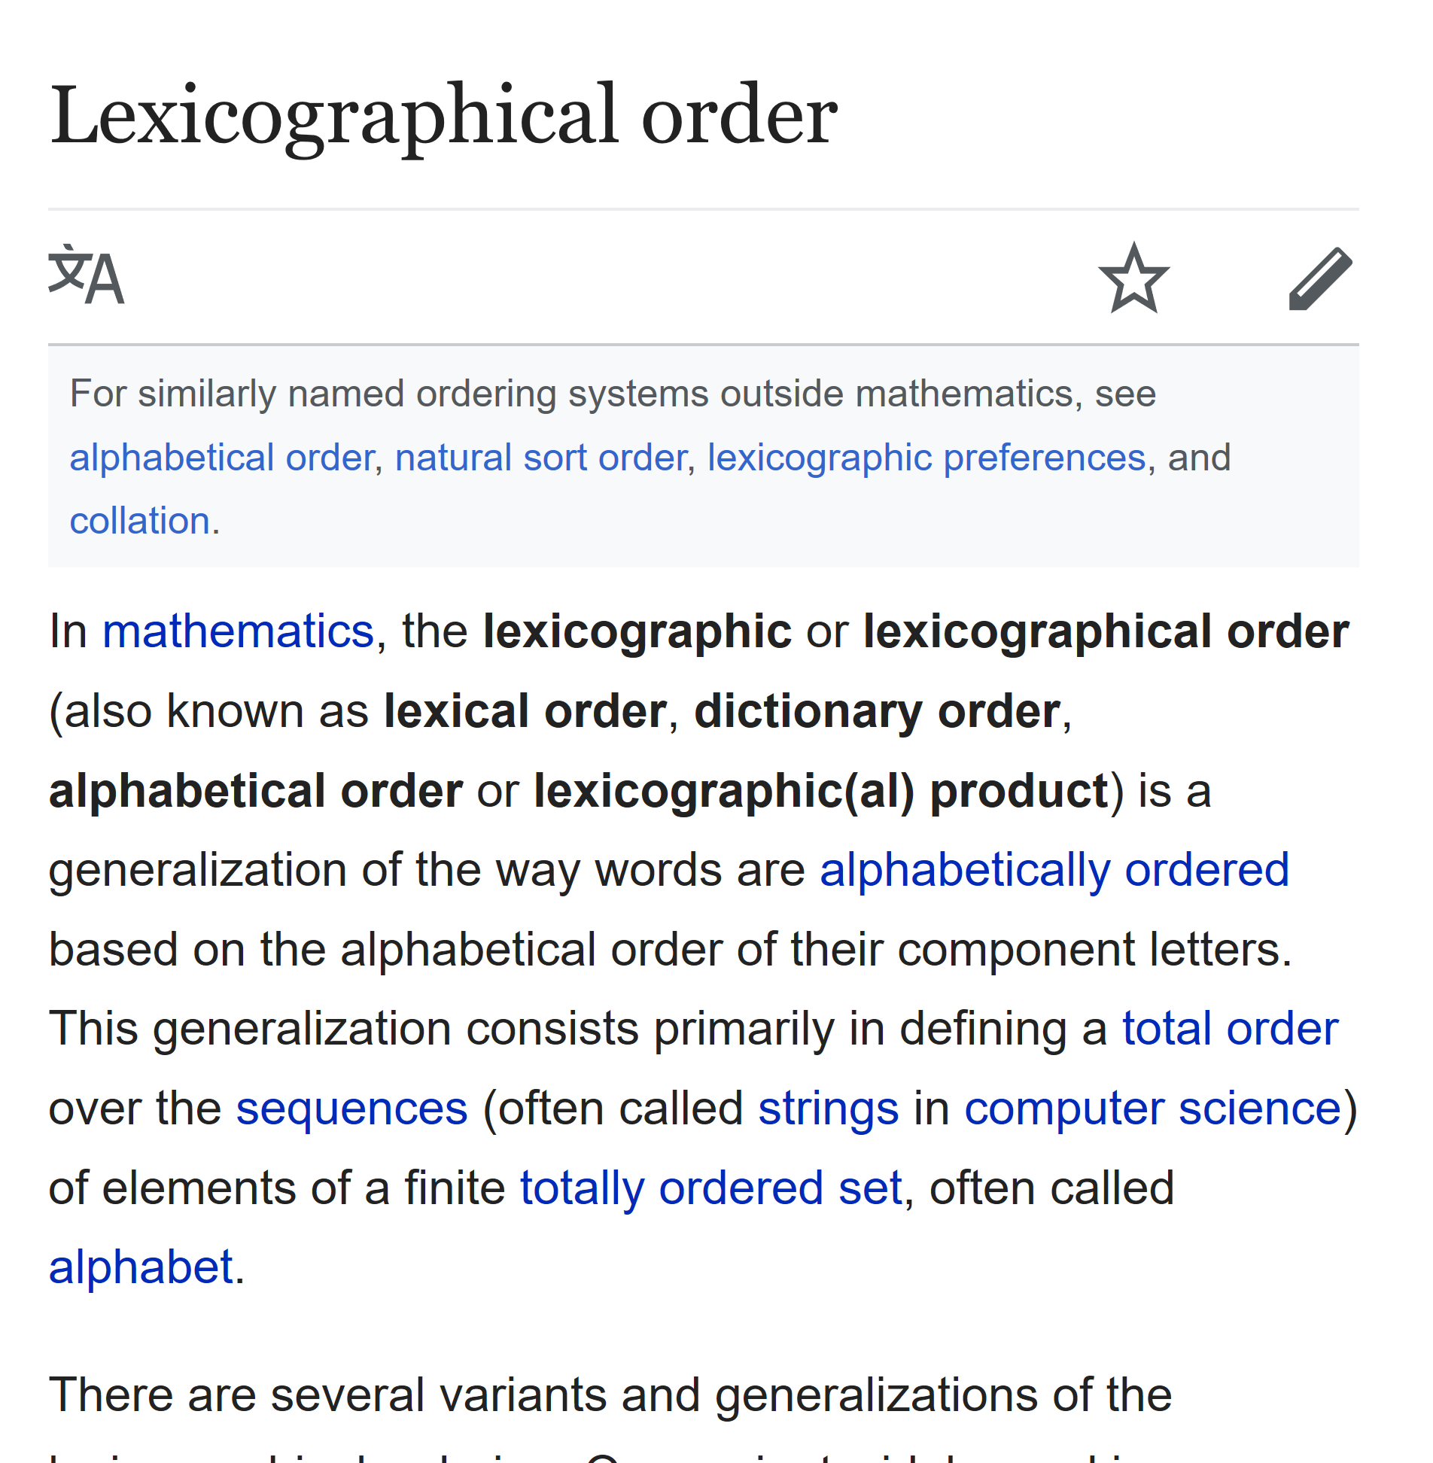
TAO Rules: different shape
CAN
CAR
CARPENTER
CARPET
CAT

Slide 36
TAO Rules: different shape
CAR
CARPENTER

Slide 37
TAO Rules: different shape
CAR
CARPENTER

Slide 38
TAO Rules: different shape
CAR
CARPENTER

Slide 39
TAO Rules: different shape
CAN
CAR
CARPENTER
CARPET
CAT

Slide 40
TAO Rules: different shape
CAN
CAR
CARPENTER
CARPET
CAT

Slide 41
TAO Rules: different shape
↑'CAR' 'CARPENTER'
CAR▉▉▉▉▉▉
CARPENTER

Slide 42
TAO Rules: different shape
↑'CAR' 'CAR␀␀␀␀␀␀'
CAR▉▉▉▉▉▉
CAR␀␀␀␀␀␀

Slide 43
TAO Rules: different shape
⍋↑'CAR' 'CAR␀␀␀␀␀␀'
2 1

Slide 44
TAO Rules: different shape
1 2 3
1 2 3 4

Slide 45
TAO Rules: different shape
¯1 ¯2 ¯3
¯1 ¯2 ¯3 ¯4

Slide 46
TAO Rules: different shape
¯1 ¯2 ¯3
¯1 ¯2 ¯3 ¯4

Slide 47
TAO Rules: different shape
↑(¯1 ¯2 ¯3) (¯1 ¯2 ¯3 ¯4)
¯1 ¯2 ¯3 0
¯1 ¯2 ¯3 ¯4

Slide 48
TAO Rules: different shape
⍋↑(¯1 ¯2 ¯3) (¯1 ¯2 ¯3 ¯4)
2 1

Slide 49
TAO Rules: different shape
¯∞

Slide 50
TAO Rules: different shape
¯∞ ≺ ⎕NULL ≺ ¯1 ≺ 0J¯2 ≺ 0 ≺ 0J2 ≺ 1 ≺ 'A'

Slide 51
TAO Rules: different shape
CAR¯∞¯∞¯∞¯∞¯∞¯∞
CARPENTER

Slide 52
TAO Rules: different shape
CAR¯∞¯∞¯∞¯∞¯∞¯∞
CARPENTER

Slide 53
TAO Rules: different shape
1 2 1 2 3
1 2 1 2 3
1 2

Slide 54
TAO Rules: different shape
1 2 ¯∞ 1 2 3
1 2 ¯∞ 1 2 3
1 2 ¯∞ ¯∞ ¯∞ ¯∞

Slide 55
TAO Rules: different shape
1 2 ¯∞ 1 2 3
1 2 ¯∞ 1 2 3
1 2 ¯∞ ¯∞ ¯∞ ¯∞
≺

Slide 56
TAO Rules: different rank
┌→──┐ ┌→────┐
│APL│ ↓Adam │
└───┘ │Jay │
│Roger│
└─────┘

Slide 57
TAO Rules: different rank
┌→──┐ ┌→────┐
↓APL│ ↓Adam │
└───┘ │Jay │
│Roger│
└─────┘

Slide 58
TAO Rules: different rank
┌→────┐ ┌→────┐
↓APL¯∞¯∞│ ↓Adam │
│¯∞¯∞¯∞¯∞¯∞│ │Jay │
│¯∞¯∞¯∞¯∞¯∞│ │Roger│
└─────┘ └─────┘

Slide 59
TAO Rules: different rank
┌→────┐ ┌→────┐
↓APL¯∞¯∞│ ↓Adam │
│¯∞¯∞¯∞¯∞¯∞│ │Jay │
│¯∞¯∞¯∞¯∞¯∞│ │Roger│
└─────┘ └─────┘

Slide 60
TAO Rules: different rank
┌→──┐ ┌→──┐
│APL│ ↓APL│
└───┘ └───┘

Slide 61
TAO Rules: different rank
┌→──┐ ┌→──┐
↓APL│ ↓APL│
└───┘ └───┘

Slide 62
TAO Rules: different rank
┌→──┐ ┌→──┐
│APL│ ↓APL│
└───┘ └───┘
1 2

Slide 63
TAO Rules: different rank
scalar vector
'A' ,'A'
A A
vector 1-row matrix
3⍴'APL' 1 3⍴'APL'
APL APL

Slide 64
TAO Rules: recap
simple scalars ⎕NULL ≺ nums ≺ chars
same shape item-by-item in ravel order
unequal shape pad with ¯∞
unequal rank prefix shape with 1s

Slide 65
TAO Rules: empty arrays
2 0 0⍴⍬ 0 0 3⍴''

Slide 66
TAO Rules: empty arrays
2 0 0⍴⍬ 0 0 3⍴''
2 0 3⍴⍬ 2 0 3⍴''

Slide 67
TAO Rules: empty arrays
2 0 0⍴⍬ 0 0 3⍴''
⍬ prototypical items ''
or
2 0 0 original shapes 0 0 3
?

Slide 68
TAO Rules: empty arrays
2 0 0⍴⍬ 0 0 3⍴''
⍬ prototypical items ''
2 0 0 original shapes 0 0 3

Slide 69
TAO Rules: empty arrays
2 0 0⍴⍬ 0 0 3⍴⍬
⍬ prototypical items ⍬
2 0 0 original shapes 0 0 3

Slide 70
TAO Rules
simple scalars ⎕NULL ≺ nums ≺ chars
same shape item-by-item in ravel order
unequal shape pad with ¯∞
unequal rank prefix shape with 1s
both empty type then shape

Slide 71
TAO Scope
⍋⍵
⍒⍵
⍺⍸⍵

Slide 72
Demo
Features coming in version 17.0…

Slide 73
Demo
Turing Awards
]load /tao/turing
Sort ← {(⊂⍋⍵)⌷⍵}
Sort turing
vol ← ⊣/5 5⍴⎕A
Cat ← {vol⍸⍵}
Chop ← {(Cat ⍵){⊂⍵}⌸ ⍵}
Chop turing
Sort Chop turing
Stock Tickers
]load /tao/stocks
Sort stocks
Under←{⍺←⊢ ⋄ (⍵⍵⍣¯1) ⍺ ⍺⍺ ⍵⍵ ⍵}
Sort Under(1⌽⊢) stocks
2⌷Under⍉ stocks
⍋ 2⌷Under⍉ stocks
Puncts ← {~⍵∊⎕D}
Nums ← ⍎' '@Puncts
Nums¨ 2⌷Under⍉ stocks
⍋ Nums¨ 2⌷Under⍉ stocks
Nums¨@2 Under⍉ stocks
⍋ Nums¨@2 Under⍉ stocks
⍋ stocks
ISO 8601
yyyy-mm-ddThh:mm:ss.mmm

Slide 74
Demo
Phonebook Record Insertion
]load /tao/pb
Sort ← {(⊂⍋⍵)⌷⍵}
Sort pb
pb ← Sort pb
new ← 'Kromberg' 'Morten' 584
pb ⍸ new
(2↑pb)⍪new⍪(2↓pb)
2(↑⍪new⍪↓)pb
Into ← {(⍵⍸⍺)(↑⍪⍺⍪↓)⍵}
new Into pb
new2←'Becker' 'Brian' 563
⊃Into/new new2 pb
Spreadsheet Data Types
ss ← (⎕NEW⊂'Clipboard').Array
Sort ss
ss[⍋ss[;1 3];]
Natural Sorting
)clear
]load /tao/names2
num←'((¯?\d+\.?\d*|¯?\d*\.\d+)(E¯?\d+)?)(J(?1))?'
ExecNums ← {⍵.PatternNum:⍵.Match ⋄ ⍎⍵.Match}
Order ← {⍋(∊num'.'⎕S ExecNums⍠1)¨⍵}
Order names
SuperNatSort ← {(⊂Order ⍵)⌷⍵}
SuperNatSort names
]defs –topdown

Slide 75
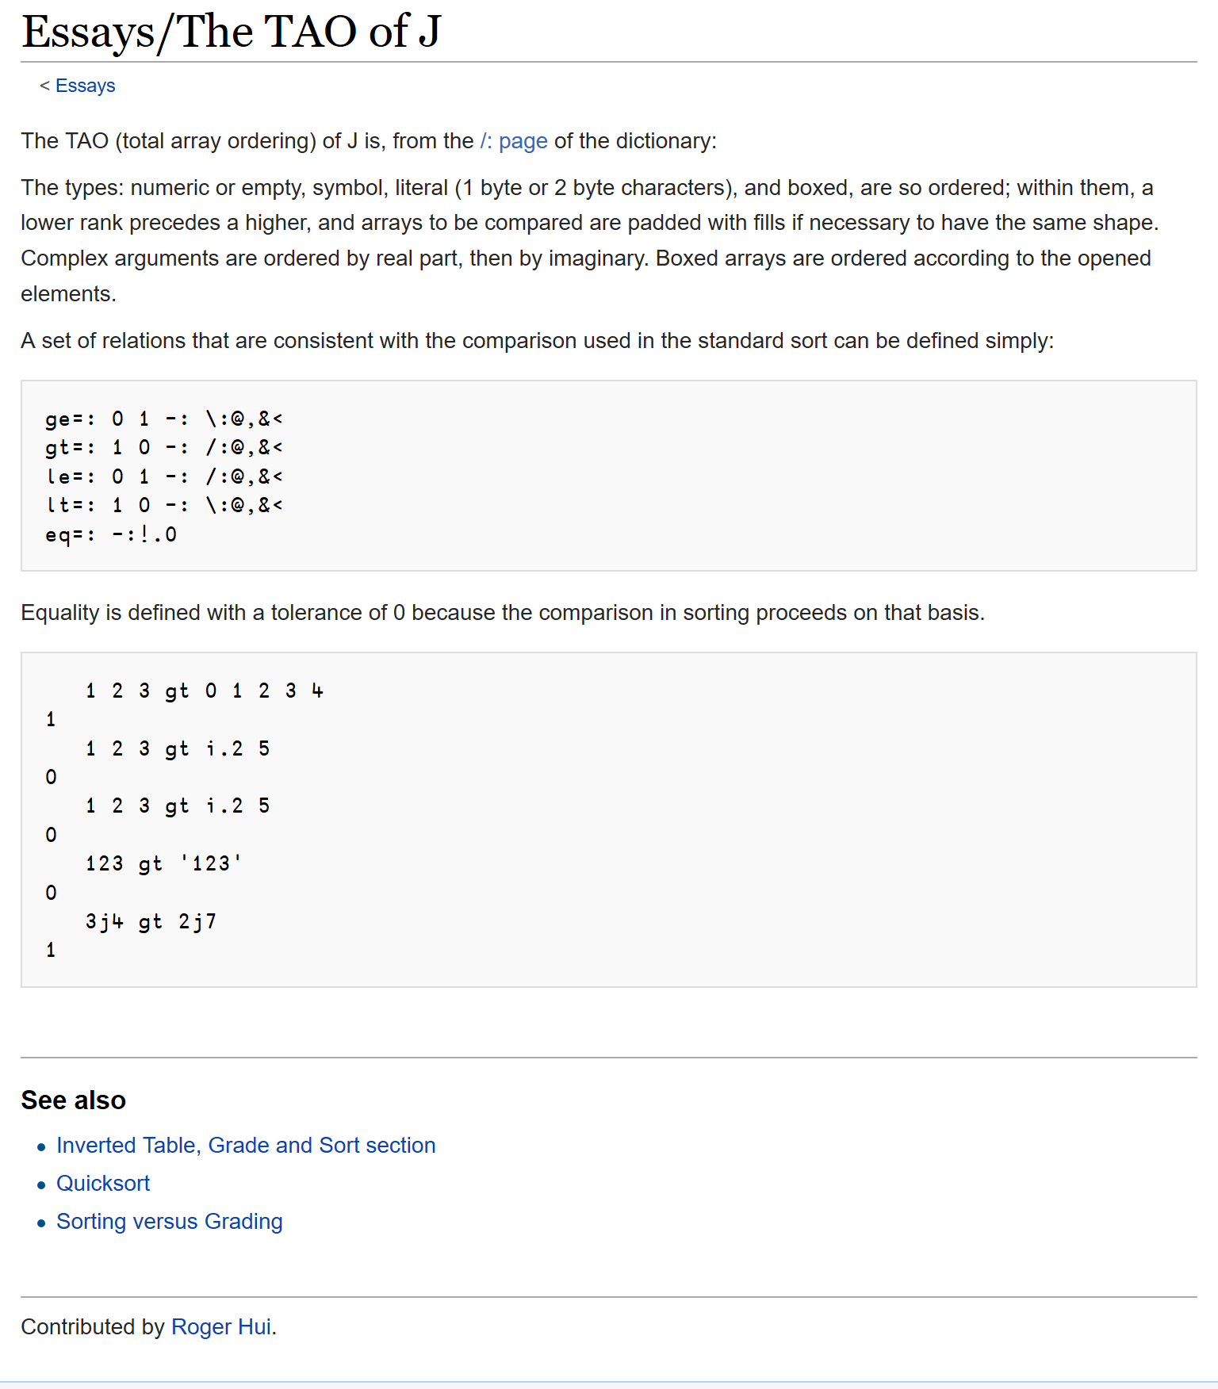
TAO: a true team effort
Arthur Whitney initial suggestion
Roger Hui TAO of J
John Scholes model: dfns.dyalog.com/n_le.htm
Roger Hui Dyalog implementation
Adám Brudzewsky, Roger Hui, Jay Foad,
John Scholes, Morten Kromberg

Slide 76
Features coming in version 17.0
Grade and Sort any^{no refs} Array {(⊂⍋⍵}⌷⍵} for all ranks – fast!
⍋⍵ ⍒⍵ ⍺⍸⍵

