Slide 1
Boolean Scans and Reductions
Richard Park

Slide 2
Booleans in APL
Logical values are the numbers 0 and 1

Slide 3
Comparisons
_ ← ,⍥⊆ ⍝ Stranding function
¯2 ¯1 0 1 2 (↑ < _ ≤ _ = _ ≠ _ ≥ _ >) 0
1 1 0 0 0
1 1 1 0 0
0 0 1 0 0
1 1 0 1 1
0 0 1 1 1
0 0 0 1 1

Slide 4
Data-driven conditionals
↑ groups salaries
A B A C C
20000 25750 21000 32350 32400
salaries × 1.05 * groups = 'A'
21000 25750 22050 32350 32400

Slide 5
Selecting from arrays
↑ values names
┌────┬───┬───────┬────┬────┬─────┐
│4 │10 │6 │8 │16 │24 │
├────┼───┼───────┼────┼────┼─────┤
│Anne│Ben│Charlie│Demi│Ella│Fiona│
└────┴───┴───────┴────┴────┴─────┘
(values≥10)/names
┌───┬────┬─────┐
│Ben│Ella│Fiona│
└───┴────┴─────┘

Slide 6
Simple statistics
(+⌿÷≢)'the alphabet'∊'aeiou'
0.3333333333

Slide 7
Sixteen logical functions
Phil Last
Boolean Reductions
archive.vector.org.uk/art10501140

Slide 8
Sixteen logical functions
0 f 0
0 f 1
1 f 0
1 f 1
0f0 0f1 1f0 1f1 2⊥ f
0 0 0 0 0 0⍨ false
0 0 0 1 1 ∧ and
0 0 1 0 2 > left but not right
0 0 1 1 3 ⊣ left
0 1 0 0 4 < right but not left
0 1 0 1 5 ⊢ right
0 1 1 0 6 ≠ exclusive or
0 1 1 1 7 ∨ or
1 0 0 0 8 ⍱ nor
1 0 0 1 9 = exclusive nor
1 0 1 0 10 ~⍤⊢ not right
1 0 1 1 11 ≥ left or not right
1 1 0 0 12 ~⍤⊣ not left
1 1 0 1 13 ≤ right or not left
1 1 1 0 14 ⍲ nand
1 1 1 1 15 1⍨ true

Slide 9
Scans and Reductions
Reductions: Summarise
Scans: Indicate progression

Slide 10
Two well known
∧/1 1 1 1 1 1 1 1 ⍝ Are all true?
1
∧\1 1 0 1 1 1 0 1 ⍝ Were all true so far?
1 1 0 0 0 0 0 0

Slide 11
Two well known
∨/0 0 1 0 0 0 0 0 ⍝ Are any true?
1
∨\0 0 1 0 0 0 1 0 ⍝ Were any true so far?
0 0 1 1 1 1 1 1

Slide 12
The last value
∨/0 0 1 0 0 0 0 0 ⍝ Are any true?
1
∨\0 0 1 0 0 0 1 0 ⍝ Were any true so far?
0 0 1 1 1 1 1 1

Slide 13
The last value
∨/0 0 1 0 0 0 0 0 ⍝ Are any true?
1
∨\0 0 1 0 0 0 1 0 ⍝ Were any true so far?
0 0 1 1 1 1 1 1

Slide 14
The last value
∨/0 0 1 0 0 0 0 0 ⍝ Are any true?
1
∨\0 0 1 0 0 0 1 0 ⍝ Were any true so far?
0 0 1 1 1 1 1 1

Slide 15
Less-than
<\0 0 1 0 1 1 1 1 1 1 0 1 0 1 1
0 0 1 0 0 0 0 0 0 0 0 0 0 0 0
</0 0 0 1
1

Slide 16
Less-than
<\0 1 0 1 1
0 → 0
0<1 → 1
0<1<0 → 0
0<1<0<1 → 0
0<1<0<1<1 → 0

Slide 17
Less-than
code ← '+/⍳10 ⍝ sum⍝of⍝first⍝10⍝ints'
c ← code = '⍝'
↑ code c (<\c)
+ / ⍳ 1 0 ⍝ s u m ⍝ o f ⍝ f i r s t ⍝ 1 0 ⍝ i n t s
0 0 0 0 0 0 0 0 1 0 0 0 0 1 0 0 1 0 0 0 0 0 1 0 0 1 0 0 0 0
0 0 0 0 0 0 0 0 1 0 0 0 0 0 0 0 0 0 0 0 0 0 0 0 0 0 0 0 0 0
c⍳1
9

Slide 18
Less-than
v ← '⍟⎕⍟⍟⍟⎕⎕⍟⎕⎕⍟⍟⍟⍟⎕⎕⎕⎕⍟⍟⎕⎕⎕⎕⍟⍟⎕⍟'
q ← '⎕'=v
↑v q (2</0,q)
⍟ ⎕ ⍟ ⍟ ⍟ ⎕ ⎕ ⍟ ⎕ ⎕ ⍟ ⍟ ⍟ ⍟ ⎕ ⎕ ⎕ ⎕ ⍟ ⍟ ⎕ ⎕ ⎕ ⎕ ⍟ ⍟ ⎕ ⍟
0 1 0 0 0 1 1 0 1 1 0 0 0 0 1 1 1 1 0 0 1 1 1 1 0 0 1 0
0 1 0 0 0 1 0 0 1 0 0 0 0 0 1 0 0 0 0 0 1 0 0 0 0 0 1 0

Slide 19
Not-equal
≠/1 1 1 1 2|+/1 1 1 1
0 0
≠/1 1 1 0 2|+/1 1 1 0
1 1
b ← 0 0 1 0 0 0 1 0 0 0 0 1 0 0 1
↑ b (≠\b)
0 0 1 0 0 0 1 0 0 0 0 1 0 0 1
0 0 1 1 1 1 0 0 0 0 0 1 1 1 0

Slide 20
Not-equal
≠\0 1 0 0 1
0 → 0
0≠1 → 1
0≠1≠0 → 1
0≠1≠0≠0 → 1
0≠1≠0≠0≠1 → 0

Slide 21
Not-equal
quoted ← 'extract the "quoted" parts from this "text"'
'"'=quoted
0 0 0 0 0 0 0 0 0 0 0 0 1 0 0 0 0 0 0 1 0 0 0 0 0 0 0 0 0 0 0 0 0 0 0 0 0 1 0 0 0 0 1
(~∧≠\)'"'=quoted
0 0 0 0 0 0 0 0 0 0 0 0 0 1 1 1 1 1 1 0 0 0 0 0 0 0 0 0 0 0 0 0 0 0 0 0 0 0 1 1 1 1 0
(⊢∨≠\)'"'=quoted
0 0 0 0 0 0 0 0 0 0 0 0 1 1 1 1 1 1 1 1 0 0 0 0 0 0 0 0 0 0 0 0 0 0 0 0 0 1 1 1 1 1 1

Slide 22
Not-equal
quoted ← 'extract the "quoted" parts from this "text"'
'"'=quoted
0 0 0 0 0 0 0 0 0 0 0 0 1 0 0 0 0 0 0 1 0 0 0 0 0 0 0 0 0 0 0 0 0 0 0 0 0 1 0 0 0 0 1
(~∧≠\)'"'=quoted
0 0 0 0 0 0 0 0 0 0 0 0 0 1 1 1 1 1 1 0 0 0 0 0 0 0 0 0 0 0 0 0 0 0 0 0 0 0 1 1 1 1 0
(⊢∨≠\)'"'=quoted
0 0 0 0 0 0 0 0 0 0 0 0 1 1 1 1 1 1 1 1 0 0 0 0 0 0 0 0 0 0 0 0 0 0 0 0 0 1 1 1 1 1 1
{⍵⌿⍨(~∧≠\)'"'=⍵}quoted
quotedtext
{⍵⊆⍨(~∧≠\)'"'=⍵}quoted
┌──────┬────┐
│quoted│text│
└──────┴────┘

Slide 23
Not-equal
quoted ← 'extract the "quoted" parts from this "text"'
q ← '"'=quoted ⍝ Quotes
p ← 2</0,≠\q ⍝ Start of each quoted segment
↑ quoted q p
e x t r a c t t h e " q u o t e d " p a r t s f r o m t h i s " t e x t "
0 0 0 0 0 0 0 0 0 0 0 0 1 0 0 0 0 0 0 1 0 0 0 0 0 0 0 0 0 0 0 0 0 0 0 0 0 1 0 0 0 0 1
0 0 0 0 0 0 0 0 0 0 0 0 1 0 0 0 0 0 0 0 0 0 0 0 0 0 0 0 0 0 0 0 0 0 0 0 0 1 0 0 0 0 0

Slide 24
Not-equal
(⊢⊆⍨∘(~∧≠\)=∘'"') quoted
┌──────┬────┐
│quoted│text│
└──────┴────┘
css ← '* {color: #000; /* text */ background: #fff; /* bg */}'
cpos ← '/*'∘(≠\⍷∨¯1⌽∘⌽⍷∘⌽)css
↑ css cpos
* {color: #000; /* text */ background: #fff; /* bg */}
000000000000000011111111110000000000000000000111111110

Slide 25
Not-equal
data
48 AAA 0.78354
70 AAA 0.55965
5 AAA 0.96690
54 AAA 0.17215
47 BBB 0.68116
15 BBB 0.26669
37 CCC 0.41522
91 CCC 0.32995
31 CCC 0.38465
48 AAA 0.78354
70 AAA 0.55965
5 AAA 0.96690
54 AAA 0.17215
47 BBB 0.68116
15 BBB 0.26669
37 CCC 0.41522
91 CCC 0.32995
31 CCC 0.38465

Slide 26
Not-equal
4 2 3
48 AAA 0.78354
70 AAA 0.55965
5 AAA 0.96690
54 AAA 0.17215
47 BBB 0.68116
15 BBB 0.26669
37 CCC 0.41522
91 CCC 0.32995
31 CCC 0.38465

Slide 27
Not-equal
MTake 4 2 3
1 0 0 0 1 0 1 0 0
MTake,4 2 3,⍤0⊢2
1 0 0 0 1 0 1 0 1 0 1 0 0 1 0
⎕←e←≠\MTake,4 2 3,⍤0⊢2
1 1 1 1 0 0 1 1 0 0 1 1 1 0 0
48 AAA 0.78354
70 AAA 0.55965
5 AAA 0.96690
54 AAA 0.17215
47 BBB 0.68116
15 BBB 0.26669
37 CCC 0.41522
91 CCC 0.32995
31 CCC 0.38465

Slide 28
Not-equal
⎕←e←≠\MTake,4 2 3,⍤0⊢2
1 1 1 1 0 0 1 1 0 0 1 1 1 0 0
e⍀⍕data
48 AAA 0.78354
70 AAA 0.55965
5 AAA 0.96690
54 AAA 0.17215
47 BBB 0.68116
15 BBB 0.26669
37 CCC 0.41522
91 CCC 0.32995
31 CCC 0.38465
48 AAA 0.78354
70 AAA 0.55965
5 AAA 0.96690
54 AAA 0.17215
47 BBB 0.68116
15 BBB 0.26669
37 CCC 0.41522
91 CCC 0.32995
31 CCC 0.38465

Slide 29
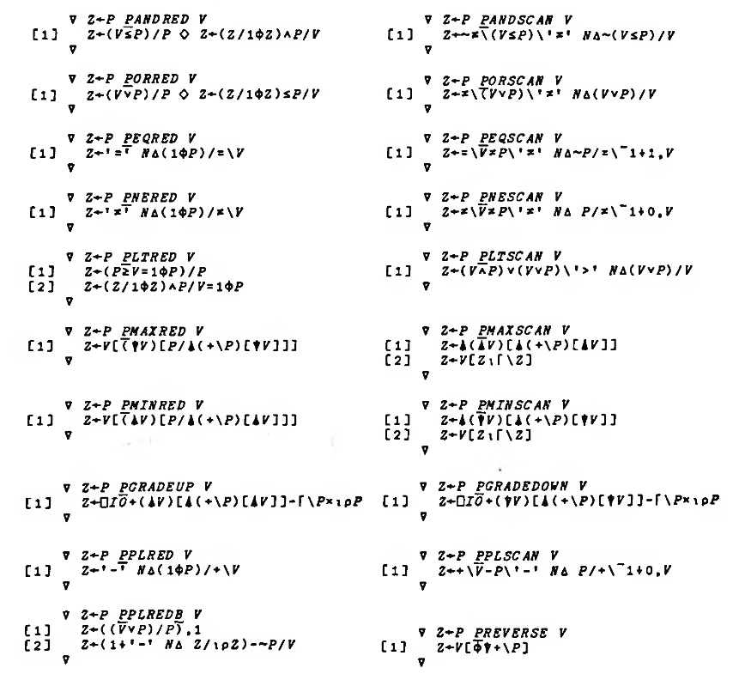
Flat partition
STSC
Boolean Functions and Techniques, 2nd Edition

Slide 30
Flat partition
1 0 0 0 1 0 0 {∊⌽¨⍺⊂⍵} 'ABCDXYZ'
DCBAZYX

Slide 31
Flat partition
b ← 1 0 0 0 1 0 0
a ← 'ABCDXYZ'
↑ a b (+\b)
A B C D X Y Z
1 0 0 0 1 0 0
1 1 1 1 2 2 2
⍒+\b
5 6 7 1 2 3 4
⌽⍒+\b
4 3 2 1 7 6 5
a[⌽⍒+\b]
DCBAZYX

Slide 32
Flat partition
p ← 1,1↓1=?1e4⍴10
t ← ⎕A[?1e4⍴26]
]runtime -c "p {∊⌽¨⍺⊂⍵} t" "p {⍵[⌽⍒+\⍺]} t"
p {∊⌽¨⍺⊂⍵} t → 1.3E¯4 | 0% ⎕⎕⎕⎕⎕⎕⎕⎕⎕⎕⎕⎕⎕⎕⎕⎕⎕⎕⎕⎕⎕⎕⎕⎕⎕⎕⎕⎕⎕⎕⎕⎕⎕⎕⎕⎕⎕⎕⎕⎕
p {⍵[⌽⍒+\⍺]} t → 3.6E¯5 | -73% ⎕⎕⎕⎕⎕⎕⎕⎕⎕⎕⎕

Slide 33
Flat partition
1 0 0 0 1 0 0 {∊+/¨⍺⊂⍵} 1 2 3 4 5 6 7
10 18

Slide 34
Flat partition
_P ← {∊⍺⍺¨⍺⊂⍵}
si ← ?1e4⍴100
li ← ?1e4⍴1000
f ← ?1e4⍴0
⎕DR¨si li f
83 163 645

Slide 35
Flat partition
]runtime -c "parts +/_P data" "parts {¯2-/0,(1⌽⍺)/+\⍵} data"
p +/_P si → 6.2E¯5 | 0% ⎕⎕⎕⎕⎕⎕⎕⎕⎕⎕⎕⎕⎕⎕⎕⎕⎕⎕⎕⎕⎕⎕⎕⎕⎕⎕⎕⎕⎕⎕⎕⎕⎕⎕⎕⎕⎕⎕⎕⎕
p {¯2-/0,(1⌽⍺)/+\⍵} si → 7.8E¯6 | -88% ⎕⎕⎕⎕⎕
p +/_P li → 7.0E¯5 | 0% ⎕⎕⎕⎕⎕⎕⎕⎕⎕⎕⎕⎕⎕⎕⎕⎕⎕⎕⎕⎕⎕⎕⎕⎕⎕⎕⎕⎕⎕⎕⎕⎕⎕⎕⎕⎕⎕⎕⎕⎕
p {¯2-/0,(1⌽⍺)/+\⍵} li → 7.8E¯6 | -89% ⎕⎕⎕⎕
p +/_P f → 7.1E¯5 | 0% ⎕⎕⎕⎕⎕⎕⎕⎕⎕⎕⎕⎕⎕⎕⎕⎕⎕⎕⎕⎕⎕⎕⎕⎕⎕⎕⎕⎕⎕⎕⎕⎕⎕⎕⎕⎕⎕⎕⎕⎕
* p {¯2-/0,(1⌽⍺)/+\⍵} f → 1.6E¯5 | -77% ⎕⎕⎕⎕⎕⎕⎕⎕⎕

Slide 36
Efficient implementation
Bit Booleans in APL Larry Breed circa 1966
SIMD without special SIMD hardware (SWAR)

Slide 37
Efficient implementation
apl.wiki/boolean
Robert Bernecky
A Compendium of SIMD Boolean Array Algorithms in APL

Slide 38
Sixteen Boolean reductions
f f/⍵ is true if ⍵ satisfies:
0⍨ never
∧ all 1s
> odd number of leading 1s
⊣ first bit is 1
< last bit is the only 1
⊢ last bit is 1
≠ odd number of 1s
∨ at least one 1
⍱ odd number of leading 0s else last is the only 1
= even number 0s
~⍤⊢ last is parity of the length
≥ even leading 0s
~⍤⊣ first is 0
≤ last is not the only 0
⍲ even leading 0s else last is only 0
1⍨ always

Slide 39
Further reading
apl.wiki/boolean
S.B. Jaffe Topics for a Second Course in APL
dl.acm.org/doi/10.1145/22008.22025
R. Bernecky A Compendium of SIMD Boolean Array Algorithms
Phil Last Boolean Reductions
archive.vector.org.uk/art10501140
STSC Boolean Functions and
Techniques

Slide 40
Next Webinar
Thursday 15th April
16:00 BST (UTC+1)
Dyalog.TV
Error Handling - Part 2
Adám Brudzewsky

Slide 41
APL Seeds '21
dyalog.com/apl-seeds-user-meetings/aplseeds21.htm
Wednesday 31st March
14:00 BST (UTC+1)
Will You Play APL With Me?
How an APL Prototype Helped Designing a Service
Algorithms as a Tool of Thought
Simulation and Gaming with APL
Zoom meetup afterwards

Slide 42
British APL Association
britishaplassociation.org/webinar-schedule-2021
Thursday 25th March 2021
Open Session

