Slide 1
Error Handling
Adám Brudzewsky
Part 2

Slide 2
Error Handling – Part 1
dyalog.tv
Tradfn structure :Trap errno (0 means all)
Dfn error guard errno::result_expression
Error Number of last error ⎕EN
Error Message for number ⎕EM

Slide 3
Overview
Trap Event: ⎕TRAP

Slide 4
Overview
Trap Error: ⎕TRAP
Extended Diagnostic Message: ⎕DMX

Slide 5
Preventing the build-up of a stack
∇ foo ⍝ bad function
1÷0
∇
foo
DOMAIN ERROR: Divide by zero
foo[1] 1÷0
∧
)si
#.foo[1]*

Slide 6
Preventing the build-up of a stack
foo
DOMAIN ERROR: Divide by zero
foo[1] 1÷0
∧
)si
#.foo[1]*
#.foo[1]*

Slide 7
Including scope info in an error report
Main
:Trap
Sub
42÷var
Data
var←0
Report
Sub:
42÷var

Slide 8
Trap Error
^{system variable}
⎕TRAP

Slide 9
Trap Error
⎕TRAP ← handler
handler handler handler
⊂handler

Slide 10
Trap Error
⎕TRAP ← handler

Slide 11
Trap Error
⎕TRAP ← ┌─────── handler ─────┐
errors
Previous webinar

Slide 12
Trap Error
⎕TRAP ← ┌─────── handler ─────┐
errors action

Slide 13
Trap Error
⎕TRAP ← ┌─────── handler ─────┐
errors action code
errors action

Slide 14
Trap Error
⎕TRAP ← ┌─────── handler ─────┐
Execute there: errors 'E' code
Cut stack first: errors 'C' code
Next handler: errors 'N'
Stop looking: errors 'S'

Slide 15
Trap Error: Execute there
∇ z←Foo y;c;⎕TRAP
c←'z←''oh no''⋄→END'
⎕TRAP←11 'E' c
z←4 3 5÷y
END:
z←↑z'done'
∇
11::
DOMAIN ERROR

Slide 16
Trap Error: Execute there
∇ z←Foo y;c;⎕TRAP
c←'z←''oh no''⋄→END'
⎕TRAP←11 'E' c
z←4 3 5÷y
END:
z←↑z'done'
∇
z←'oh no'
→END

Slide 17
Trap Error: Execute there
∇ z←Foo y;c;⎕TRAP
c←'z←''oh no''⋄→END'
⎕TRAP←11 'E' c
z←4 3 5÷y
END:
z←↑z'done'
∇

Slide 18
Trap Error: Execute there
∇ z←Foo y;c;⎕TRAP
c←'z←''oh no''⋄→END'
⎕TRAP←11 'E' c
z←4 3 5÷y
END:
z←↑z'done'
∇

Slide 19
Trap Error: Execute there
∇ z←Foo y;c;⎕TRAP
c←'z←''oh no''⋄→END'
⎕TRAP←11 'E' c
z←4 3 5÷y
END:
z←↑z'done'
∇

Slide 20
Trap Error: Execute there
∇ z←Foo y;c;⎕TRAP
c←'z←''oh no''⋄→END'
⎕TRAP←11 'E' c
z←4 3 5÷y
END:
z←↑z'done'
∇

Slide 21
Trap Error: Execute there
∇ z←Foo y;c;⎕TRAP
c←'z←''oh no''⋄→END'
⎕TRAP←11 'E' c
z←4 3 5÷y
END:
z←↑z'done'
∇

Slide 22
Trap Error: Execute there
∇ z←Foo y;c;⎕TRAP
c←'z←''oh no''⋄→END'
⎕TRAP←11 'E' c
z←4 3 5÷y
END:
z←↑z'done'
∇

Slide 23
Trap Error: Execute there
∇ z←Foo y;c;⎕TRAP
c←'z←''oh no''⋄→END'
⎕TRAP←11 'E' c
z←4 3 5÷y
END:
z←↑z'done'
∇
Notes:
z is local because it mentioned in the header, as the result

Slide 24
Trap Error: Execute there
∇ z←Foo y;c;⎕TRAP
c←'z←''oh no''⋄→END'
⎕TRAP←11 'E' c
z←4 3 5÷y
END:
z←↑z'done'
∇
Foo 1
4 3 5 0
d o n e
Foo 0
oh no
done

Slide 25
Trap Error: Execute there
⎕TRAP←5 'E' '''Silly!'''
'a'+'b'
DOMAIN ERROR
'a'+'b'
∧
1 2+3 4 5
Silly!
5::
LENGTH ERROR
Notes:
NOT the result of +

Slide 26
Trap Error: ⎕TRAP value normalisation
⎕TRAP←5 'E' '''Silly!'''
⍴⎕TRAP
1
⎕SE.Dyalog.Utils.repObj ⎕TRAP
,⊂(,5) 'E' '''Silly!'''
18.1:
]Repr

Slide 27
Trap Error: ⎕TRAP value normalisation
⎕TRAP←5 'E' '''Silly!'''
⍴⎕TRAP
1
⎕SE.Dyalog.Utils.repObj ⎕TRAP
,⊂(,5) 'E' '''Silly!'''

Slide 28
Trap Error: ⎕TRAP value normalisation
⎕TRAP←5 'E' '''Silly!'''
⍴⎕TRAP
1
⎕SE.Dyalog.Utils.repObj ⎕TRAP
,⊂(,5) 'E' '''Silly!'''

Slide 29
Trap Error: Resetting ⎕TRAP
⎕TRAP←5 'E' '''Silly!'''
⎕TRAP←⍬
Silly!
LENGTH ERROR

Slide 30
Trap Error: Resetting ⎕TRAP
or
⎕TRAP⍴⍨←0
⎕TRAP←5 'E' '''Silly!'''
⎕TRAP←0⍴⎕TRAP
⎕SE.Dyalog.Utils.repObj ⎕TRAP
0⍴⊂(,0) ' ' (8⍴' ')

Slide 31
Trap Error: Multiple handlers in one
∇ z←Foo y;c;⎕TRAP
c←'z←''oh no''⋄→END'
⎕TRAP←11 'E' c
z←4 3 5÷y
END:
z←↑z'done'
∇
Foo 1 2
LENGTH ERROR: Mismatche
Foo[2] z←4 3 5÷y
∧
11::
DOMAIN ERROR

Slide 32
Trap Error: Multiple handlers in one
∇ z←Foo y;c;⎕TRAP
c←'z←''oh no''⋄→END'
⎕TRAP←(11 5) 'E' c
z←4 3 5÷y
END:
z←↑z'done'
∇
Foo 1 2
oh no
done
Foo 0
oh no
done
11 5::
DOMAIN
& LENGTH ERROR

Slide 33
Trap Error: Multiple handlers in one
∇ z←Foo y;c;⎕TRAP
c←'z←''oh no''⋄→END'
⎕TRAP←0 'E' c
z←4 3 5÷y
END:
z←↑z'done'
∇
0::
ALL ERRORS

Slide 34
Trap Error: Multiple handlers in one
∇ z←Foo y;b;c;⎕TRAP
b←'z←''bad''⋄→END' ⋄ c←'z←''count!''⋄→END'
⎕TRAP←(11 'E' b) (5 'E' c)
z←4 3 5÷y
END:
z←↑z'done'
∇

Slide 35
Trap Error: Multiple handlers in one
∇ z←Foo y;b;c;d;⎕TRAP
b←'z←''bad''⋄→END' ⋄ c←'z←''count!''⋄→END'
d←'z←''oh no''⋄→END'
⎕TRAP←(11 'E' b) (5 'E' c) (0 'E' d)
z←4 3 5÷y
END:
z←↑z'done'
∇

Slide 36
Trap Error: Use-case
Main
:Trap
Sub
42÷var
Data
var←0
Report
Sub:
42÷var

Slide 37
Trap Error: Use-case
Main ⎕TRAP←0 'E'
Sub
42÷var
Data
var←0
'#.Report {⍵(⍎⍵)}¨⎕NL ¯2'
Report
Sub:
42÷var

Slide 38
Trap Error: Use-case
Main ⎕TRAP←0 'E'
Sub
42÷var
Data
var←0
'#.Report {⍵(⍎⍵)}¨⎕NL ¯2'
Report
Sub: var 0
42÷var

Slide 39
Trap Error: Use-case
⎕TRAP←0 'E' '#.Report {⍵(⍎⍵)}¨⎕NL ¯2'
⎕TRAP←0 'E' 'err #.Report {⍵(⍎⍵)}¨⎕NL ¯2'

Slide 40
Trap Error: Use-case
⎕TRAP←0 'E' '#.Report {⍵(⍎⍵)}¨⎕NL ¯2'
⎕TRAP←0 'E' '⎕EN #.Report {⍵(⍎⍵)}¨⎕NL ¯2'
Previous webinar

Slide 41
Extended Diagnostic Message
niladic namespace-returning system function
⎕DMX

Slide 42
Extended Diagnostic Message
)clear
clear ws
⍴⎕DMX
≡⎕DMX
0
⎕DMX
{⎕NC'⍵'}⎕DMX
9
Namespace

Slide 43
Extended Diagnostic Message
1÷0
DOMAIN ERROR: Divide by zero
1÷0
∧
⎕DMX
EM DOMAIN ERROR
Message Divide by zero

Slide 44
Extended Diagnostic Message
⎕DMX.(2 2⍴'EM' EM 'Message' Message)
EM DOMAIN ERROR
Message Divide by zero
⎕DMX
EM DOMAIN ERROR
Message Divide by zero

Slide 45
Extended Diagnostic Message
⎕JSON⍠'Compact'0⊢⎕DMX
{
"Category": "General",
"DM": [
"DOMAIN ERROR",
" 1÷0",
" ∧"
],
"EM": "DOMAIN ERROR",
"EN": 11,
"ENX": 1,
"HelpURL": "https://help.dyalog.com/dmx/18.0/General/1",

Slide 46
Extended Diagnostic Message: use case
⎕DMX.(EM,' caused by ',{⍵/⍨∨\⍵≠' '}2⊃DM)
DOMAIN ERROR caused by 1÷0
⎕TRAP←0 'E' ⍞
⎕DMX.(EM,' caused by ',{⍵/⍨∨\⍵≠' '}2⊃DM)
⍬+1 2
LENGTH ERROR caused by ⍬+1 2

Slide 47
Extended Diagnostic Message: use case
⎕TRAP⍴⍨←0
1÷0
DOMAIN ERROR: Divide by zero
1÷0
∧
2×'A'
DOMAIN ERROR
2×'A'
∧

Slide 48
Extended Diagnostic Message: use case
aplcart.info
⎕TRAP⍴⍨←0
⎕NGET'nope'
FILE NAME ERROR: nope: Unable to open file ("The system cannot find the file specified.")
⎕NGET'nope'
∧
18.1:
]APLcart

Slide 49
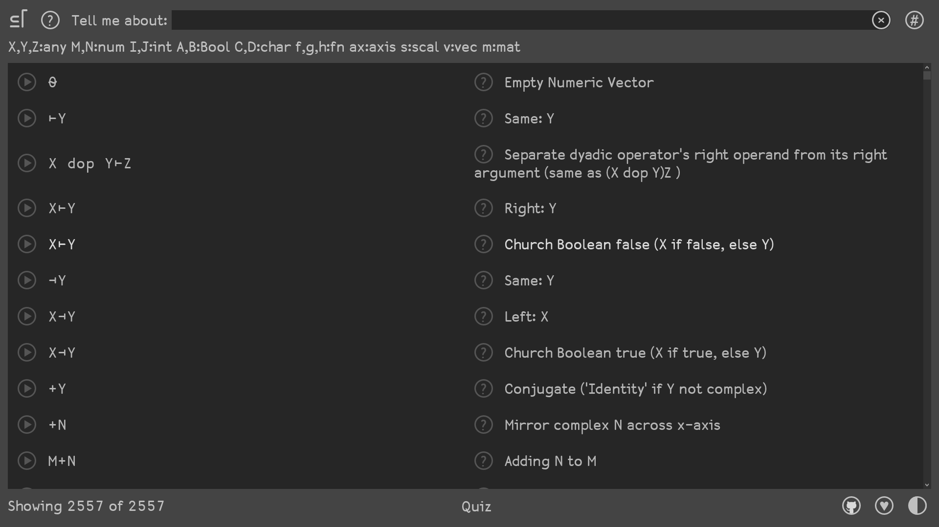

Slide 50
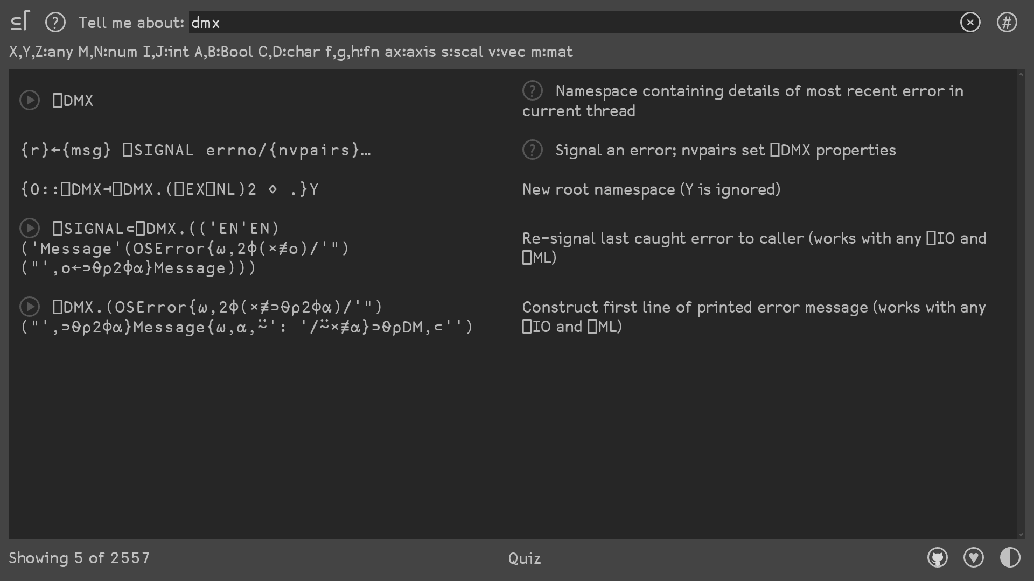

Slide 51
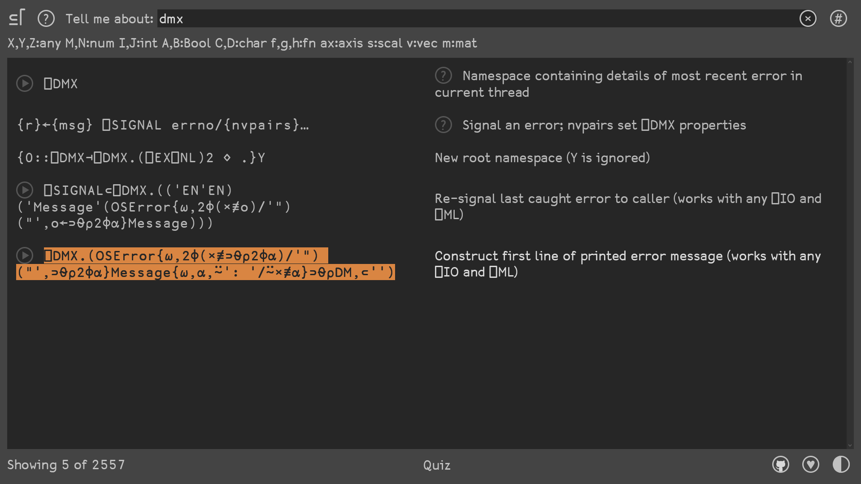

Slide 52
Extended Diagnostic Message: use case
∇ err ⍝ error handler
⎕DMX.(OSError{⍵,2⌽(×≢⊃⍬⍴2⌽⍺)/'") ("',⊃⍬⍴
↑1↓⎕DMX.DM
∇
⎕TRAP←0 'E' '#.err'
1÷0
DOMAIN ERROR: Divide by zero
1÷0
∧
???

Slide 53
Extended Diagnostic Message: use case
∇ foo ⍝ bad function
1÷0
∇
foo
DOMAIN ERROR: Divide by zero
foo[1] 1÷0
∧
)si
#.foo[1]*

Slide 54
Extended Diagnostic Message: use case
foo
DOMAIN ERROR: Divide by zero
foo[1] 1÷0
∧
)si
#.foo[1]*
#.foo[1]*

Slide 55
Trap Error
⎕TRAP ← ┌─────── handler ─────┐
Execute there: errors 'E' code
Cut stack first: errors 'C' code
Next handler: errors 'N'
Stop looking: errors 'S'

Slide 56
Extended Diagnostic Message: use case
foo
DOMAIN ERROR: Divide by zero
foo[1] 1÷0
∧
)si
#.foo[1]*
#.foo[1]*

Slide 57
Extended Diagnostic Message: use case
⎕TRAP←0 'E' '#.err'

Slide 58
Extended Diagnostic Message: use case
⎕TRAP←0 'C' '#.err'
)sic
foo
DOMAIN ERROR: Divide by zero
foo[1] 1÷0
∧
)si

Slide 59
Error Handling – Part 2
Construct error message
aplcart.info?q=dmx 1
Execute there on error ⎕TRAP←errors 'E' code
Cut back and execute ⎕TRAP←errors 'C' code
Ext'd Diagnostic Message ⎕DMX
F1
Press F1 for full docs!

Slide 60
Upcoming webinars
britishaplassociation.org
Apr 22 BAA open session
Apr 29 - - -
May 6 BAA open session
May 13 Dyalog Drawing the Mandelbrot Set
May 20 BAA open session
May 27 - - -
Jun 5 BAA open session
Jun 10 Dyalog Error Handling – Part 3

