Slide 1
Language Features of version 18.0 in Depth
Adám Brudzewsky
Part 2

Slide 2
New Improved
⎕C Case convert
f⍥g Over
f⍤g Atop
≠Y Unique mask
A⍨ Constant
⎕DT Date-time
1200⌶ Format date-time
⎕JSON⍠'HighRank'
⎕JSON⍠'Dialect'
⎕R/⎕S⍠'Regex'
⎕NPUT⍠'NEOL'
⍸Y
X⊂Y
↑[k]Y

Slide 3
New Improved
dyalog.tv/webinar
⎕C Case convert
f⍥g Over
f⍤g Atop
≠Y Unique mask
A⍨ Constant
⎕DT Date-time
1200⌶ Format date-time
⎕JSON⍠'HighRank'
⎕JSON⍠'Dialect'
⎕R/⎕S⍠'Regex'
⎕NPUT⍠'NEOL'
⍸Y
X⊂Y
↑[k]Y

Slide 4
New Improved
⎕C Case convert
f⍥g Over
f⍤g Atop
≠Y Unique mask
A⍨ Constant
⎕DT Date-time
1200⌶ Format date-time
⎕JSON⍠'HighRank'
⎕JSON⍠'Dialect'
⎕R/⎕S⍠'Regex'
⎕NPUT⍠'NEOL'
⍸Y
X⊂Y
↑[k]Y

Slide 5
Constant
^{makes {0} and {0}¨ obsolete}
A⍨

Slide 6
Why?
Lightweight notation
Proper visual order in trains
Avoid ugly work-arounds

Slide 7
Lightweight notation
'Hi'(1 2 3⍨)'Earth'
1 2 3
(1 2 3⍨)'Hello'
1 2 3
# ⎕SE⍨'World'
# ⎕SE

Slide 8
f g h
train
Lightweight notation
Train {A}×h
At {A}@h

Slide 9
Lightweight notation
Train {A}×h A×h
At {A}@h A@h
Constant {A}

Slide 10
Lightweight notation
Train {A}×h A×h
At {A}@h A@h
Constant {A}⍨

Slide 11
Lightweight notation
Train {A}×h A×h
At {A}@h A@h
Constant {A}⍨ A⍨

Slide 12
Lightweight notation
42⍨¨'Life' 'Universe' 'Everything'
42 42 42
(?9)⍨¨1 2∘.×1 2 3 4
7 7 7 7
7 7 7 7
('R'⍨⍤1)2 3 4⍴⍳24
RRR
RRR

Slide 13
Proper visual order in trains
normal code (⍺+⍵)*3
invalid train +*3
workaround 3*⍨+
workaround *∘3+

Slide 14
Proper visual order in trains
normal code (⍺+⍵)*3
invalid train +*3
valid train +*3⍨

Slide 15
Proper visual order in trains
normal code (⍺+⍵)*÷3
invalid train +*∘÷3
workaround (÷3)*⍨+
workaround 3*∘÷⍨+

Slide 16
Proper visual order in trains
normal code (⍺+⍵)*÷3
invalid train +*∘÷3 valid train +*∘÷3⍨
valid train +*1÷3⍨

Slide 17
Avoid ugly work-arounds
mask←1 0 0 0 1 0 0 ⋄ data←'AbcdEfg'
'⎕'@{mask}data
⎕bcd⎕fg
(mask/data)←'⎕' ⋄ data
⎕bcd⎕fg

Slide 18
Avoid ugly work-arounds
mask←1 0 0 0 1 0 0 ⋄ data←'AbcdEfg'
'⎕'@{mask}data
⎕bcd⎕fg
mask{'⎕'@{⍺}⍵}data
VALUE ERROR
mask{'⎕'@{⍺}⍵}data
∧

Slide 19
Avoid ugly work-arounds
mask←1 0 0 0 1 0 0 ⋄ data←'AbcdEfg'
'⎕'@{mask}data
⎕bcd⎕fg
mask{'⎕'@(⍺⍨)⍵}data
⎕bcd⎕fg

Slide 20
Enough, give it to me already!
Constant ← {⍺⍺}

Slide 21
New Improved
Date & time
⎕C Case convert
f⍥g Over
f⍤g Atop
≠Y Unique mask
A⍨ Constant
⎕DT Date-time
1200⌶ Format date-time
⎕JSON⍠'HighRank'
⎕JSON⍠'Dialect'
⎕R/⎕S⍠'Regex'
⎕NPUT⍠'NEOL'
⍸Y
X⊂Y
↑[k]Y

Slide 22
Date-time
Timestamp
Time number
Military time zone

Slide 23
Timestamp
^{year month day… ms} 2020 6 11 16 0 0 0 ⎕TS
^{year week weekday… µs} 2020 24 4 16 0 0 0
BST

Slide 24
Time number
^{days since 1899-12-31 00:00} 43992.70833
^{seconds since 1970-01-01 00:00} 1591894800
BST

Slide 25
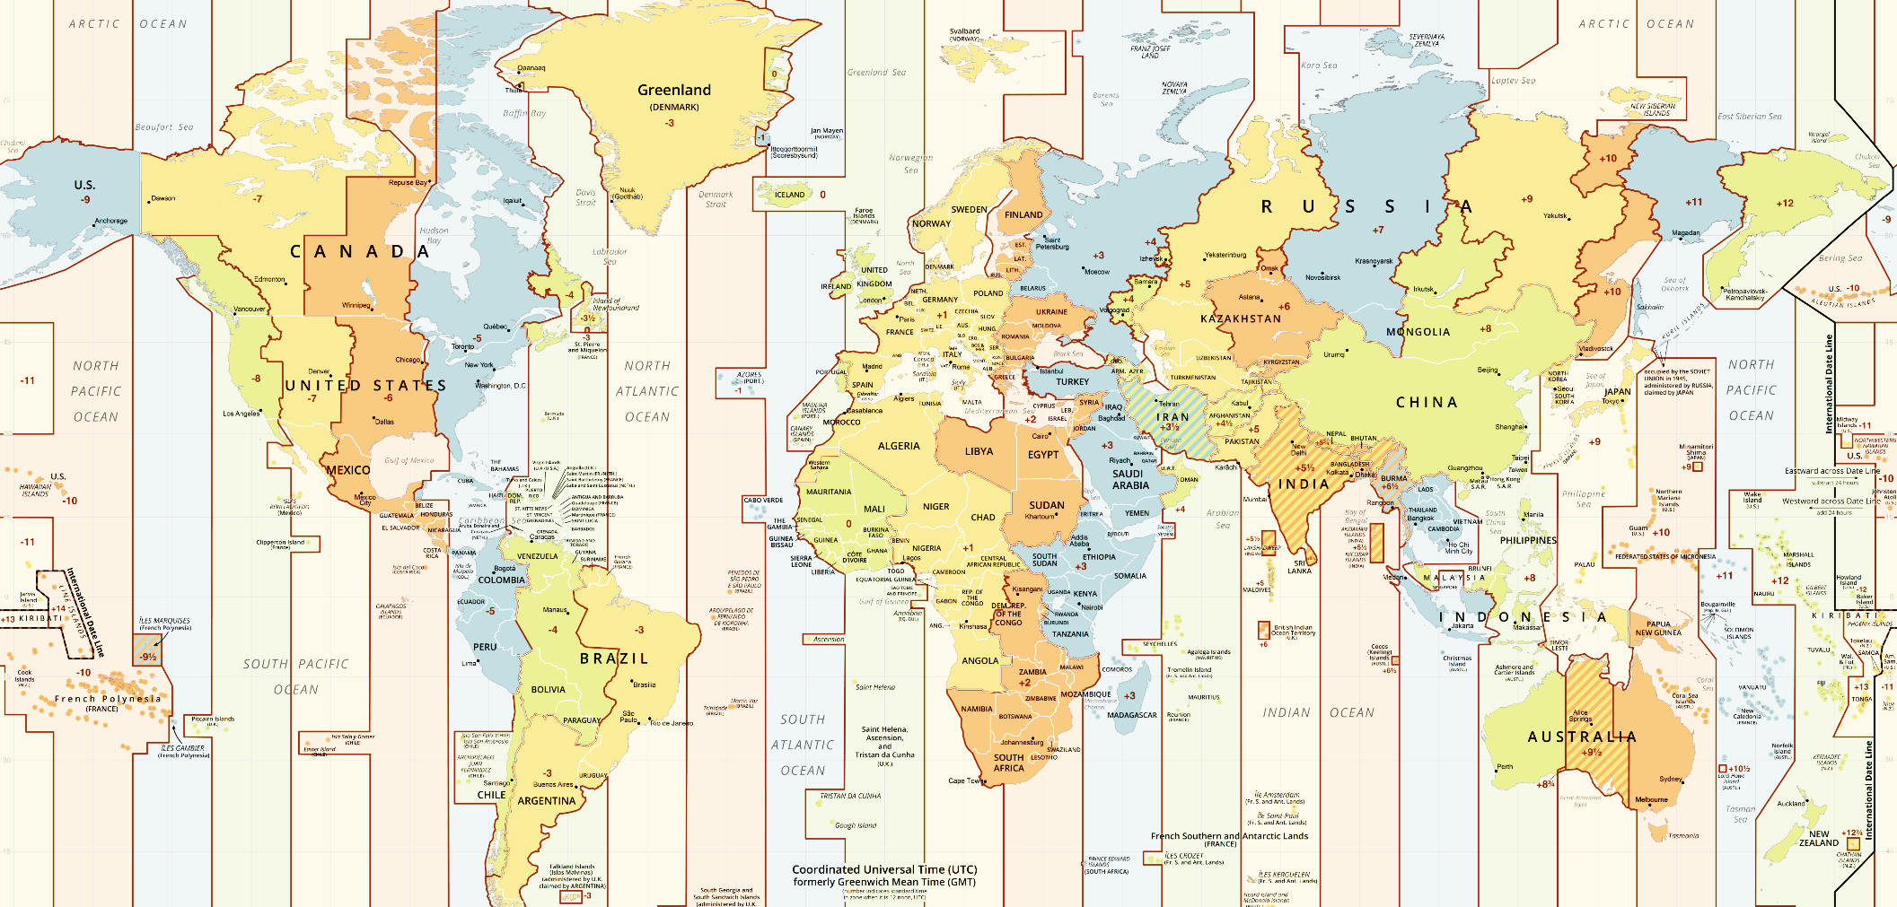
'Y' UTC-12
⋮
'P' UTC-3
'O' UTC-2
'N' UTC-1
'Z' UTC
'A' UTC+1 'J' local
'B' UTC+2
'C' UTC+3
⋮
'M' UTC+12
Military time zone
YXWVUTSRQPONZABCDEFGHIKLM
↑
J
BST

Slide 26
Time numbers Timestamps
1 Dyalog day number
2 Dyalog component file
10 J nanoseconds
11 Shakti K milliseconds
12 JavaScript/D/Q ms
13 R chron format
20 Unix time
30 MS-DOS date/time
31 MS-Win32 FILETIME
et cetera ad abundantiam
¯1 ⎕TS-style: year month… ms
¯2 Like ⎕TS but µs replacing ms
¯3 Like ⎕TS but ns replacing ms
¯10 ISO year day hour min sec µs
¯11 ISO year week weekday… µs
etc.

Slide 27
⎕DT syntax
Conversion
outCode ⎕DT dateTimes
inCode outCode ⎕DT dateTimes
Validation
0 ⎕DT dateTimes
inCode 0 ⎕DT dateTimes

Slide 28
⎕DT syntax: one-element left argument
Conversion: ⎕TS-style timestamp to Unix time
20 ⎕DT ⊂ 2020 06 11 16 00 00 000
1591891200
Validation: Leap year check
0 ⎕DT ⊂ 1900 02 29
0

Slide 29
⎕DT syntax: one-element left argument
Conversion: Current ⎕TS-style UTC time
¯1 ⎕DT 'Z'
2020 6 11 16 0 0 0
What time zone am I in?
3600÷⍨-/20 ⎕DT 'JZ'
1
BST=UTC+1

Slide 30
⎕DT syntax: two-element left argument
Conversion: Unix time to ⎕TS-style timestamp
20 ¯1 ⎕DT 1591891200
2020 6 11 16 0 0 0
Validation: Leap year check
60 0 ⎕DT 19000229
0

Slide 31
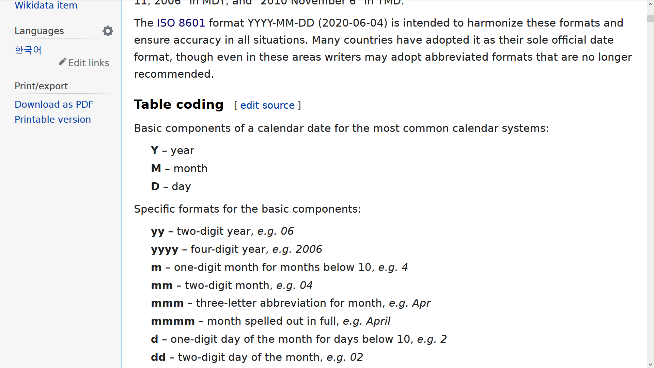
1200⌶ syntax
Format one or more date-times
format (1200⌶) dyalogDateNumbers
format (1200⌶) code 1 ⎕DT dateTimes
format (1200⌶) dyalogDateNumbers
format (1200⌶) code 1 ⎕DT dateTimes
12:00⌶
12:00⌶

Slide 32
1200⌶ syntax
Format one or more date-times
'YYYY-MM-DD' (1200⌶) dyalogDateNumbers

Slide 33
1200⌶ syntax: patterns
Format one or more date-times
'YYYY-MM-DD' (1200⌶) dyalogDateNumbers
'M' '6'
'MM' '06'
'MMM' 'JUN'
'MMMM' 'JUNE'

Slide 34
1200⌶ syntax: numbers
Format one or more date-times
'YYYY-MM-DD' (1200⌶) dyalogDateNumbers
'M' '6'
'MM' '06'
'_M' ' 6'

Slide 35
1200⌶ syntax: names
Format one or more date-times
'YYYY-MM-DD' (1200⌶) dyalogDateNumbers
'MMMM' 'JUNE'
'__en__MMMM' 'JUNE'
'__ru__MMMM' 'ИЮНЬ'
'__fr__MMMM' 'JUIN'

Slide 36
1200⌶ syntax: names
Format one or more date-times
'YYYY-MM-DD' (1200⌶) dyalogDateNumbers
'mmmm' 'june'
'Mmmm' 'June'
'MMMM' 'JUNE'

Slide 37
1200⌶ syntax: names
Format one or more date-times
'YYYY-MM-DD' (1200⌶) dyalogDateNumbers
__en__ __fr__
'mmmm' 'june' 'juin'
'Mmmm' 'June' 'Juin'
'MMMM' 'JUNE' 'JUIN'

Slide 38
1200⌶ syntax: names
Format one or more date-times
'YYYY-MM-DD' (1200⌶) dyalogDateNumbers
__en__ __fr__
'_mmm' 'June' 'juin'
'mmmm' 'june' 'juin'
'Mmmm' 'June' 'Juin'
'MMMM' 'JUNE' 'JUIN'

Slide 39
1200⌶ syntax: ordinals
Format one or more date-times
'YYYY-MM-DD' (1200⌶) dyalogDateNumbers
__en__ __fr__
'D' '1' '1'
'Doo' '1st' '1er'
'DD' '11' '11'
'DDoo' '11th' '11'

Slide 40
1200⌶ syntax: ordinals
Format one or more date-times
'YYYY-MM-DD' (1200⌶) dyalogDateNumbers
__en__ __da__
'D' '1' '1'
'Doo' '1st' '1.'
'DD' '11' '11'
'DDoo' '11th' '11.'

Slide 41
1200⌶ syntax: 12/24 hours
Format one or more date-times
'hh:mm' (1200⌶) dyalogDateNumbers
'h' '16'
't' '4'
't pp' '4 pm'
'tPP' '4PM'

Slide 42
1200⌶ examples
'DDoo Mmmm YYYY "at" hh:mm:ss.fff'
11th June 2020 at 16:00:00.000
'__da__Dddd, D. mmmm "''"YY'
Torsdag, 11. juni '20
'%ISO%'
2020-06-11T16:00:00

Slide 43
New Improved
Questions?
⎕C Case convert
f⍥g Over
f⍤g Atop
≠Y Unique mask
A⍨ Constant
⎕DT Date-time
1200⌶ Format date-time
⎕JSON⍠'HighRank'
⎕JSON⍠'Dialect'
⎕R/⎕S⍠'Regex'
⎕NPUT⍠'NEOL'
⍸Y
X⊂Y
↑[k]Y

Slide 44
New Improved
⎕C Case convert
f⍥g Over
f⍤g Atop
≠Y Unique mask
A⍨ Constant
⎕DT Date-time
1200⌶ Format date-time
⎕JSON⍠'HighRank'
⎕JSON⍠'Dialect'
⎕R/⎕S⍠'Regex'
⎕NPUT⍠'NEOL'
⍸Y
X⊂Y
↑[k]Y

Slide 45
Thinking in APL: Array-Oriented Solutions
Richard Park
Part 1 June 25, 2020

