Slide 1
New User Commands in Dyalog v18.2
Rich Park

Slide 2
Overview
]OUTPUT.View
]WS.Names
]TOOLS.APLCart
]OUTPUT.Repr
]EXPERIMENTAL.Get

Slide 3
Overview
]OUTPUT.View
]WS.Names
]TOOLS.APLCart
]OUTPUT.Repr
]EXPERIMENTAL.Get

Slide 4
]OUTPUT.View
]WS.Names
]TOOLS.APLCart
]OUTPUT.Repr
]EXPERIMENTAL.Get

Slide 5
]OUTPUT.View
Classic window mode

Slide 6
]OUTPUT.View
Classic window mode

Slide 7
]OUTPUT.View
Classic window mode
Inspect long output

Slide 8
]OUTPUT.View
Classic window mode
Inspect long output
]rows on

Slide 9
]OUTPUT.View
Classic window mode
Inspect long output
]view ⍳⍳5

Slide 10
]OUTPUT.View
Classic window mode
Inspect long output
]view ⍳⍳5

Slide 11
]OUTPUT.View
Classic window mode
Inspect long output
Snapshot an APL item

Slide 12
]OUTPUT.View
Classic window mode
Inspect long output
Snapshot an APL item
var←'oldvalue'

Slide 13
]OUTPUT.View
Classic window mode
Inspect long output
Snapshot an APL item
var←'oldvalue'
]view var

Slide 14
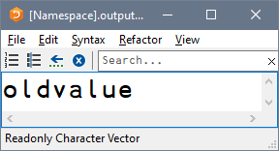
]OUTPUT.View
Classic window mode
Inspect long output
Snapshot an APL item
var←'oldvalue'
]view var

Slide 15
]OUTPUT.View
Classic window mode
Inspect long output
Snapshot an APL item
var←'oldvalue'
]view var
(3↑var)←'new'

Slide 16
]OUTPUT.View
Classic window mode
Inspect long output
Snapshot an APL item
var←'oldvalue'
]view var
(3↑var)←'new'
)ed var

Slide 17
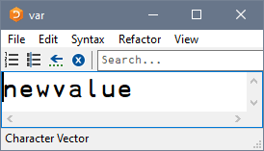
]OUTPUT.View
Classic window mode
Inspect long output
Snapshot an APL item
var←'oldvalue'
]view var
(3↑var)←'new'
)ed var

Slide 18
]OUTPUT.View
Classic window mode
Inspect long output
Snapshot an APL item
Settings: ]Box -view=

Slide 19
]OUTPUT.View
Classic window mode
Inspect long output
Snapshot an APL item
Settings: ]Box -view=
]box on –v=max

Slide 20
]OUTPUT.View
Classic window mode
Inspect long output
Snapshot an APL item
Settings: ]Box -view=
]box on –v=max
Was OFF -view=min

Slide 21
]OUTPUT.View
Classic window mode
Inspect long output
Snapshot an APL item
Settings: ]Box -view=
]box on –v=max
Was OFF -view=min
]view ⍳⍳5

Slide 22
]OUTPUT.View
Classic window mode
Inspect long output
Snapshot an APL item
Settings: ]Box -view=
]box on –v=max
Was OFF -view=min
]view ⍳⍳5
]WS.Names
]TOOLS.APLCart
]OUTPUT.Repr
]EXPERIMENTAL.Get

Slide 23
]OUTPUT.View
]WS.Names
]TOOLS.APLCart
]OUTPUT.Repr
]EXPERIMENTAL.Get

Slide 24
]WS.Names
]OUTPUT.View
]TOOLS.APLCart
]OUTPUT.Repr
]EXPERIMENTAL.Get
Notes:
Set PW, Friendly view of namespace content

Slide 25
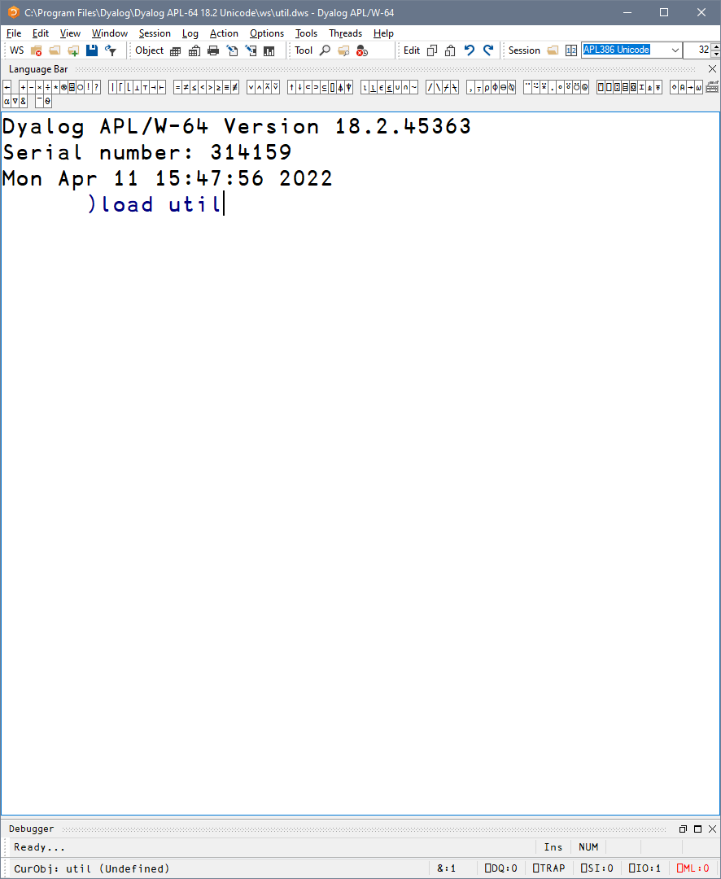
]WS.Names
Notes:
Set PW, Friendly view of namespace content

Slide 26
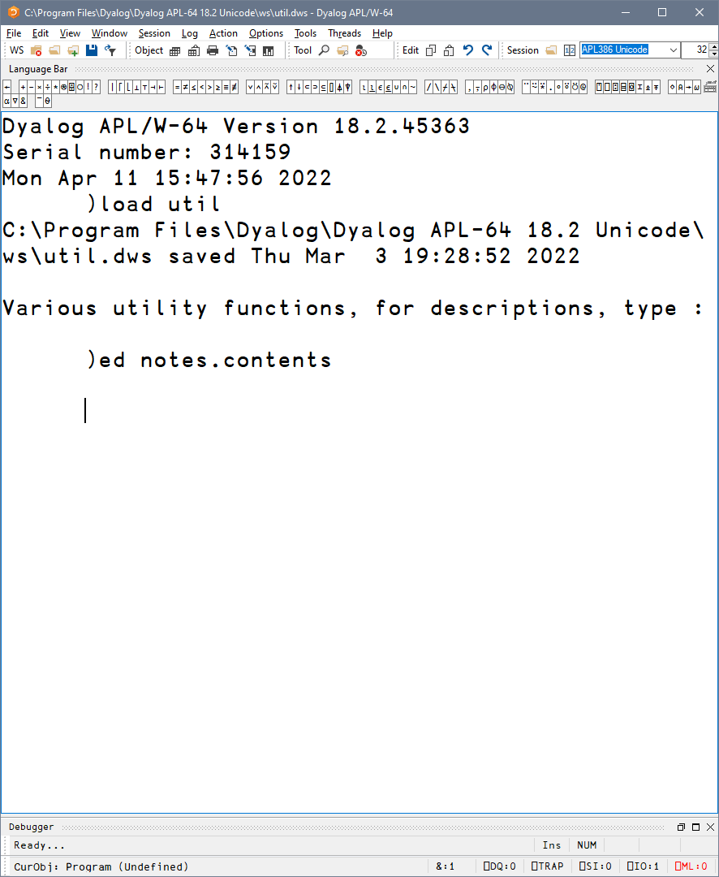
]WS.Names
Notes:
Set PW, Friendly view of namespace content

Slide 27
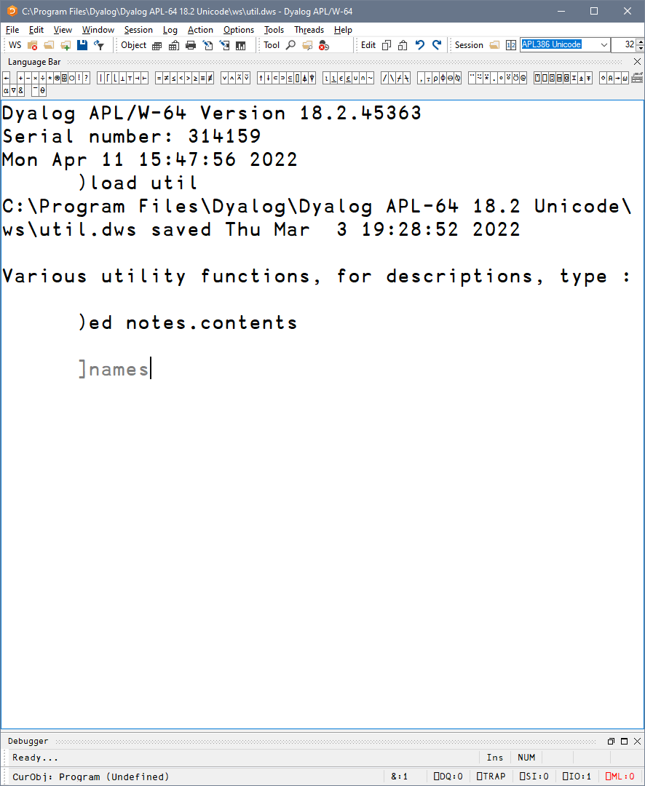
]WS.Names
List all
Notes:
Set PW, Friendly view of namespace content

Slide 28
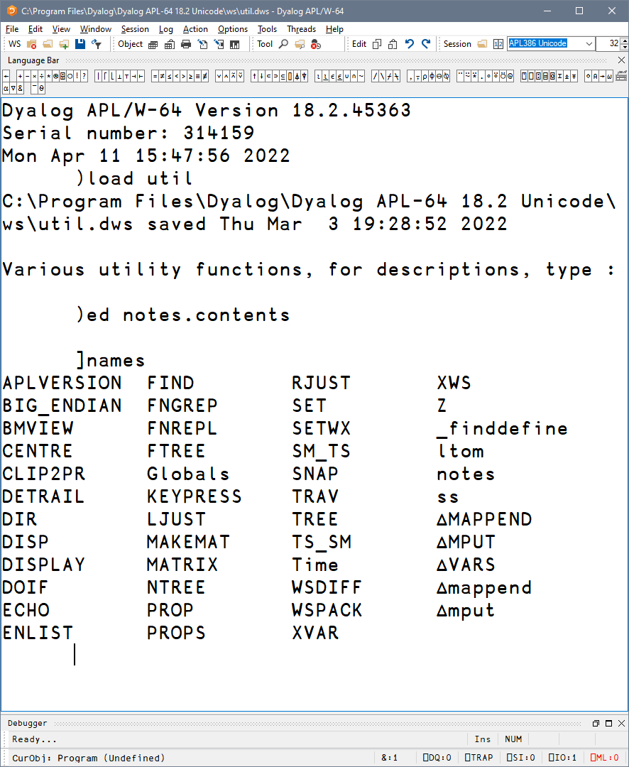
]WS.Names
List all
Notes:
Set PW, Friendly view of namespace content

Slide 29
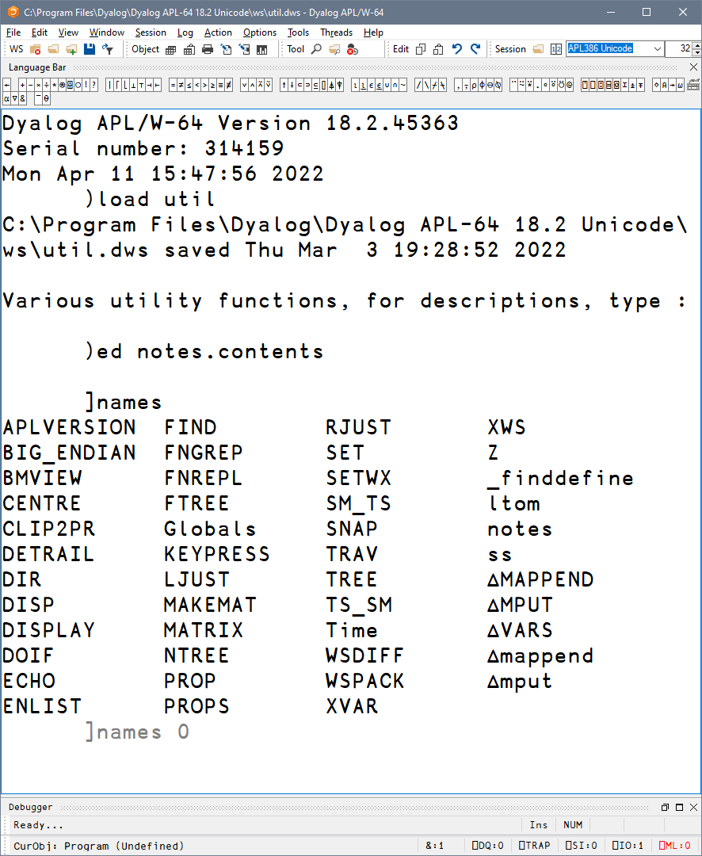
]WS.Names
List all
Group by nameclass
Notes:
Set PW, Friendly view of namespace content

Slide 30
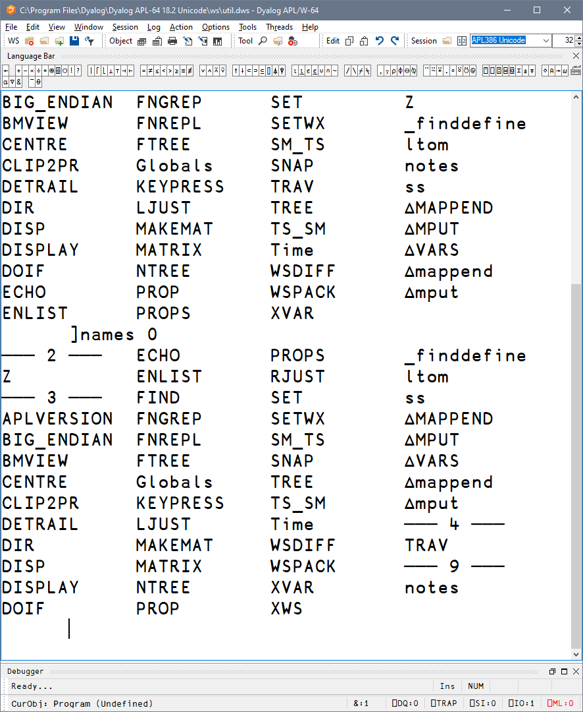
]WS.Names
List all
Group by nameclass
Notes:
Set PW, Friendly view of namespace content

Slide 31
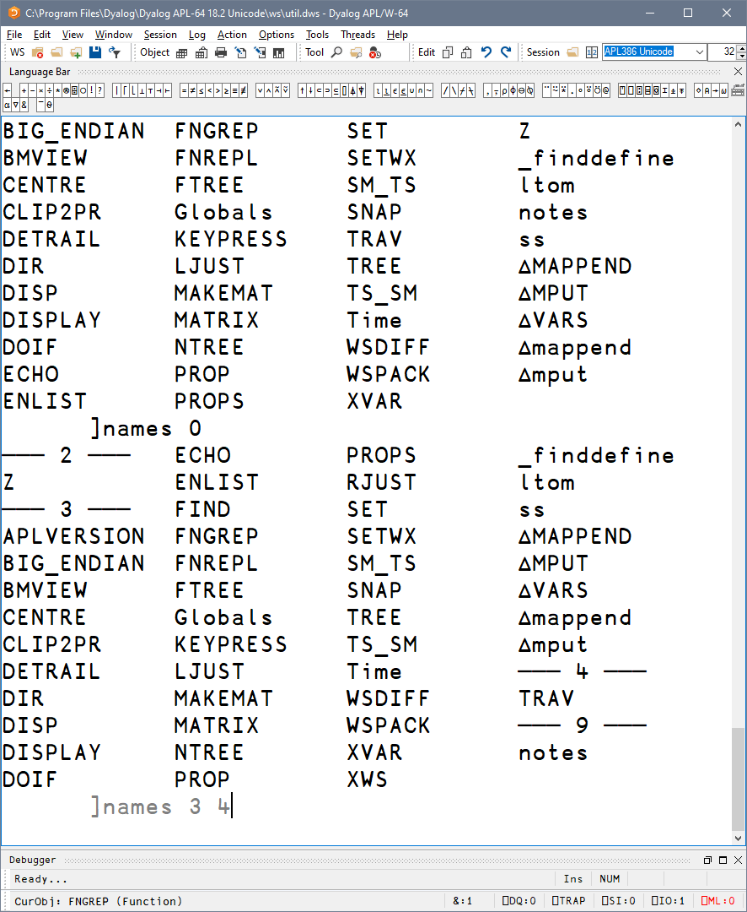
]WS.Names
List all
Group by nameclass
Filter by nameclass
Notes:
Set PW, Friendly view of namespace content

Slide 32
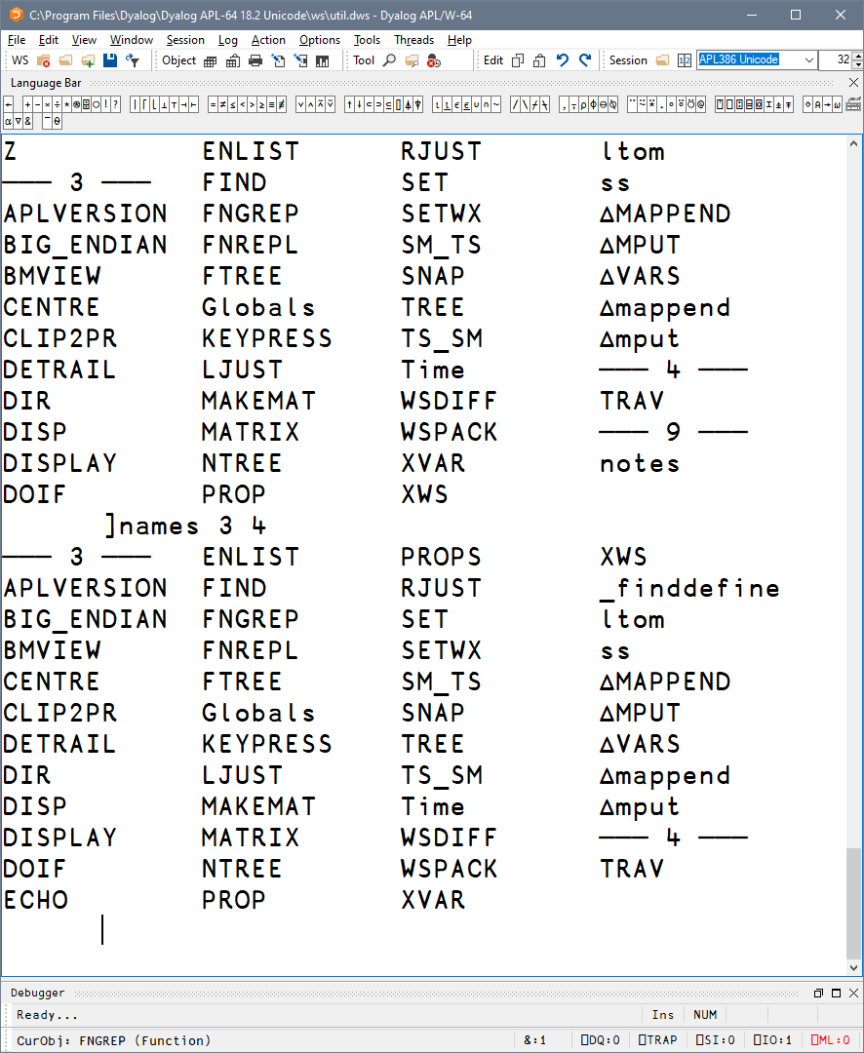
]WS.Names
List all
Group by nameclass
Filter by nameclass
Notes:
Set PW, Friendly view of namespace content

Slide 33
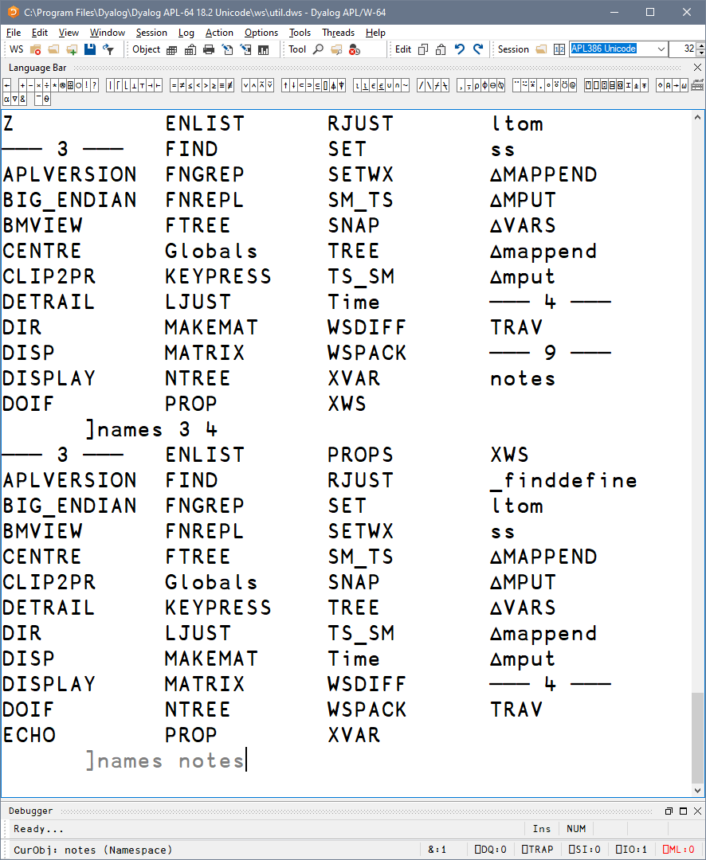
]WS.Names
List all
Group by nameclass
Filter by nameclass
Specific namespace
Notes:
Set PW, Friendly view of namespace content

Slide 34
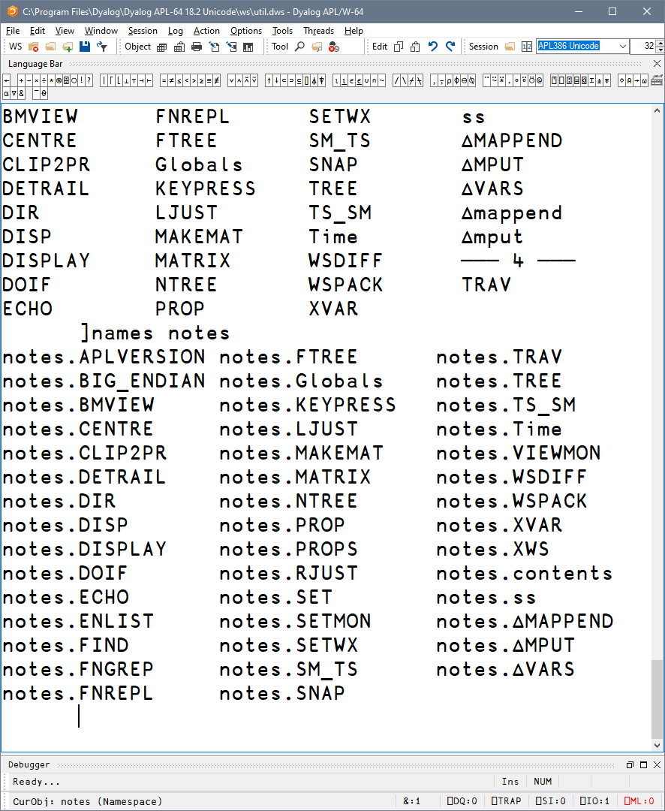
]WS.Names
List all
Group by nameclass
Filter by nameclass
Specific namespace
Notes:
Set PW, Friendly view of namespace content

Slide 35
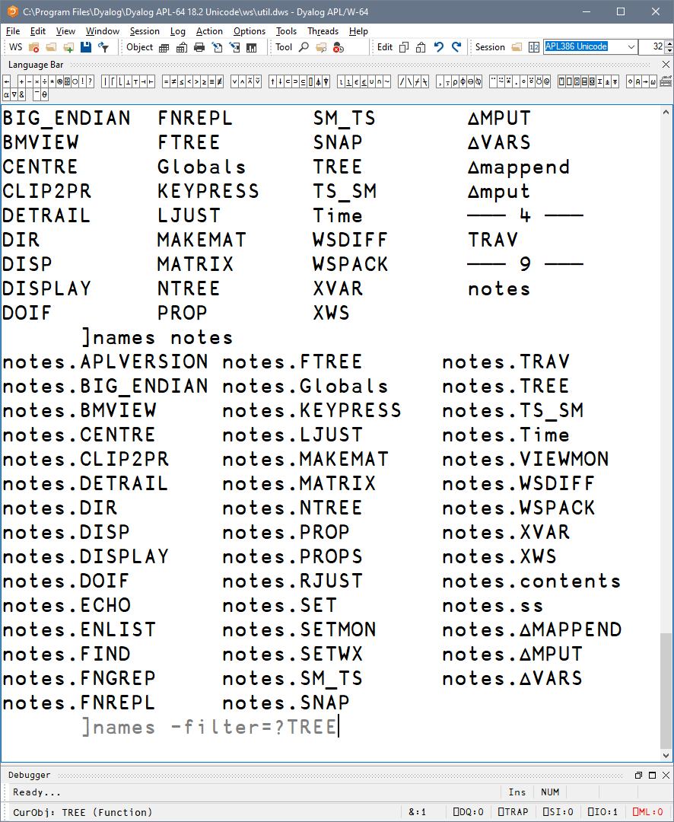
]WS.Names
List all
Group by nameclass
Filter by nameclass
Specific namespace
Filter using wildcards
Notes:
Set PW, Friendly view of namespace content

Slide 36
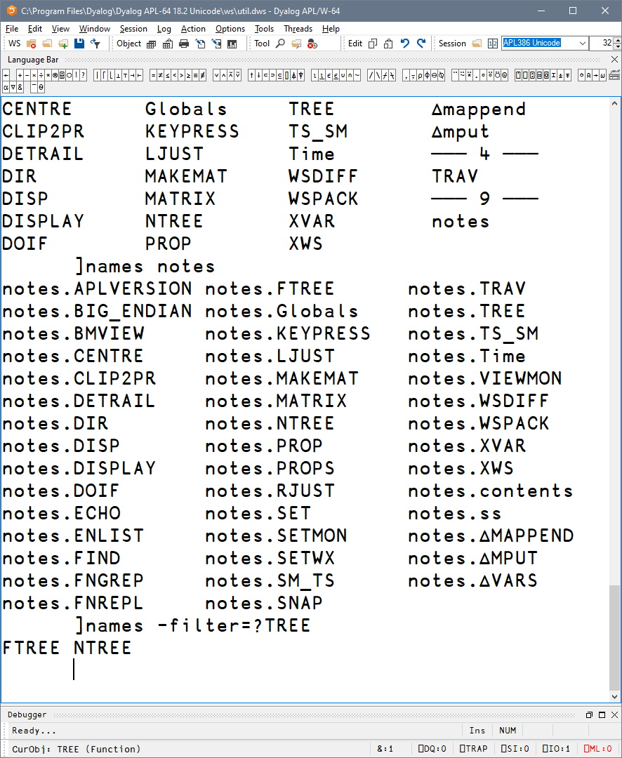
]WS.Names
List all
Group by nameclass
Filter by nameclass
Specific namespace
Filter using wildcards
Notes:
Set PW, Friendly view of namespace content

Slide 37
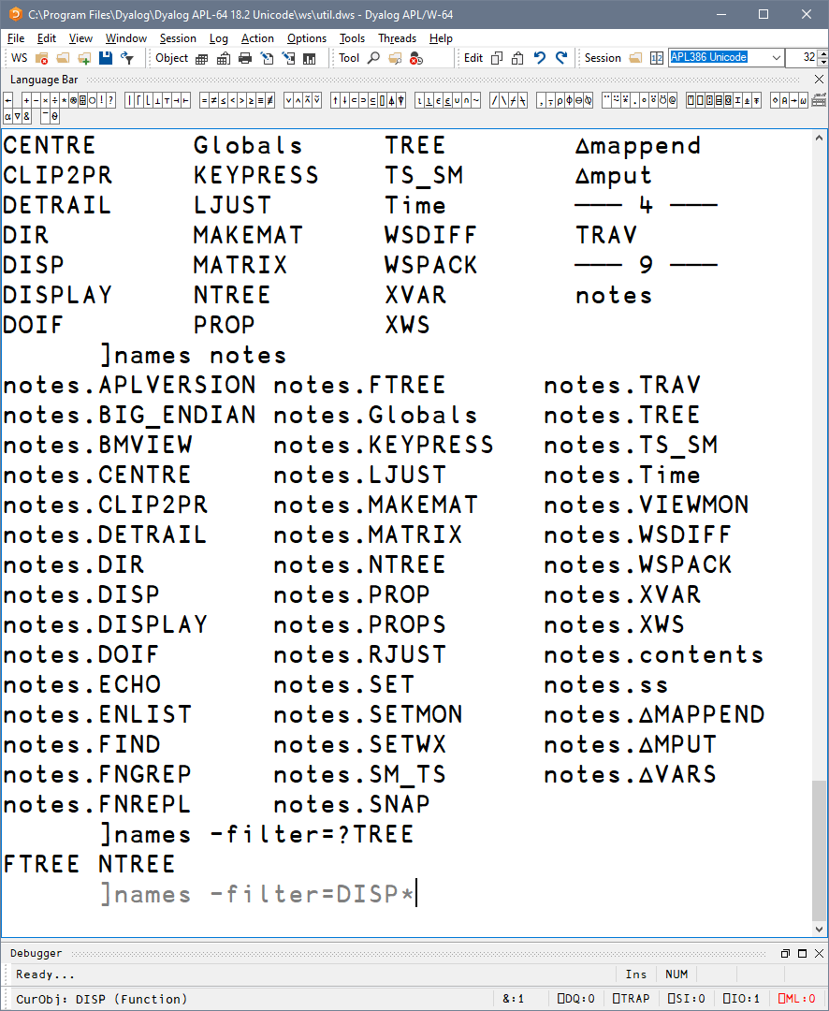
]WS.Names
List all
Group by nameclass
Filter by nameclass
Specific namespace
Filter using wildcards
Notes:
Set PW, Friendly view of namespace content

Slide 38
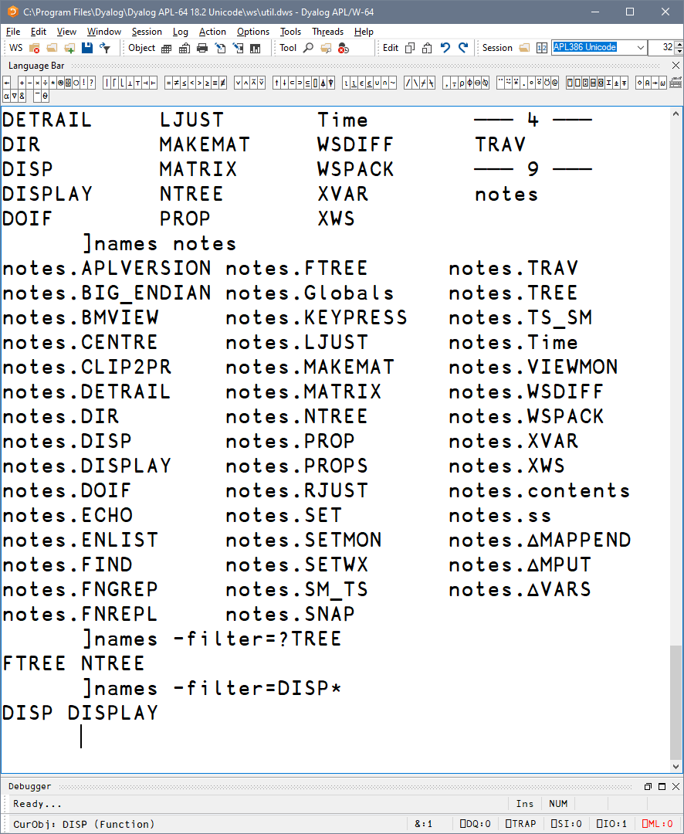
]WS.Names
List all
Group by nameclass
Filter by nameclass
Specific namespace
Filter using wildcards
Notes:
Set PW, Friendly view of namespace content

Slide 39
]WS.Names
List all
Group by nameclass
Filter by nameclass
Specific namespace
Filter using wildcards
Filter using regex
Notes:
Set PW, Friendly view of namespace content

Slide 40
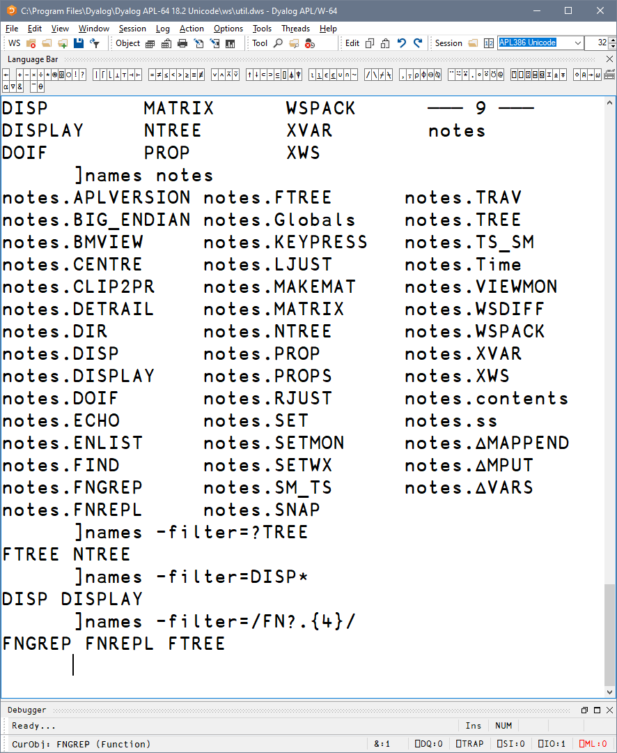
]WS.Names
List all
Group by nameclass
Filter by nameclass
Specific namespace
Filter using wildcards
Filter using regex
Notes:
Set PW, Friendly view of namespace content

Slide 41
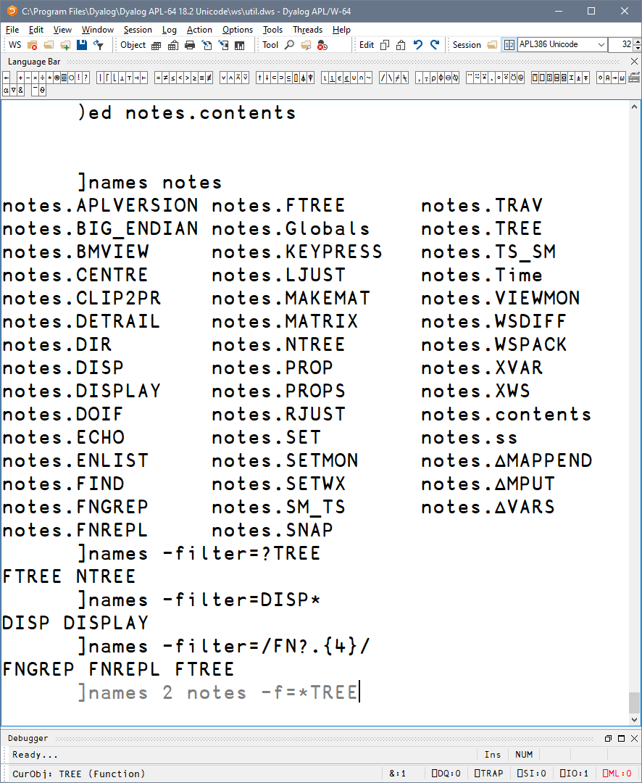
]WS.Names
List all
Group by nameclass
Filter by nameclass
Specific namespace
Filter using wildcards
Filter using regex
Combine all of these!
Notes:
Set PW, Friendly view of namespace content

Slide 42
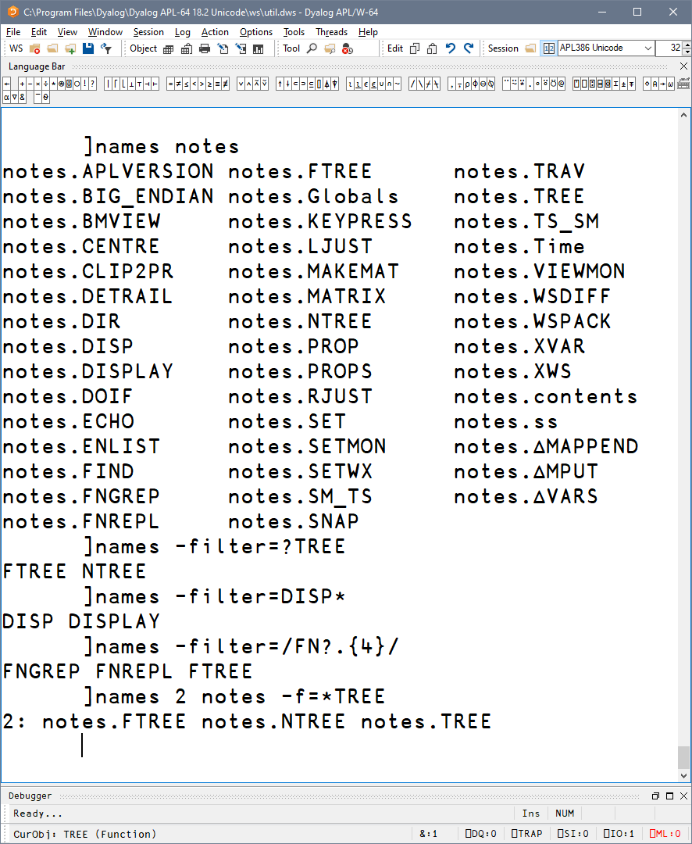
]WS.Names
]OUTPUT.View
List all
Group by nameclass
Filter by nameclass
Specific namespace
Filter using wildcards
Filter using regex
]TOOLS.APLCart
Combine all of these!
]OUTPUT.Repr
]EXPERIMENTAL.Get
Notes:
Set PW, Friendly view of namespace content

Slide 43
]OUTPUT.View
]WS.Names
]TOOLS.APLCart
]OUTPUT.Repr
]EXPERIMENTAL.Get

Slide 44
]TOOLS.APLCart
]OUTPUT.View
Display in session
]WS.Names
]OUTPUT.Repr
]EXPERIMENTAL.Get
Notes:
You know what you want, how do I…?

Slide 45
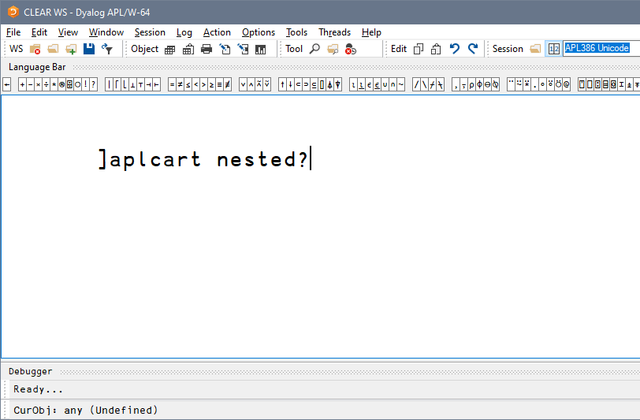
]TOOLS.APLCart
Display in session
Notes:
You know what you want, how do I…?

Slide 46
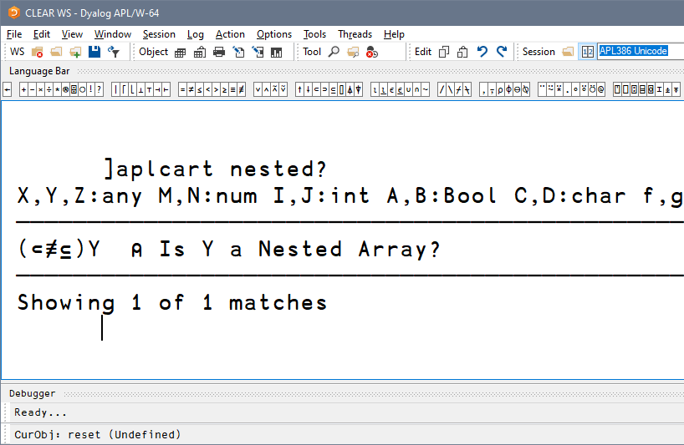
]TOOLS.APLCart
Display in session
Notes:
You know what you want, how do I…?

Slide 47
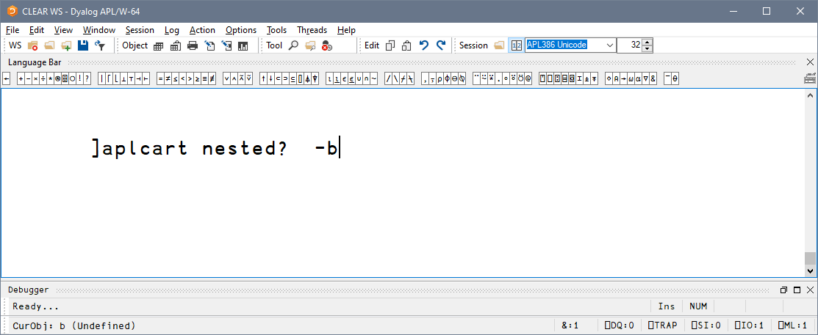
]TOOLS.APLCart
Display in session
Display in browser
Notes:
You know what you want, how do I…?

Slide 48
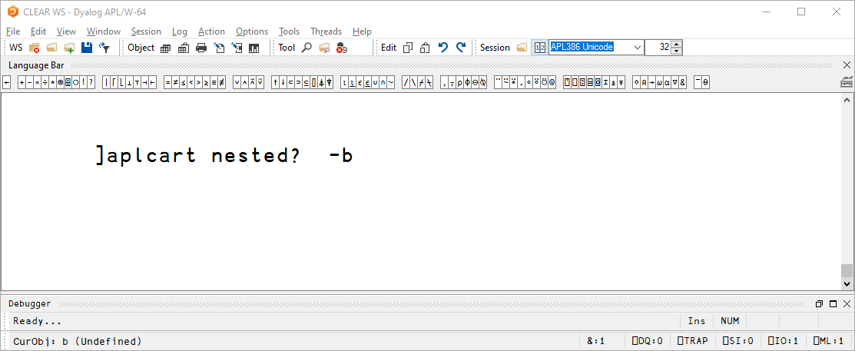
]TOOLS.APLCart
Display in session
Display in browser
Notes:
You know what you want, how do I…?

Slide 49
]TOOLS.APLCart
Display in session
Display in browser
Display in popup
Notes:
You know what you want, how do I…?

Slide 50
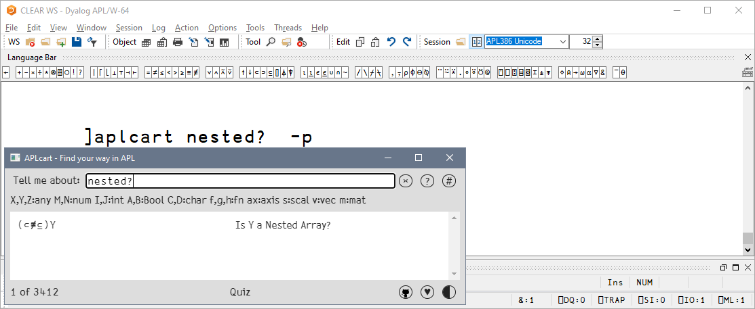
]TOOLS.APLCart
]OUTPUT.View
Display in session
Display in browser
Display in popup
]WS.Names
]OUTPUT.Repr
]EXPERIMENTAL.Get
Notes:
You know what you want, how do I…?

Slide 51
]OUTPUT.View
]WS.Names
]TOOLS.APLCart
]OUTPUT.Repr
]EXPERIMENTAL.Get

Slide 52
]OUTPUT.Repr
]OUTPUT.View
]repr expression
]TOOLS.APLCart
]WS.Names
]EXPERIMENTAL.Get

Slide 53
]OUTPUT.Repr
]repr expression -format=
APL ^{single-line APL expression}
APLAN ^{APL Array Notation}
JS JavaScript for inclusion in code
JSON ^{JavaScript Object Notation}
XML ^{Extensible Markup Language}
CSV ^{Comma-Separated Values} ,
SSV ^{Semicolon-Separated Values} ;
PSV ^{Pipe-Separated Values} |
TSV ^{Tab-Separated Values} ⭾

Slide 54
]OUTPUT.Repr
]repr expression -format=format

Slide 55
]OUTPUT.Repr
]repr expression -format=format -outfile=filename

Slide 56
]OUTPUT.Repr
]display var
┌→──┐
│1 1│
└+──┘
]repr var
1 '1'

Slide 57
]OUTPUT.Repr
]repr +⌿÷1⌈≢
(+⌿)÷(1⌈≢)
Merge←⍳⍤≢⍤⊣⌷∘⊃⍤0⌷⍤0 99
]repr Merge
Merge←((⍳⍤≢)⍤⊣)((⌷∘⊃)⍤0)(⌷⍤0 99)

Slide 58
]OUTPUT.Repr
]repr ⍳1 2 –f=aplan
[
(
1 1
1 2
)
]

Slide 59
]OUTPUT.Repr
]repr Hook
⎕FX' Hook←{' ' ⍺←⍵' ' ⍵ ⍵⍵⍨⍺⍺ ⍵' ' }'
]repr Hook -f=aplan
Hook←{
⍺←⍵
⍵ ⍵⍵⍨⍺⍺ ⍵
}

Slide 60
]OUTPUT.Repr
'ns.sub'⎕NS⍬
ns.sub.val←,42
]repr ns -f=aplan
(
sub:(
val:(42⋄)
)
)

Slide 61
]OUTPUT.Repr
'ns.sub'⎕NS⍬
ns.sub.val←,42
]repr ns -f=js
{
sub: {
val: [42],
},
}
]repr ns -f=json
{
"sub": {
"val": [42]
}
}

Slide 62
]OUTPUT.Repr
'ns.sub'⎕NS⍬
ns.sub.val←,42
]repr ns -f=js
{
sub: {
val: [42],
},
}
]repr ns -f=js
{
"sub": {
"val": [42]
}
}

Slide 63
]OUTPUT.Repr
⎕JSON⍠('HighRank' 'Split')('Compact' 0)⊢m
[
[
1,
2
],
[
3,
4
]
]
]repr -f=json 2 2⍴⍳4
[[1,2],
[3,4]]

Slide 64
]OUTPUT.Repr
]repr 3 3⍴⍳9 -f=xml
<array>
<shape>3 3</shape>
<list>1 2 3 4 5 6 7 8 9</list>
</array>

Slide 65
]OUTPUT.Repr
]repr 3 3⍴⍳9 -f=csv
1,2,3
4,5,6
7,8,9

Slide 66
]OUTPUT.Repr
]OUTPUT.View
]repr 3 3⍴⍳9 -f=ssv
1;2;3
4;5;6
7;8;9
]WS.Names
]TOOLS.APLCart
]EXPERIMENTAL.Get

Slide 67
]OUTPUT.View
]WS.Names
]View -?
]TOOLS.APLCart
]OUTPUT.Repr
]EXPERIMENTAL.Get

Slide 68
Next Webinar
]OUTPUT.View
May 12: Getting Data and Code into the Workspace featuring
Remember: BAA webinars every other week britishaplassociation.org/webinar-schedule-2022 April 21st, May 5th, May 19th, June 2nd, etc.
More at: apl.wiki/activities
]EXPERIMENTAL.Get
]WS.Names
]TOOLS.APLCart
]OUTPUT.Repr

