Slide 1
Array Notation
Morten Kromberg, CTO

Slide 2

















Dyalog – The Next Generation
2010-2021
2022
2023
2024
2023 Summer Interns

Slide 3
Dyalog – The Next Generation
2010-2021
2022
2023
2024
2023 Summer Interns

Slide 4
A Way to Write Most Arrays Literally
Literally means: Statically parseable,
without executing APL primitives
Nested vectors using ( … )
High rank arrays using [ … ]
Namespaces using (name:value pairs)

Slide 5
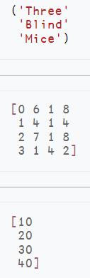
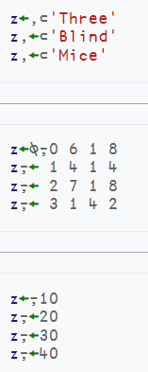

Hopefully "Intuitive" … let's test it!
Multiple statements within parentheses define a nested vector

Slide 6
Matrices
Statements within brackets define a high rank array
The results of the statements are "mixed" to produce the final array
NB: The minimum rank of each individual result is 1 (vector)
  The result will have 2 or more dimensions.
The last example gives us a one-column matrix, not a vector

Slide 7
"Multiple Statements"
Array Notation uses
brackets and parentheses…
… that span Multiple Statements.
[1 0 1
0 1 0
1 0 1]
… is equivalent to …
[1 0 1 ⋄ 0 1 0 ⋄ 1 0 1]
Statements can be separated by new lines
OR by diamonds

Slide 8
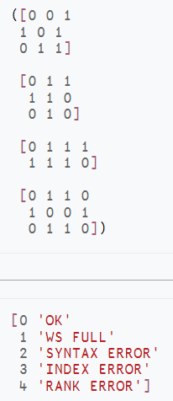
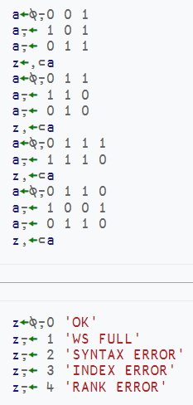
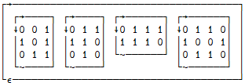
Vector of Matrices
A vector (…) of four matrices […]

Slide 9
Error Message Table
A two-column nested matrix

Slide 10


Literal Namespace Notation
"JSON for APL"

Slide 11
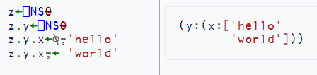
Namespace With a Matrix
Vector notation, Matrix notation, and Namespace notation can be contained within each other.

Slide 12

Empty Namespace(s)

Slide 13
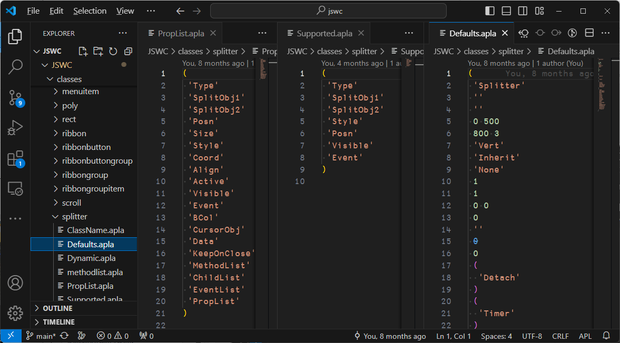

Slide 14
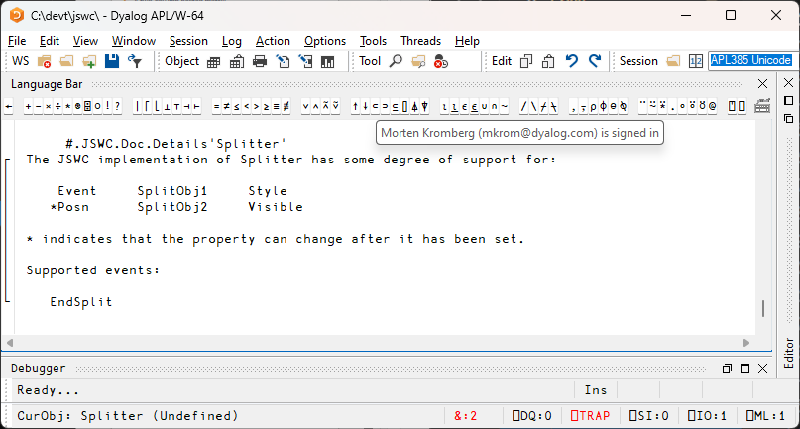
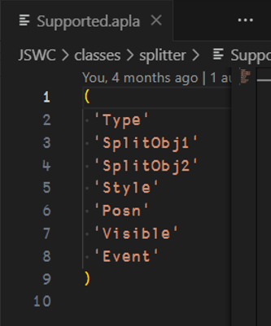

Slide 15
Array Notation - Status
APL model used by Link to store variables for a couple of years
⎕SE.Dyalog.Array.Serialise
|Deserialise
Public proposal published
  https://aplwiki.com/wiki/Array_notation
Very little feedback from the community
Will be integrated with interpreter in v20.0

Slide 16


Prototypes
V20.0 Production

Slide 17
Live Demos..?

