Slide 1
Migrating to Dyalog
Morten Kromberg, CTO

Slide 2
A New Wave of Migrants
Dyalog APL was created by Dyadic Systems Ltd in 1981
To replace mainframe APL systems
Almost all users of Dyalog APL are migrants
from SHARP APL, IBM APL2, APL+Win, APLX, or DEC APLSF, or …
Waves of migrants
Death of mainframes and minicomputers (1980's)
Superior support for Windows GUI (1990's)
Now, "the cloud" (& a few more mainframes being shut down)

Slide 3
Why migrate to Dyalog?
Dyalog re-invests 90-95% of revenues in
Enhancing APL core technology
Creating tools for APL developers
Marketing APL outside the current APL community
Combined revenues of products and services based on Dyalog APL exceeds $1Bn per year – and is growing

Slide 4
Selected Features added 2006-2024
Web Server and Web Service Frameworks
Run APL as a Windows Service
Public Docker Containers
Remote IDE for debugging service processes
Health Monitor for monitoring multiple processes
Parallel and Asynchronous Execution
New Data Types:
128-bit Decimal Floating Point
Complex Numbers
Functional Programming (dfns)
New primitives: Key, Stencil, Where, …
Significant steps towards an APL compiler
Many speed-ups of interpreter algorithms
Object Orientation
Microsoft.Net Integration
HTMLRenderer object embeds Chromium Web Browser engine
64-bit: *NO* workspace or component file size limits
Unicode Support, APL Source in Text Files
Secure TCP Sockets w/ IPv6 Support
Encryption Toolkit
Regular Expressions (PCRE) built-in to APL
XML and JSON parsers for fast conversion to (and from) APL structures
Most features identical across all platforms

Slide 5
Why Migrate to Dyalog?
Developer tools are free, cross-platform and mostly open source:
Name | Description
SQAPL | ODBC Interface (also ADO and ADO.NET)
Jarvis | HTTP/JSON and REST service framework
HttpCommand | HTTP client
SAWS | SOAP service framework
Conga | TCP and UDP layer
SharpPlot | Business and Technical graphics
⎕XML, ⎕JSON, ⎕CSV | Built in to interpreter
Name | Description
RConnect | Interface to R
MiServer / DUI | Web Application Framework
Docker Containers | Published examples
Link | Interface to source code management
APLProcess | And isolates

Slide 6
Why Migrate to Dyalog?
Emerging Tools
Separately Licensed Tools
Name | Description
Cider | Project Management
Tatin | Package Manager
NuGet | Interface to .NET Packages
Selenium | Automated GUI testing
Jupyter | Jupyter notebooks containing APL
eWC | JavaScript emulation of Win32 GUI
Arrow & Parquet | Data Science data formats
Name | Description
DFS | Dyalog File Server ("SHAREFILE")
Static Analysis | Static Analyisis of APL Code (code linting and vulnerability detection) Planned for 2025

Slide 7
Why Migrate to Dyalog?
Dyalog is 100% Cross Platform
Born under UNIX (Solaris, AIX, …)
Ported to DOS, Windows, Linux (ARM, Intel), MacOS (Intel, Mx)
Single source for all platforms
Workspaces and component files compatible across all platforms
All tools are tested on all platforms
Exceptions where O/S does not provide a feature
.NET not under AIX, many Windows-only features like DDE, COM/OLE

Slide 8
Remote IDE (RIDE)
Connect to and debug Dyalog APL running on any platform
From Windows, Linux or MacOS
Or indeed a browser running anywhere…
Interpreter can serve up RIDE as a web app

Slide 9
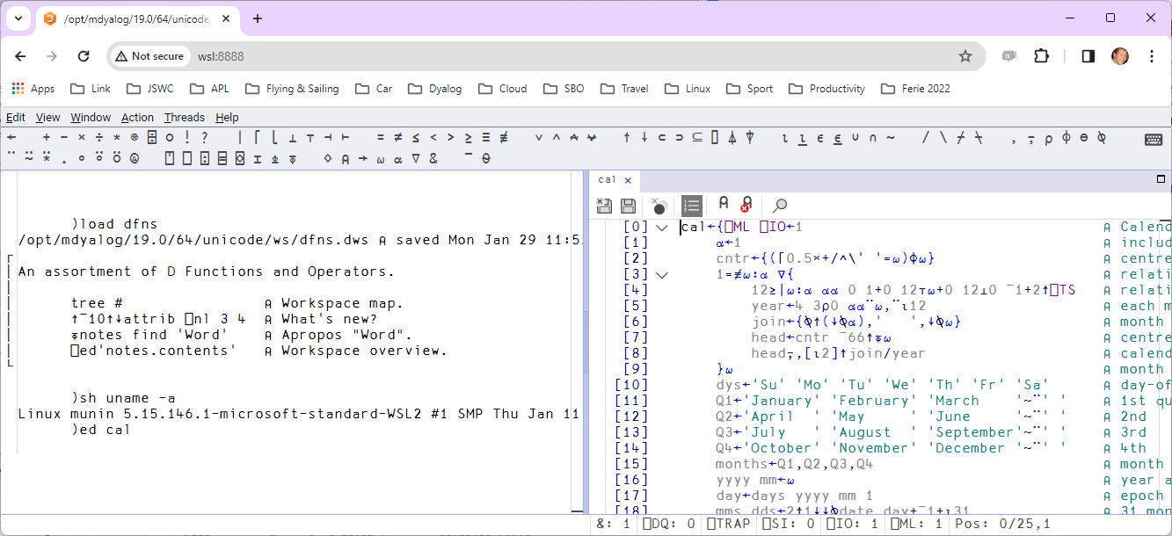
RIDE running in a browser

Slide 10
Why Migrate to Dyalog?
Dyalog is "Cloud Ready"
ARM and Intel Linux versions
Public Docker containers
Remote IDE
Text-based source supports "Continuous Integration"
Build & deploy containers on commit or push
User community starting to gain significant experience
Working on tools to port Windows GUI to HTML/JS

Slide 11
Why Migrate to Dyalog?
Dyalog APL is fast!
Core algorithms regularly updated to take advantage of new hardware and new theory
Research into a compiler continues

Slide 12
Why Migrate to Dyalog?
Dyalog APL is carefully designed to last. For example:
Dyalog APL is tightly integrated with .NET
… and still supports the old .NET Framework
However, Dyalog APL does not and WILL NOT depend on .NET
It also runs under IBM AIX, where .NET does not exist
Dyalog *will* remain very portable and independent of "temporary" frameworks

Slide 13

















The Real Reason to Pick Dyalog APL

Slide 14
HOW to Migrate to Dyalog APL
From IBM / Logon APL2
From APL+Win or MicroAPL APLX

Slide 15
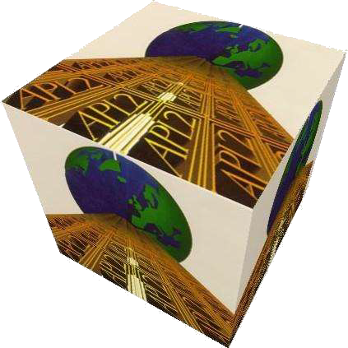
From APL2
Relatively straightforward
A few language differences
User Interfaces and file I/O are usually handled by simple cover-functions and possible to emulate automatically
Linux or Windows apps may be making external calls which will require "tweaking"
Considering implementing "format by example" but so far it has not been necessary '555-5555'⍕nums
Easy to model in APL if necessary

Slide 16
Recent / Active APL2 Migrations
Insurance company
No UI, manipulates text and Excel files
Handled by European Consulting Partner
Sandvik (Sweden) – in progress: Mainframe APL2 direct to Docker Containers and HTML/svg
Handled by Tiamatica in Malmö (Gilgamesh Athoraya)
BIG Jewellers: Windows
Handled by customer "with a little help"
Two more under discussion
(Germany, Canada)

Slide 17
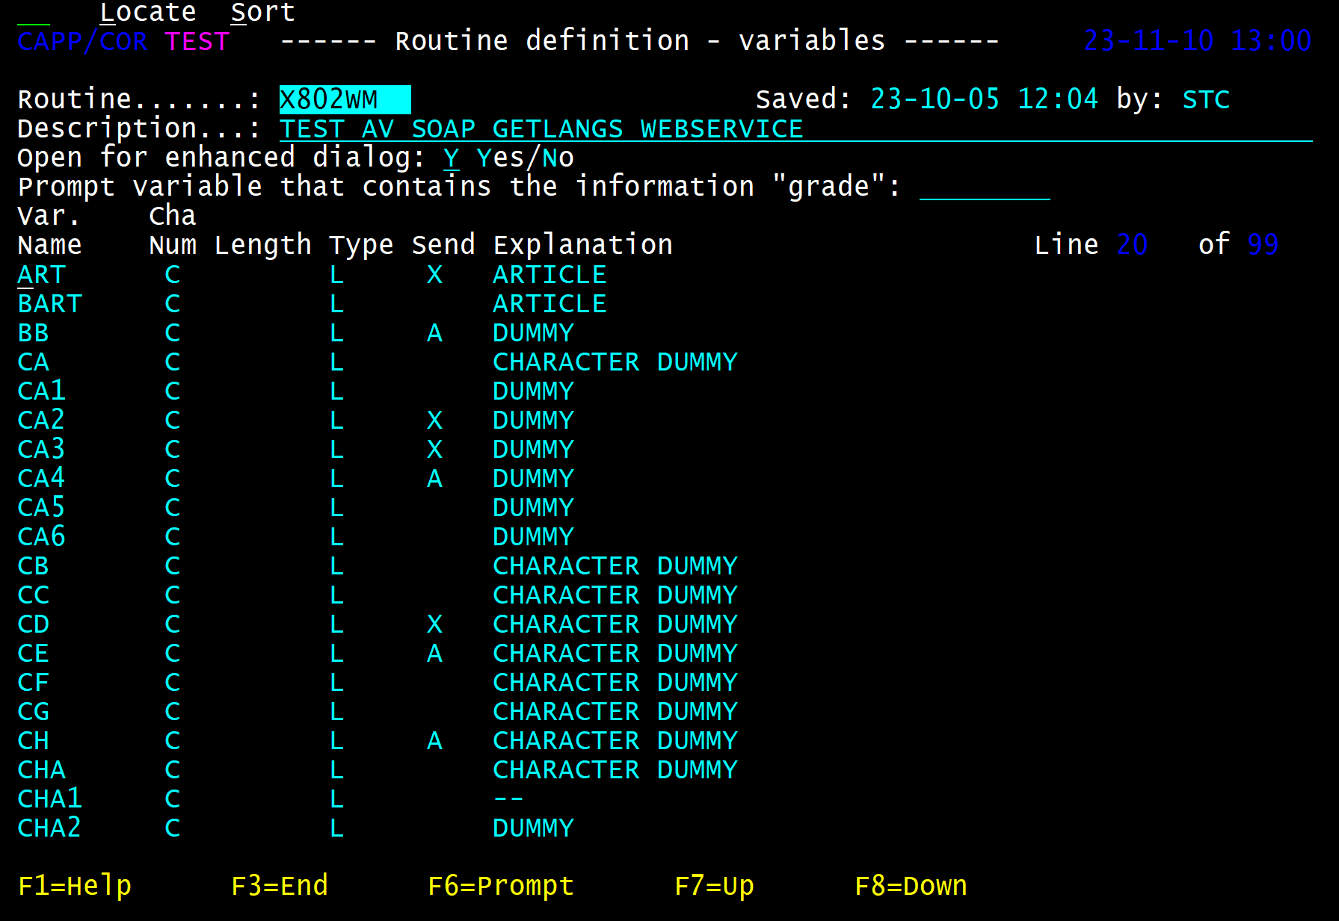
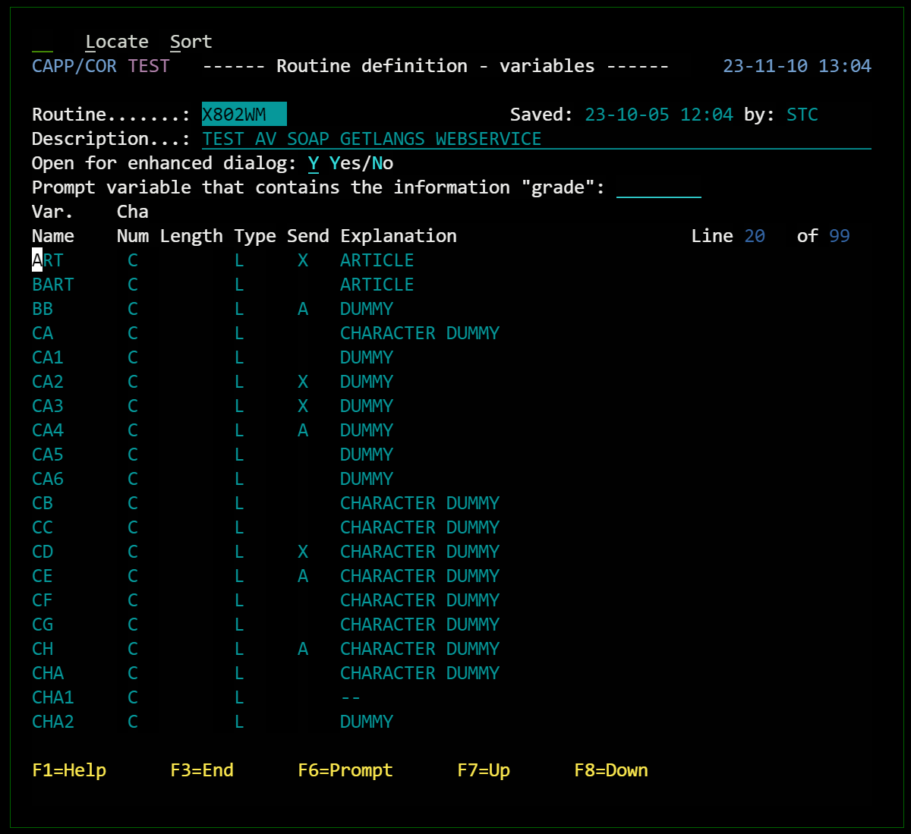
Migrated APL2 Mainframe UI

Slide 18
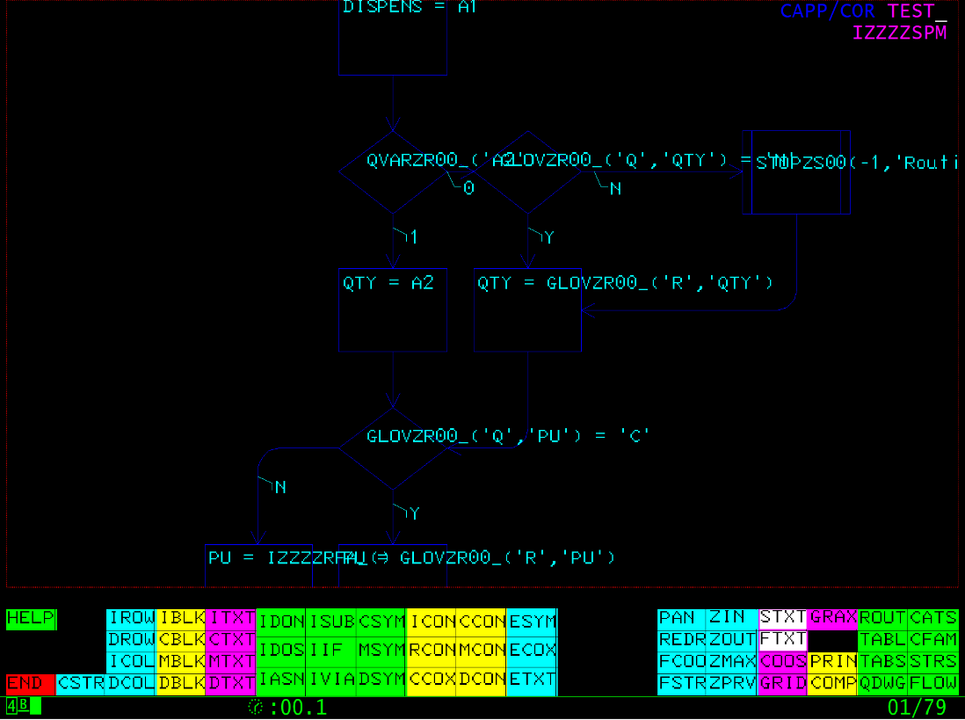
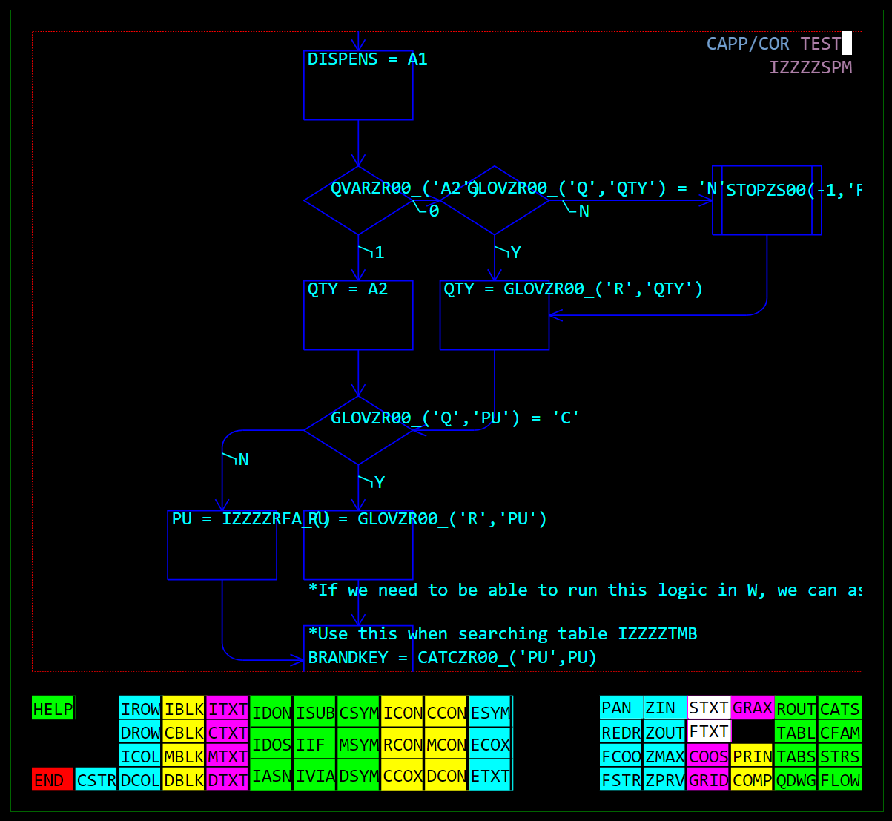
Migrated APL2 Mainframe UI

Slide 19

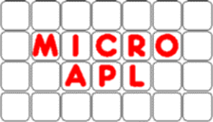
From APL+Win or MicroAPL APLX
Same language differences as APL2, plus:
Many system functions & control structures not found in Dyalog APL
Double quotes ("Don't do this!")
Advanced Graphical User Interfaces
Calls to external libraries

Slide 20
APLX Migrations
MicroAPL stopped developing APLX in 2016
Dyalog hosts a download of the last free version
Dyalog developed migration tools in 2016

Slide 21
Recent / Active APL+Win Migrations
Two European Insurance companies
One with GUI, completely rewritten in Dyalog APL, the other a pure service converted to Jarvis in Linux containers
Handled by a European consulting partner
METSIM® - in progress
Dyalog engaged to perform this migration
Will be used to develop tools to automate migration, including the Graphical User Interface
Met one more potential migrant last week

Slide 22
Differences which are "easy"
/ is sometimes a function in Dyalog APL 1 0 1/¨'ABC' 'DEF' 'GHI'
←Y
'AC' 'DF' 'GI' vs 'ABC' 'GHI'
Translate /¨ to ∘/¨
Not supported in Dyalog
Translate ← to {}

Slide 23
Other "Easy" Differences
⎕XLIB
System function not in Dyalog
R←∆XLIB X
X,←'*'↓⍨≢X
:If 0∊⍴R←↑⊃⎕NINFO⍠1⊢X
:If ∨/'?*'∊X
R←0 0⍴' '
:Else
'XFHOST ERROR FindFirstFile 1 0 3 The system cannot find the path specified.' ⎕SIGNAL 22
:EndIf
:Else
R←R[⍋R;]
:EndIf

Slide 24
Tricky Differences
A B[I]
f.g when f or g are not scalar functions Fortunately, these are very rare in practice :LeaveIf
A (B[I]) or (A B)[I] ?
Detect and rewrite
Enhance Interpreter

Slide 25
The Hard Parts
Component Files
User Interfaces (especially Graphical)
Other I/O (e.g. SQL Databases)
External Library Calls

Slide 26
Component Files
We will develop an APL+Win COM server to read/write APL+Win component files directly from Dyalog APL
Avoid the need for "big bang" data migrations
Component files can be migrated over time

Slide 27
The Elephant in the Room: ⎕WI ?
Dyalog is building an emulator to support the METSIM® migration
Our goal is that no significant changes to application code will be required
METSIM® screen shots follow
Many thanks to Alex Holtzapple, CEO of MSI

Slide 28
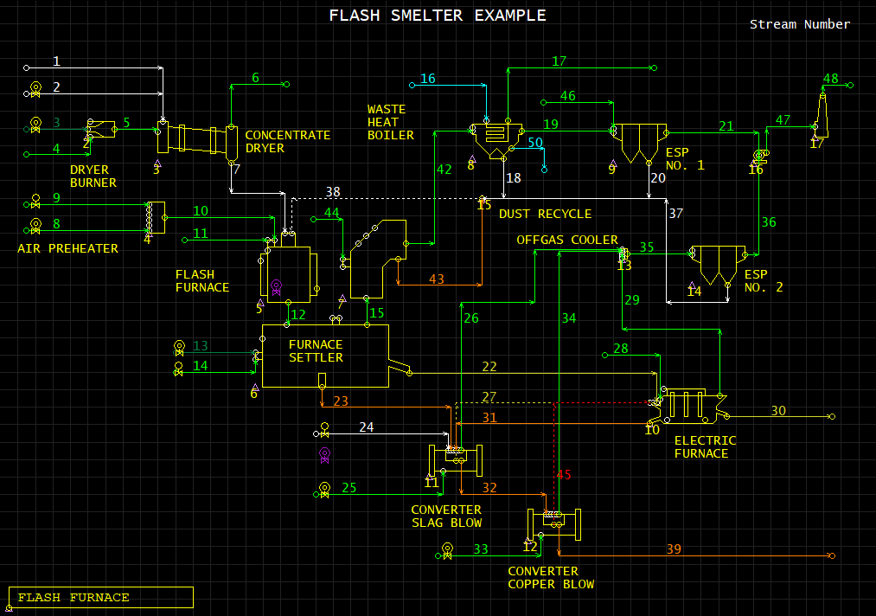

Slide 29
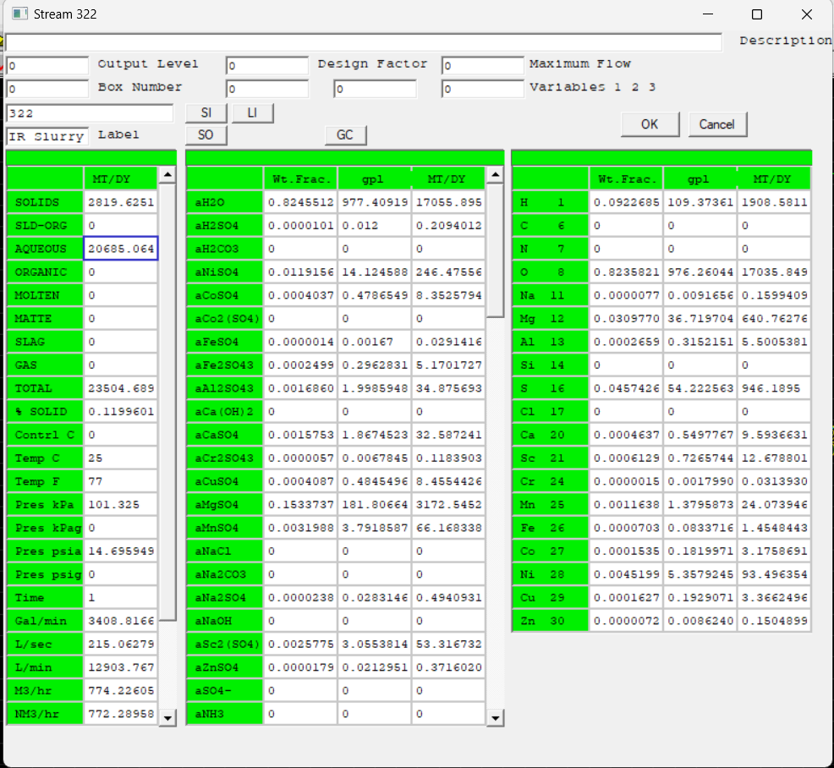

Slide 30
Practicing
APL+WIN comes with a handful of GUI demonstration applications

Slide 31
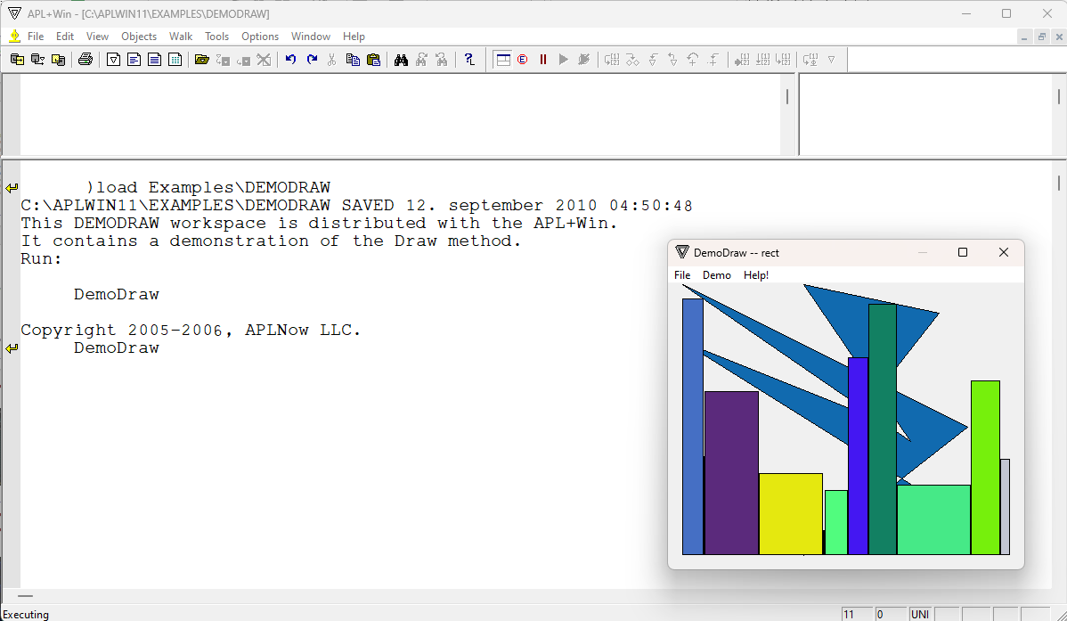
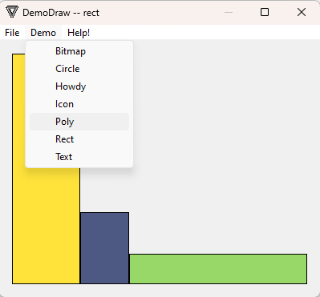
My copy of APL+Win is a little dated…

Slide 32

Now export the APL+Win code to APL Transfer Format

Slide 33
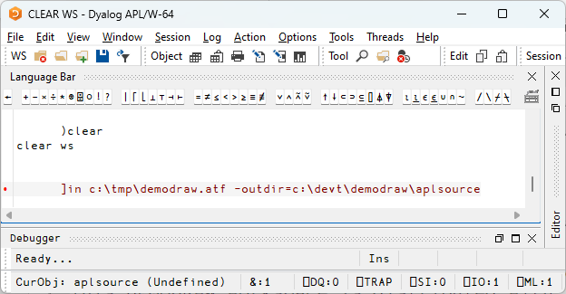
Convert the ATF file to Dyalog Source files

Slide 34
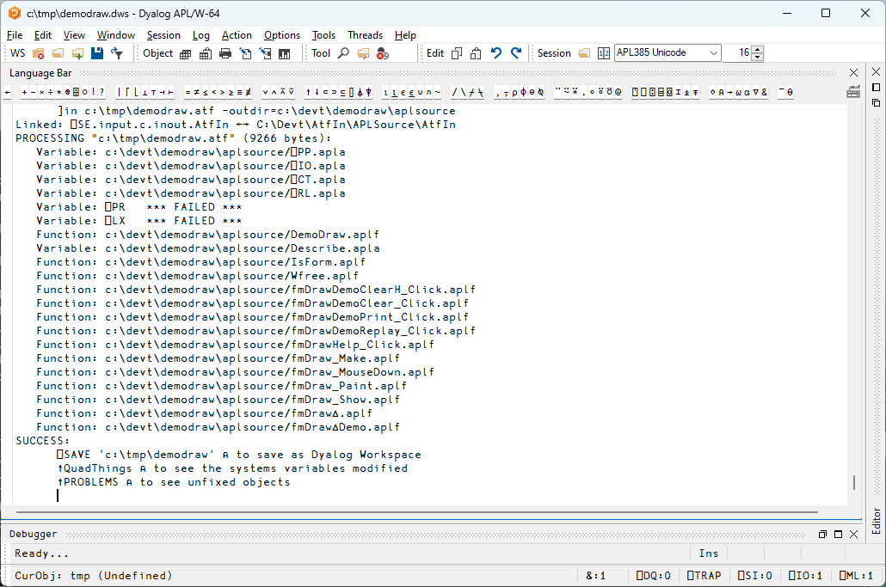

Slide 35
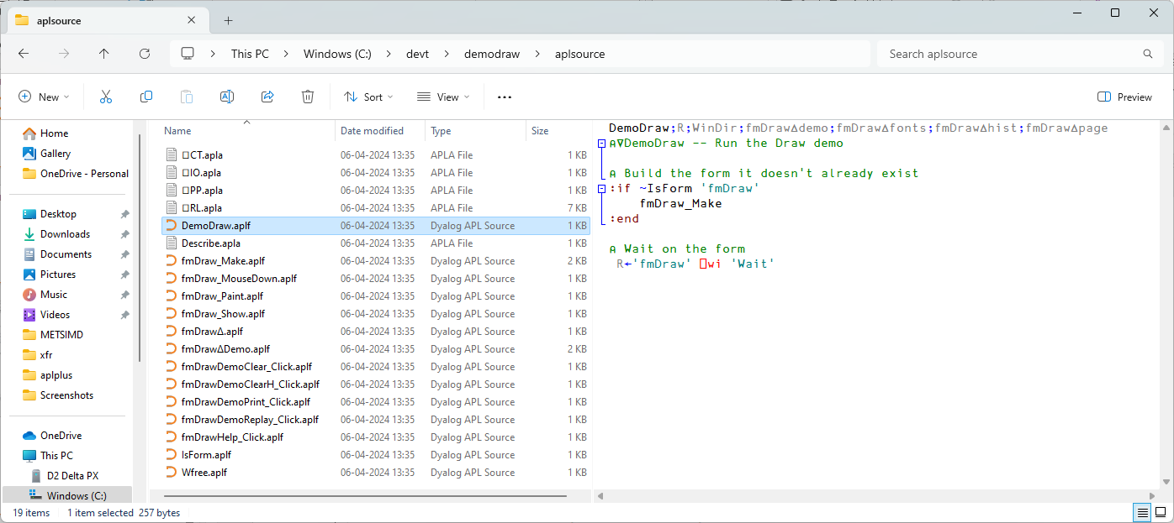
NB this is original APL+Win Source For METSIM®, we plan to update the APL+Win environment to run off text files too.

Slide 36
Next, map code from APL+Win to Dyalog
]todyalog aplsource c:\devt\demodraw\dyalog a2k Using c:\devt\demodraw\aplsource\atfmap.txt 20 files processed

Slide 37
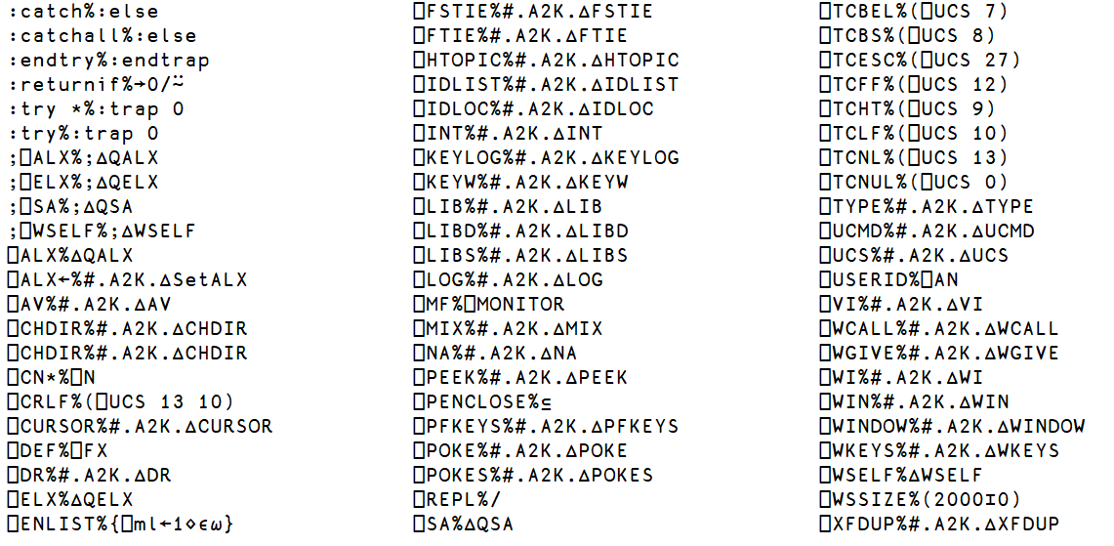
atfmap.txt

Slide 38
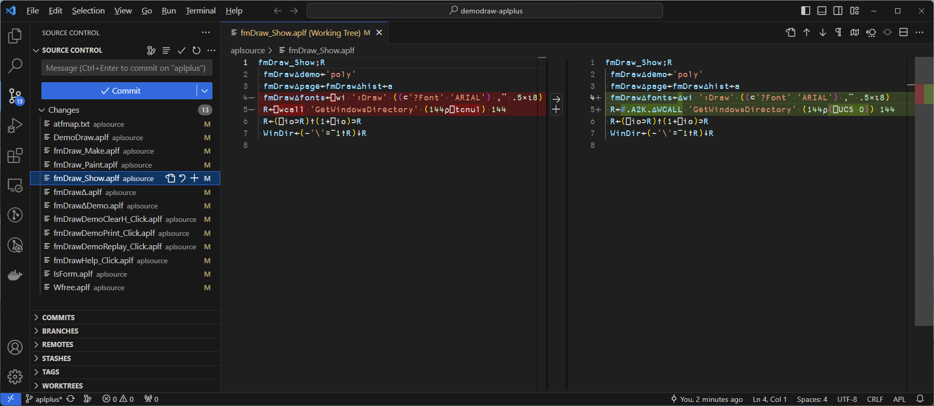
Take advantage of Git and VS Code

Slide 39
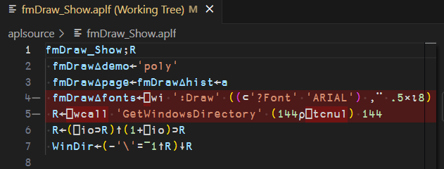
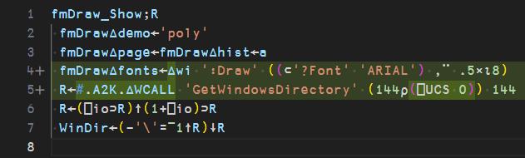
Original APL+Win code
Converted to Dyalog
So what is #.A2K.∆WCALL ?

Slide 40
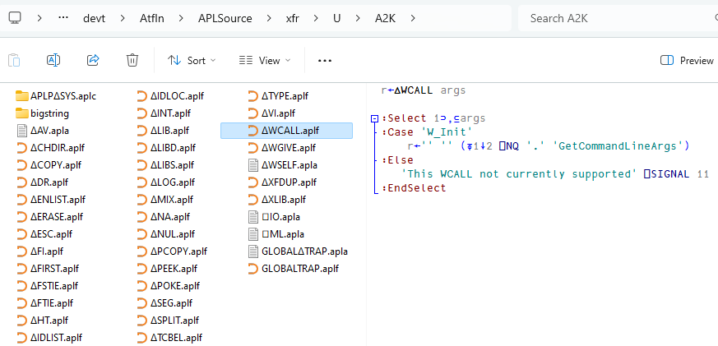
∆
So what is #.A2K.∆WCALL ?

Slide 41
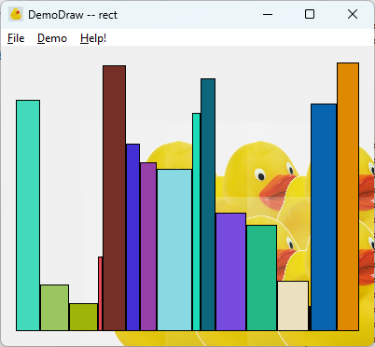

Slide 42
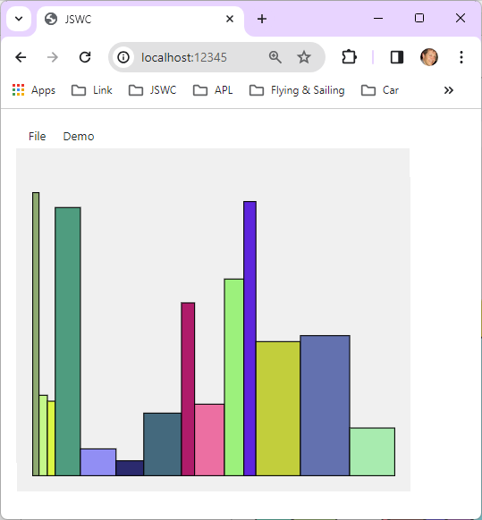

Slide 43
Status
We are reworking and enhancing the tools developed for APLX migrations
Will enumerate differences between APL+Win and Dyalog
Will create emulation functions as required
We *may* also decide to add new features to Dyalog v20 (which should start user testing in late 2024)
For example :LeaveIf

Slide 44
Status
Dyalog has been contracted to port the METSIM® application
Hired one new APL developer in January, aiming for 1 more
We will have ~1.5-2 full time equivalent resources working on migration tools until further notice
All the resulting tools and documentation will be free and open source

